Slide 1
Exemplary Arts Schools Awards
Data from 2019-2020 school year

Slide 2
PHASE 1 Results!
Arizona Score Breakdown: Gold Schools – 28 Silver Schools – 423 Bronze Schools – 535 Developing Schools - 556 Total Schools Rated: 1,542 https://azarts.gov/azartsed-explorer/

Slide 3
Rating Criteria – K-8 Schools
 | Access | Participation | Growth
Gold | 3 or 4 Artistic Disciplines | 100% Enrollment in 2 Artistic Disciplines | Grew or maintained 100% Enrollment
Silver | 2 Artistic Disciplines | All students enrolled in at least 1 Artistic Discipline | Grew or maintained less than 100% enrollment
Bronze | 1 Artistic Discipline | 70-99% Arts Enrollment | Enrollment declined in some but not all
Developing | No arts | Less than 70% Arts Enrollment | Enrollment declined in all
Overall Rating = Lowest Score

Slide 4
Gold Schools!! – Elementary, Middle, K-8
BASIS Chandler Primary - North Campus | BASIS Charter Schools, Inc. | Maricopa
BASIS Peoria Primary | BASIS Charter Schools, Inc. | Maricopa
Learning Foundation and Performing Arts Warner | CAFA, Inc. dba | Maricopa
Madison Rose Lane School | Madison Elementary District | Maricopa
Phoenix Modern | New Learning Ventures, Inc. | Maricopa
Arts Academy at Estrella Mountain | P.L.C. Charter Schools | Maricopa
Amberlea Elementary School | Pendergast Elementary District | Maricopa
Copper King Elementary | Pendergast Elementary District | Maricopa
Desert Mirage Elementary School | Pendergast Elementary District | Maricopa
Garden Lakes Elementary School | Pendergast Elementary District | Maricopa
Sonoran Sky Elementary School | Pendergast Elementary District | Maricopa
Sunset Ridge Elementary School | Pendergast Elementary District | Maricopa
Villa De Paz Elementary School | Pendergast Elementary District | Maricopa
Westwind Elementary School | Pendergast Elementary District | Maricopa
South Phoenix Prep and Arts Academy | South Phoenix Academy Inc. | Maricopa
Florence K-8 | Florence Unified School District | Pinal
Maricopa Elementary School | Maricopa Unified School District | Pinal
Desert Star Community School | Desert Star Community School, Inc. | Yavapai

Slide 5
Rating Criteria – High Schools
 | Access | Participation | Growth
Gold | 4 Artistic Disciplines | 60% + Arts Enrollment | Grew or maintained 100% Enrollment
Silver | 3 Artistic Disciplines | 50 – 59% Arts Enrollment | Grew or maintained less than 100% enrollment
Bronze | 2 Artistic Discipline | 40 – 49% Arts Enrollment | Enrollment declined in some but not all
Developing | 1 or 0 Artistic Disciplines | Less than 40% Arts Enrollment | Enrollment declined in all
Overall Rating = Lowest Score

Slide 6
Gold Schools!! – High Schools
School | LEA | County
Independence High School | Glendale Union High School District | Maricopa
Moon Valley High School | Glendale Union High School District | Maricopa
Washington High School | Glendale Union High School District | Maricopa
Heritage Academy Maricopa | Heritage Academy, Inc. | Maricopa
Alhambra High School | Phoenix Union High School District | Maricopa
Maryvale High School | Phoenix Union High School District | Maricopa
West Point High School | Tolleson Union High School District | Maricopa
Catalina High School | Tucson Unified District | Pima
Cholla High School | Tucson Unified District | Pima
Maricopa High School | Maricopa Unified School District | Pinal

Slide 7
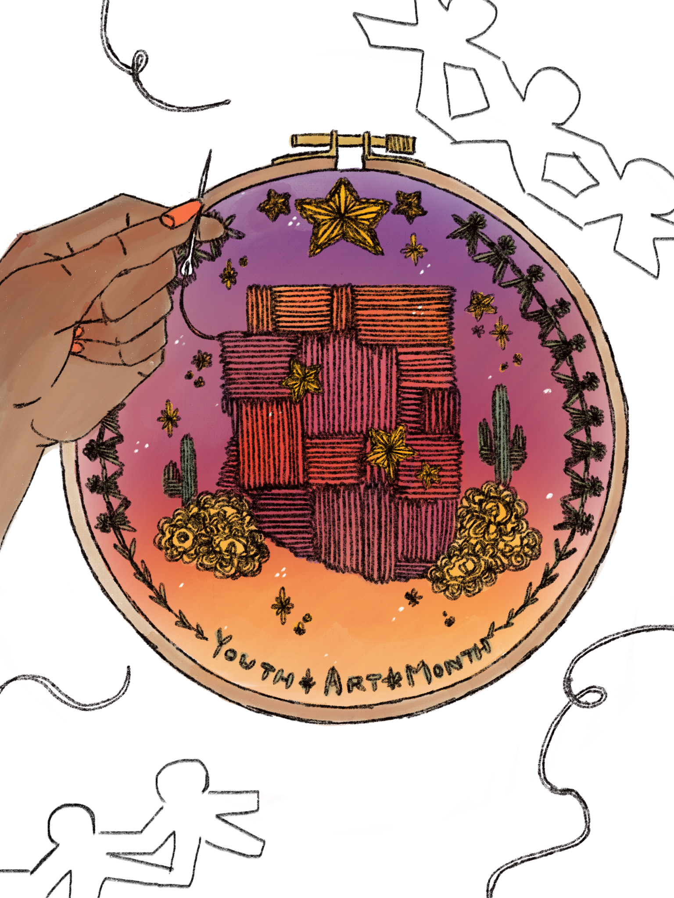
Framed Award sent to Gold Schools
2021 Arizona Youth Arts Month Flag Winner
Lexa White - Bradshaw Mountain High School Humboldt Unified School District

