Slide 1
Friday Focus: HS Math Test 01/29/2021

Slide 2
Welcome to Webinar – HS Math Reporting HS Math Reporting – Changes and Updates
Please enter your First and Last Name in the Chat for tracking purposes for the live event.
This webinar will be recorded and posted on the ADE Assessments webpage.
We will also be capturing the chat questions. If there are questions that were frequently asked or need further clarification, ADE will compile and create an FAQ which will be posted on the ADE Assessment Main webpage and emailed to the primary registered participant.

Slide 3
Context
One test in HS starting 2019-2020
Moving away from EOC to grade level
ELA in grade 10
Math in grade 10 – a combination of Algebra and Geometry

Slide 4
Timeline
New HS Math test designed for April 2020
60% Algebra and 40% Geometry
Plan was to do standard setting and psychometric analysis in summer 2020
Test to be used for two years (2020 and 2021) and transition to ACT in 2022

Slide 5
Timeline changes- COVID 19
Testing cancelled due to COVID in 2020
Using 2019 forms for all tests except HS Math
HS Math –new form was developed for 2020 for the new test.
State board decision to use the new test because schools were informed of the change in 2019 - 2020
Schools may have changed program placement decisions in HS due to this.
Schools may have combined Algebra and Geometry classes due to this change.

Slide 6
HS Math Test
60% Algebra and 40% Geometry
Psychometric analysis in summer 2021
Test to be used for one year (2021) and transition to ACT in 2022
Difficult decision
Testing mandated for federal compliance.
Explored the option not to test.

Slide 7
HS Math Test
HS Math is a new test
60% Algebra and 40% Geometry – new blueprint
AZ educators were brought together to work on the blueprint in summer 2019.
Scaling will be done using the established scale from AzMERIT
Worked with the TAC

Slide 8
HS Math Test- Reporting
Only performance levels will be reported.
A challenge due to the one-year administration but this was the best possible solution.
Standard setting is an expensive process and time consuming.
Traditional standard setting is done with multiple meetings the educators over multiple days.
This will delay the score reports by months.
Best possible solution was to report performance levels on the already established scale given the unique circumstances.

Slide 9
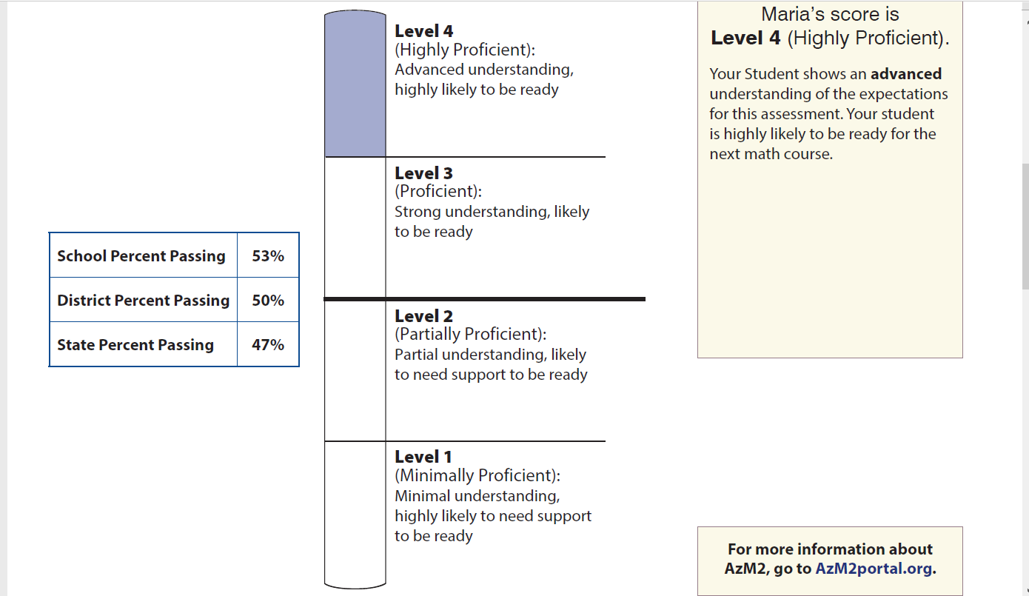
Paper Score Report
Add picture of a mock up score report if available

Slide 10
Questions

