Slide 1
Education Leaders Call
January 20, 2021
Notes:
L

Slide 2
Welcome

Slide 3
Purpose for Weekly Calls
Share regular and critical updates with our Education Leaders
Provide answers to shared questions

Slide 4
House Keeping
Please remain muted throughout the call
Turn cameras off unless presenting
Place all questions in the chat
We will respond to questions within 48 hours
Each call will be recorded for the benefit of leaders unable to participate in person * For future calls, we will work to share an agenda in advance so that the most appropriate leader can attend from each LEA.

Slide 5
Agenda for Today
Assessments/Accountability:
Kelly Koenig, Associate Superintendent
Public Health:
Stephanie Martinez, Arizona Department of Health Services
Funding:
Callie Kozlak, Associate Superintendent
Ross Begnoche, Chief Financial Officer
Survey of Additional Topics from the Field

Slide 6
Accountability Updates
Accountability
Federal Accountability -School Improvement labels
ADE will be submitting a waiver request
State Accountability – requires legislative action

Slide 7
Accountability Contacts
Contact
(602) 542-5151
Achieve@azed.gov

Slide 8
Assessment Updates
Assessments - No waivers for Assessments
AZELLA – USED guidance emphasizes importance of Spring administration
Test window extended (February 1 – May 21)
Stand alone field test POSTPONED
AZM2 – Last year of administration
Test window has been extended for grades 4-8 and 10
Test window for grade 3 remains unchanged to ensure reporting requirements for Move on When Reading will be met.
AzSCI and MSAA Science field test- Grades 5, 8, and 11
MSAA – Test window March 15 - April 30
All assessments must be in person

Slide 9
Assessment Contacts
Testing Inbox
(602) 542-5031
testing@azed.gov
AzM2 Inbox
AzM2@azed.gov
AZELLA Inbox
azella@azed.gov
AzSCI Inbox
AzSCI@azed.gov
Alternate Assessment Inbox
AssessingSWDs@azed.gov

Slide 10
Public Health

Slide 11
ESSER 2

Slide 12
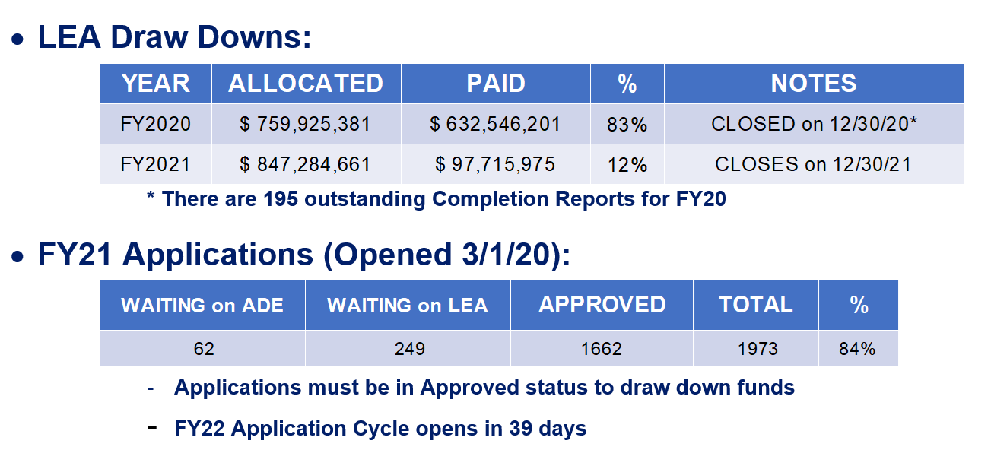
WEEKLY GRANTS STATUS

Slide 13
Grants Management Contacts

Slide 14
Future Call Topics
Please complete the following survey to tell us what information you would like to learn about on future calls.

