Slide 1


Director of Youth Programs: Kenneth McKinley
Safe Place Coordinator: Lisa Scarber

Slide 2
To prevent and end homelessness with innovative strategies and housing solutions that meet the unique needs of each family and individual.
Family Housing Hub:
  Emergency housing
  Extended housing
  Halle Women’s Center
Youth Resource Center
Independent Living Programs
  Hazelwood
  Earll
  Open Hands
  Safe Place & Street Outreach

Slide 3
Youth Homelessness in Arizona 2019
2019 Point in Time Count
YOUTH <18
YOUTH 18-24
Total
1,602
708
Sheltered
877
215
Unsheltered
47
318
Transitional Housing
678
174

Slide 4
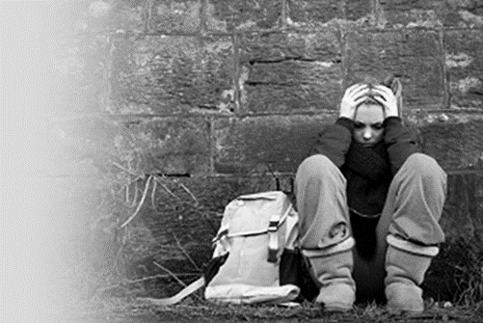

AZ YOUTH EXPERIENCES SURVEY (YES)
Youth AZ homelessness cont…
179 Participants (Maricopa and Pima County)
45.8% identify as Heterosexual & 39.7% LGBTQ
Average Age of first homelessness was 16.3 years-old
On average, youth experienced 4 periods of homelessness
34% had sexual trafficking exploitation experiences
30.7 % experienced labor trafficking
44.7% experienced at least one and 20.7% experienced both

Slide 5
Challenges & Risk Factors
YES cont…
DRUG USE | 57%
ENGAGING IN SELF-HARMING BEHAVIORS | 54%
SUICIDE ATTEMPTS | 36%
CURRENT MENTAL HEALTH DIAGNOSIS | 69%
REPORTING MORE THAN 1 MENTAL HEALTH DX | 54%
CURRENT MEDICAL ISSUES | 54%
KICKED OUT OF HOME BY FAMILY | 38%
HISTORY OF RHY | 48%
CHILDHOOD EMOTIONAL ABUSE | 45%
CHILDHOOD SEXUAL ABUSE | 30%

Slide 7
Positive Life Experiences Reported…
YES cont…

Slide 8

Reporting a runaway…
Runaway vs Missing Persons
Status Offense: Running away is not a crime
    Call your local non-emergency police line
Family issues account for approximately 28% of crisis calls
More than two thirds of sex trafficking cases of minors are runaway youth
Research shows that after two weeks living on the streets a youth has an 80% greater chance of becoming chronically homeless as an adult
Tips for supporting a family with a runaway child
1800runaway.org

Slide 9

National Safe Place Program
Outreach and prevention program
Founded by YMCA of Greater Louisville, KY in 1983
UMOM as a lead agency (est. in Maricopa County since 2005)
Open Hands as the 24/7 crisis shelter
Safe Place (30sec)
Notes:
How presentation will benefit audience: Adult learners are more interested in a subject if they know how or why it is important to them.
Presenter’s level of expertise in the subject: Briefly state your credentials in this area, or explain why participants should listen to you.

Slide 10
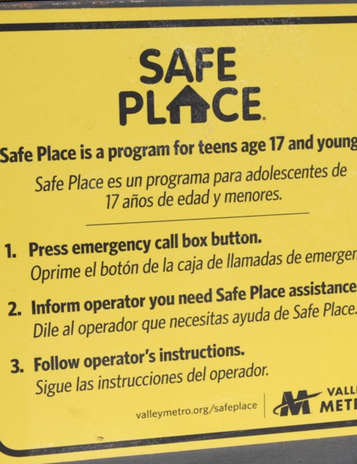
Partnerships: Valley Metro
174 stationary sites; 900 mobile sites
National Safe Place Network emergency call boxes
Notes:
Example objectives
At the end of this lesson, you will be able to:
Save files to the team Web server.
Move files to different locations on the team Web server.
Share files on the team Web server.

Slide 11
Community Partners
Quick Trip
Valley Metro
Avondale Public Library
Chandler Fire Stations
Civic Center Avondale Library
Family Advocacy Center
MIKID
Mesa Family Advocacy Center
Open Door Fellowship Church
Phoenix Dream Center
Phoenix Youth Resource Center
Sunnyslope Family Services Center
Travis L. Williams Family Service Center
Young Adult Program Earll
Young Adult Program Hazelwood
Maricopa County Community Colleges
John F. Long Family Community Center
Queen Creek Fire Stations

Slide 12


For Youth…
Someplace to Go.
Someone to help.
Resources:
  24/7 hotline: 602.841.5799
  24/7 text line: 69866 or HELP (44357)
  Safe Place sites
Why youth need Safe Place:
Notes:
Lesson descriptions should be brief.

Slide 13
Community Support and Engagement
602-841-5799 – 24/7 crisis line
In 2019 the crisis line received nearly 300 calls from adults seeking shelter and over 200 calls from adults looking for community information, support and resources for themselves or other individuals.
Through community events 3,534 youth were reached and provided info on SP.
5,636 SP info cards were distributed to the youth.
32 youth were counseled via telephone.
1,092 adults were provided information about SP at school and community events.
74 youth were helped at a SP site or other location
2,446 youth received outreach cards.

Slide 14

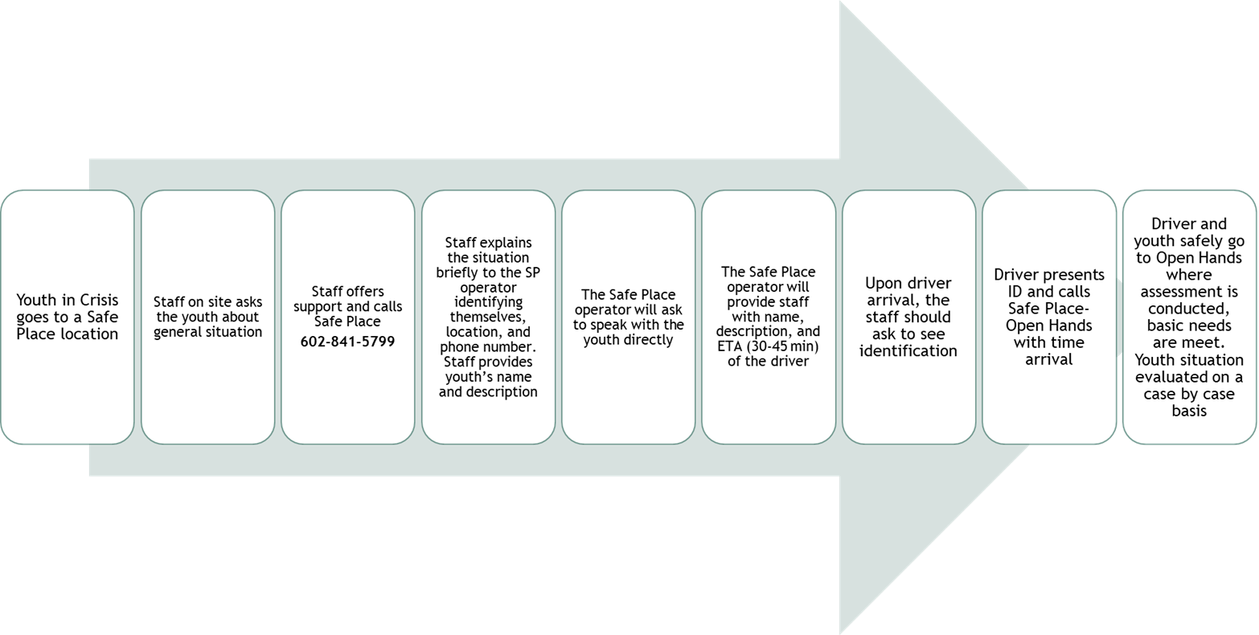

WORKFLOW

Slide 15
Open Hands (OH)
Is a six-bed residential emergency shelter in Phoenix.
OH provides a safe, home-like setting for youth experiencing crisis, including homelessness, family conflict or abuse.
Open Hands offers individual and family counseling with the goal of family reunification. Youth who aren’t able to safely return home may stay for a longer term; learning life skills and receiving workforce and job readiness training.
Additional care provided: case management, recreation/outings, education support, food, clothing, transportation assistance.
Approximately 200 youth are served each year and nearly all youth are exited to safe and permanent housing.

Slide 16
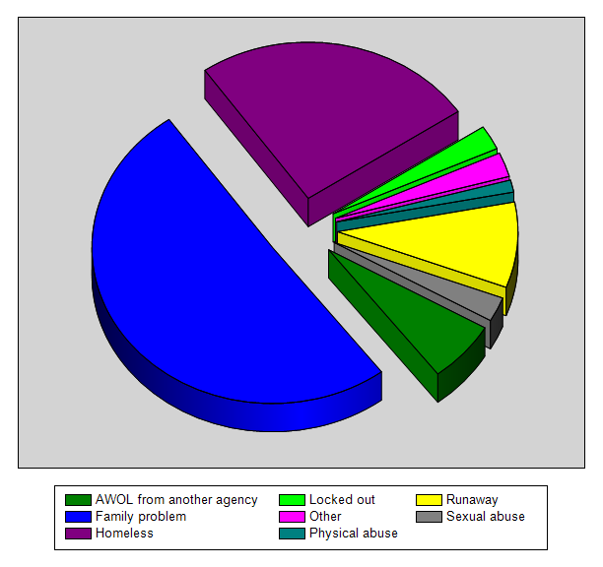
Total Number of Youth Helped by Safe Place in 2019
79
Presenting Problem | Count | Percentage
AWOL from another agency | 5 | 6.33 %
Family problem | 40 | 50.63 %
Homeless | 20 | 25.32 %
Locked out | 2 | 2.53 %
Other | 2 | 2.53 %
Physical abuse | 1 | 1.27 %
Runaway | 7 | 8.86 %
Sexual abuse | 2 | 2.53 %
20
7
40
5

Slide 17
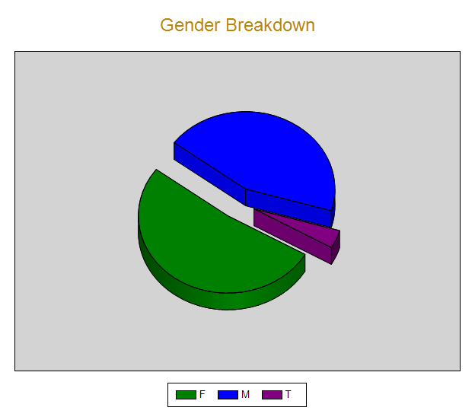
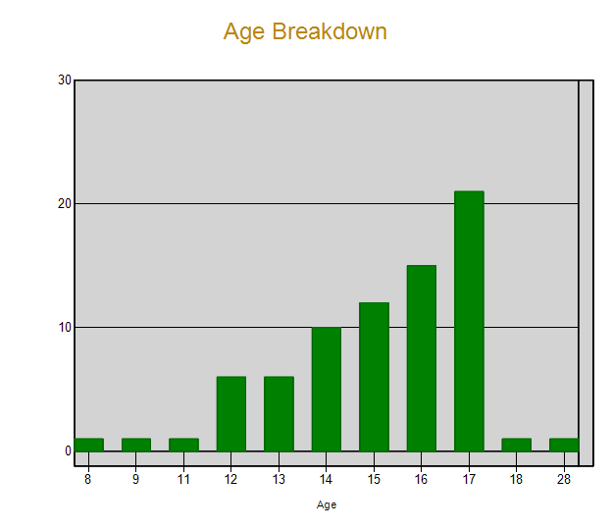
Total Number of Youth Helped by Safe Place in 2019
79
35
3
41

Slide 18
Tucson Youth Statistics
More than 1,500 youth are reported as run-aways each year
OFS served more than 1,100 youth (12-17) last year
  Outreach
  Phone
  Counseling
  Reunion House (RH) Shelter
About half of homeless youth served at RH arrive through Safe Place
Most youth reunify with family

Slide 19
Our Family Services
Safe Place Lead Agency in Tucson
35 Stationary Sites 240+ Mobile Sites
Emergency Shelter & Basic Needs
Assessment & Counseling
Education & Employment Support
Transportation
Linkage to Community Supports & TLP

Slide 20
Tucson Metro Community Partners
American Legion
Aviva Children’s Services
COPE Community Services
Our Family Services
Pima Prevention Partnership
QuikTrip
Southern Arizona AIDS Foundation
Sullivan Jackson Employment Center
SunTran
Tucson Preparatory School
Tucson Youth Development
City of Tucson Ward 3
City of Tucson Ward 6

Slide 21
Tucson Contact Info
24/7 Shelter Line
520.320.5122
Cindy McClain, Safe Place Coordinator
520.323.1708, 113

Slide 22
Safe Place Story
One of our clients was just 14-years-old and struggled with behavioral issues due to family’s use of drugs that lead to emotional distance between mother and daughter and unsafe situations. During youth’s stay at the emergency shelter, she received safety planning, individual counseling, group counseling with our on-site counselor and family preservation services through DCS. Family reunification was achieved and the family continues to strengthen through safety planning and resources provided in after care services.

Slide 23
How YOU can help
Educate: Providing information to youth is critical to their safety and the success of the Safe Place program. They need to know that there is a “safe place” to go when they need help. When adults share information about Safe Place, it lets youth know that “it’s ok” to use the program when they need help.
Get involved! Consider donating- your time and items.
Connect us with your establishments:
* Virtual Fairs
* PSA’s (videos, announcements)
* Trainings
Become a Safe Place Site.
- Complete “Safe Place Site Agreement”
- $200 fee
- Complete trainings.
- To become a Safe Place site in Maricopa County, e-mail LSCARBER@UMOM.ORG for more information or to begin the process of becoming a Safe Place Site.

Slide 24

FAQ’s
What if youth is over 17 or under 12?
What if youth is accompanied by a parent?
What if youth decides they no longer wish to receive services?
Will the parent or guardian be contacted?
What if youth is under the influence of substances?

