Slide 1
McKinney –Vento Homeless Education
Homeless Education Program:
Data Collection Requirements under the McKinney-Vento Act
September 17, 2020

Slide 2
Agenda
What is the McKinney-Vento Act?
Responsible Parties
What data to collect
How to submit data
Data quality Checklist
Once data are submitted
New Changes
Resources

Slide 3
What is the mckinney-vento act?
McKinney-Vento Act

Slide 4
Homeless Education Program McKinney-Vento Act
Our mission is to ensure that homeless children and youth have equal access to the same free, appropriate public education, including a public preschool education, as provided to other Arizona children and youth.

Slide 5
Arizona Data
2
Notes:
Arizona McKinney Vento Student Data
*SY 18-19: 21,062 students identified
*SY 17-18: 24,393 students identified
*SY 16-17: 25,448 students identified

Slide 6
Responsible parties
McKinney-Vento Act

Slide 7
Federal Requirement
Data collection begins at the school and LEA level. Each LEA has a local liaison for homeless education who is responsible for ensuring the identification of homeless students through coordinated activities with other school personnel and community agencies
[42 U.S.C. [42 U.S.C. § 11432(g)(6)(A)(i)].
LEA Liaison
LEA’s Data staff
State Coordinator

Slide 8
Federal Requirements
Data collection and analyzing data is importation for the education of homeless children and youth.
MV Subgrant Application Requirement
Federal Reporting Requirement
SEA Approval of Student Need per Program Description
Compliance with Title 1, Part A
Calculation for the Set-Aside of Title 1, Part A
2
Notes:
SEA may consert the number of homeless student enrolled in the LEA prior to making subgrant awards [42 U.S.C. § 11433(c)(2)]. SEAs must consider the quality of a subgrant application, the appropriateness of proposed activities based on identified student needs, and past success in meeting student needs before making awards [42 U.S.C. § 11433(c)(3), 2 C.F.R. Section 200.205].

Slide 9
Why is Data Collected?
Data required at the state, LEA and school/site level
Determines the effectiveness of the program
Identifies trends
Identifies technical assistance
Helps determine areas of opportunity
.
2
Notes:
Click on picture for link to the the NCHE national over
There are several pieces of data considered important to the evaluation of outcomes for homeless students. Schools are required to collect and provide the identified data to the SEA on an annual basis. The SEA then submits the information collected to ED and use the data for required elements of public reports such as state report cards. ED also keeps record of data as part of the EDFacts Initiative and stores all the data submitted by the SEAs regarding the education of homeless students and other federal programs. This data is used by ED to create reports for Congress, the general public and state coordinators.
view facts page.

Slide 10
What data Is collected
McKinney-Vento Act

Slide 11
What Data Is Collected?
The data below must be submitted to ED for each education unit.
*The racial/ethnic background of homeless enrolled students (FS C118)

Slide 12
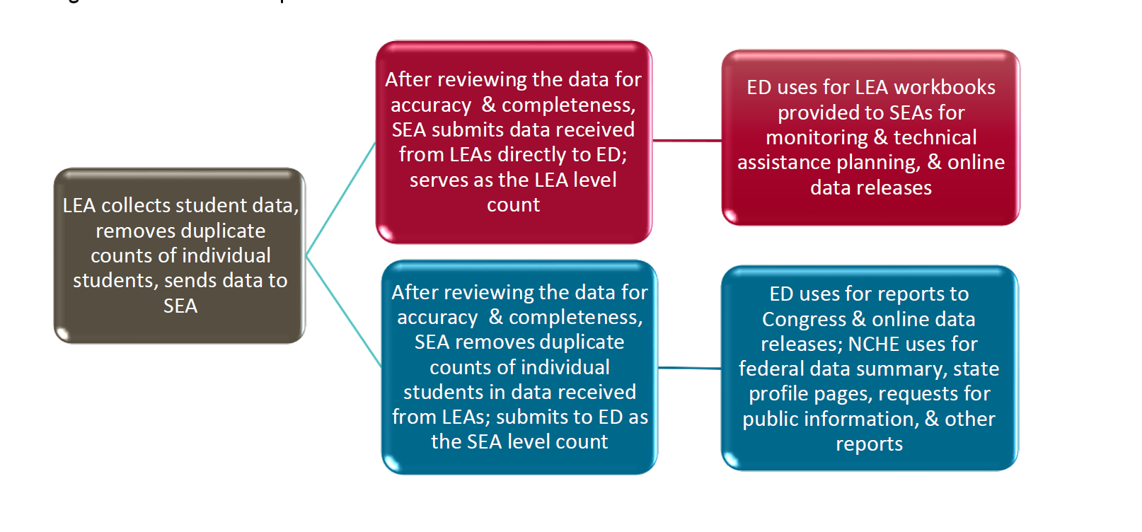
Data Collection Process

Slide 13
Data Quality Notes
The number of students experiencing homelessness who were served by McKinney-Vento subgrants, must be reported, regardless of their status as enrolled in school. This count only includes students who are birth to 2 or age 3 to 5, NOT Kindergarten. SERVED is different from enrolled. The definitions of data collection can be found on the ADE-Homeless website.
2
Notes:
Taken from Chapter 13 of the Homeless Liaison Toolkit. The exception is due to COVID-19: testing will not be required for SY 19-20. No word of exceptions for SY20-21.
Preschool is ages 3-5 yrs old, not in kindergarten.
Send the link to the chatbox, ask attendees to follow the link and open the Glossary: link: https://www.azed.gov/homeless/professional-development-ehcy
Definition of served from this glossary: The definition of served includes homeless children who have been served in any way through McKinney-Vento funds regardless of their enrollment in school or preschool. Services would include both direct services, as outlined in the McKinney-Vento Act [42 U.S.C. § 11433], and indirect services, such as those provided by a staff member whose position is supported through McKinney-Vento funds and who is involved in the administration of the McKinney-Vento program but does not necessarily provide direct services. An example of an indirect service includes outreach activities for which a staff member’s time is paid and results in an increase in the identification of homeless students. This definition includes children aged Birth through 5 years old who are served by the subgrant program. While students may be served by multiple funding sources, only those homeless students who were served by McKinney-Vento subgrant funds specifically may be included in the federal data collection for data group 655.
Primary nighttime residence of homeless student categories are: Doubled up; Motel/Hotel; Shelter/Transitional Housing; Unsheltered
4 subgroups are: English Learners, unaccompanied youth, students with disabilities and Migrant/migratory students.
Is it drop out OR graduate or dropout AND graduate??????

Slide 14
Data Quality Notes
Subgroups of students are not exclusive, that is, a homeless student could be part of some, all or none of the subgroup categories.
Families or Unaccompanied youth sometime will decline educational services available based on their homeless status. This student should still be included as part of the homeless counts and receipt of educational services is not required and does not impact the student’s status as homeless.
2
Notes:
Taken from Chapter 13 of the Homeless Liaison Toolkit. The exception is due to COVID-19: testing will not be required for SY 19-20. No word of exceptions for SY20-21.
Preschool is ages 3-5 yrs old, not in kindergarten.
Primary nighttime residence of homeless student categories are: Doubled up; Motel/Hotel; Shelter/Transitional Housing; Unsheltered
4 subgroups are: English Learners, unaccompanied youth, students with disabilities and Migrant/migratory students.
Is it drop out OR graduate or dropout AND graduate??????

Slide 15
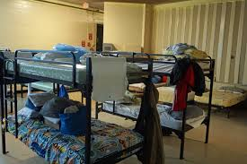
Data Quality Notes
Primary Nighttime Residence:
Nighttime residence data should reflect the type of residence the student was using at the time the student was identified as meeting the homeless definition.
Only submit the type of housing when the student was first identified as homeless.
Same goes for Unaccompanied youth.
Students living in substandard housing should be included in “Unsheltered” category.
All students living in a shelter must be coded as “STH”.
2
Notes:
Taken from Chapter 13 of the Homeless Liaison Toolkit. The exception is due to COVID-19: testing will not be required for SY 19-20. No word of exceptions for SY20-21.
Preschool is ages 3-5 yrs old, not in kindergarten.
Primary nighttime residence of homeless student categories are: Doubled up; Motel/Hotel; Shelter/Transitional Housing; Unsheltered
4 subgroups are: English Learners, unaccompanied youth, students with disabilities and Migrant/migratory students.
Is it drop out OR graduate or dropout AND graduate??????

Slide 16
Collecting Data
Collection begins with IDENTIFICATION of students by the schools. Avenues such as office managers, registrars, teachers, cafeteria staff and homeless liaisons.
Identify the student as a “Need” in your school data system. That identification must be submitted to AzEDS as ”24-homeless” and “60-Unaccompanied” ( if the student meets that criteria) Young Homeless also has a number for need.
Data is submitted to the SEA in late spring or early summer of each year.
The greatest threat to data quality is a breakdown in the communication feedback loop between LEA data techs, liaisons, State Coordinators and SEA data staff.
2
Notes:
Taken from Chapter 13 of the Homeless Liaison Toolkit. The exception is due to COVID-19: testing will not be required for SY 19-20. No word of exceptions for SY20-21.

Slide 17
How to Collect Data
Questions to ask your local LEA/Charter:
Does the district have a data reporting technician? Who is that person or persons?
Are there additional data, which the data system is unable to collect, that the liaison is responsible for? What are those data? What is the process for submitting that data?
How does the LEA collect and store data? Does it use a web-based or other electronic student information system? Does it rely on spreadsheets?
What is the deadline for submitting data to the SEA? Is there an internal deadline for admin to review the data before submitting to SEA?
What steps does the LEA take to ensure the data is accurate?
Can the LEA correct data that has already been submitted? Are there additional deadlines for corrections?
2
Notes:
Taken from Chapter 13 of the Homeless Liaison Toolkit. The exception is due to COVID-19: testing will not be required for SY 19-20. No word of exceptions for SY20-21.

Slide 18
How to submit data
McKinney-Vento Act

Slide 19
Data Quality Notes
If your ADE school data system does not record children below preschool (any child 0-5), and you have served the child, you will have to submit the data with your numbers to Silvia.Chavez@azed.gov by OCTOBER 1st, 2020.
Example (more information to come)
2
Notes:
Taken from Chapter 13 of the Homeless Liaison Toolkit. The exception is due to COVID-19: testing will not be required for SY 19-20. No word of exceptions for SY20-21.
Preschool is ages 3-5 yrs old, not in kindergarten.
Review served vs. enrolled

Slide 20
Once data are submitted
McKinney-Vento Act

Slide 21
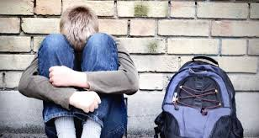
Use of Data
The use of data is to collect information on student outcomes is to help the students succeed.
Measuring program outcomes: Is your “to-do” list supporting long term program goals?

Slide 22
New implementations
McKinney-Vento Act

Slide 23
New Implementations for SY 20-21:
Check in with your data team quarterly
Verify data PRIOR to submission
Include race/ethnicity data for homeless students
Arizona Homeless Education reporting timeline is: July 1st – June 30th.
Upcoming due date for data submission
October 1, 2020
February 1. 2021
June 1. 2021

Slide 24
New Implementations for SY 20-21:
Different grade levels assigned to the same child by different LEAs the child might attend during that school year.
Category “UNKNOWN” is not valid
Category “MISSING” is not valid.
If there is no data to report in a category, then a “ZERO” must be entered. Categories should not be left blank
Year to Year comparisons are not happening. IF your LEA is submitting a large change in their reported numbers of youth, there should be an explanation of the changes (either – or +) to ADE State Coordinator.

Slide 25
Resources
McKinney-Vento Act

Slide 26
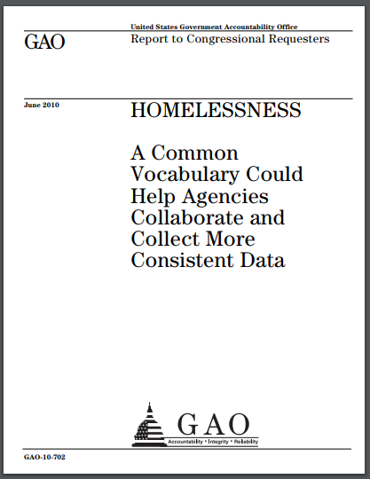
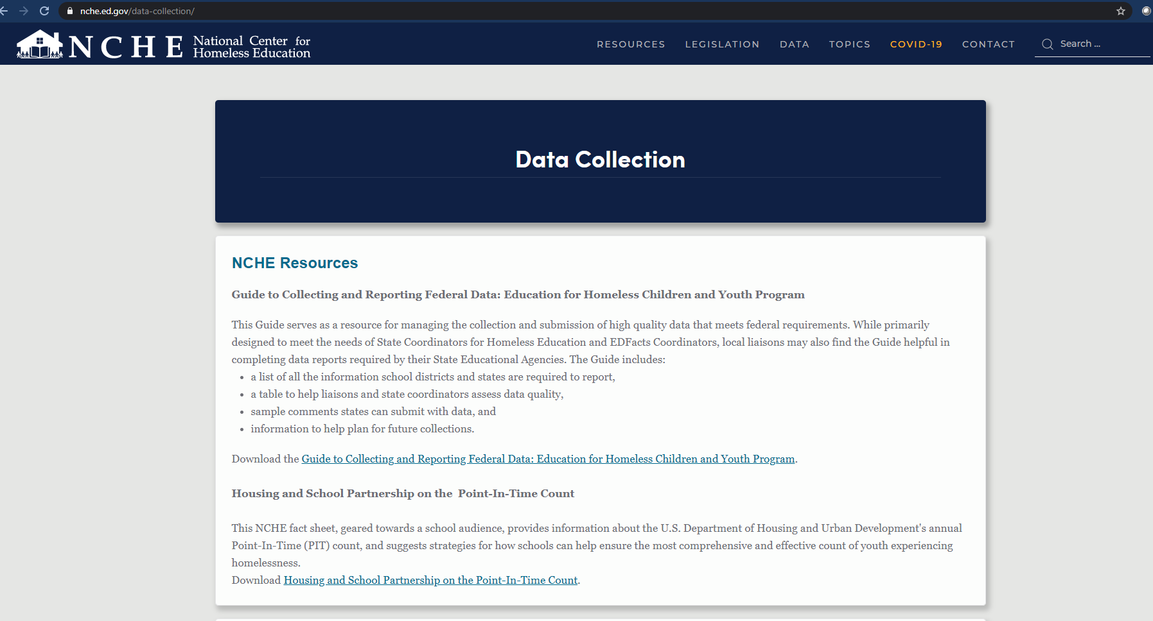
Data Resources
Chapter 13- NCHE Homeless Liaison Toolkit: https://nche.ed.gov/homeless-liaison-toolkit/
Data Quality Handout 2020: https://www.azed.gov/homeless/professional-development-ehcy
GAO Glossary for Data Collection: https://www.azed.gov/sites/default/files/2020/09/common%20vocabulary%20for%20collaboration%20and%20collection%20of%20more%20consistent%20data-2010.pdf
NCHE Data Collection website: https://nche.ed.gov/data-collection/

Slide 27
Have Questions?
Silvia Chavez
State Coordinator for Homeless Education
Silvia.Chavez@azed.gov
Homeless@azed.gov
(602)542-4963-Desk
www.azed.gov/homeless

