Slide 1
GME Planning Tool
ALEAT to GME
Trainer of Trainers
Title I, II, III, IV
Notes:
Open:
2. Navigator
https://www.azed.gov/titlei/planning-workflow/

Slide 2

Access
Participants must have the appropriate level of access
LEA Plan Update: allows a user to initiate, edit, save and revise a district-level plan.
  This role enables the user to view all school (site) plans as well. It is best practice to provide this role to a Federal Programs Director/Coordinator, Superintendent and/or their designee.
School Plan Update: allows a user to initiate, edit, save and revise an individual school level plan.
  This role is provided to the user(s) per school (site). It is best practice to provide this role to your schools’ Principals and Lead Specialists (e.g. Title I Lead Specialist).
Note: As with any other GME user roles, the same user can be provided with both of the above mentioned roles if your organization determines this to be appropriate.
Notes:
Check with audience to ensure everyone has needed level of access -
Test site link for those needing it:
GME test site: https://gmetest.azed.gov/default.aspx?ccipSessionKey=637118576062001509
LEA access is on
egrants5@mailinator.com The password is the same for all log ins: P@ssword1
Have all participants Log-in and access a School Plan

Slide 3

Connector
Why is it important to have a plan?
Discuss the Planning Components of the Integrated Action Plan (IAP) in ALEAT?
Notes:
5 min Connector – stand up and meet someone new
3 min Have participants discuss the prompts
2 min Discuss & share out.

Slide 4

Outcomes
    Please note: Training is on functionality of the Planning Tool only. Content in regards to CNA/RCA/IAP is provided in other ADE trainings.
    Participants will learn how to transfer the Planning Tools (CNA/IAP information) into a new location on GME.
    Participants will learn how to transfer Comprehensive Needs Assessment Data to Principles 1-6.
    Participants will learn how to input Primary Needs, RCA, Needs Assessment and Desired Outcomes into Final Summary.
    Participants will learn how to build IAP: Principles, Strategies and Action Steps.
    Participants will learn to access LIAP and SIAP Planning Tool Navigator.
    Participants will be able to train LEA users at the district and school sites.
Notes:
Remind participants that plan of Train the Trainer – so they need to not only be learners, but be thinking as trainers as well.

Slide 5
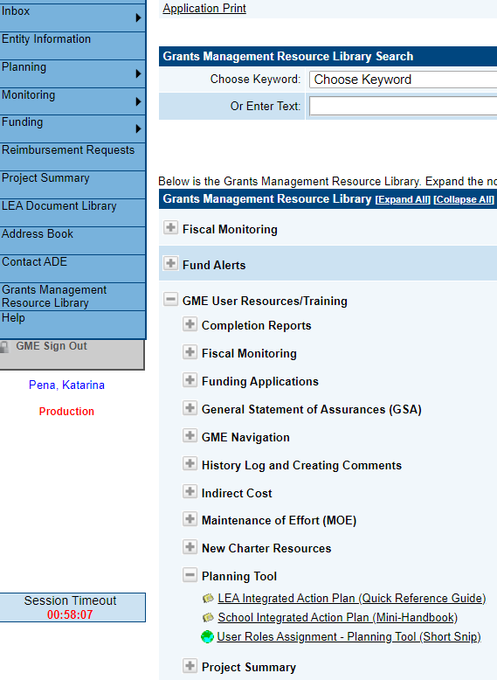
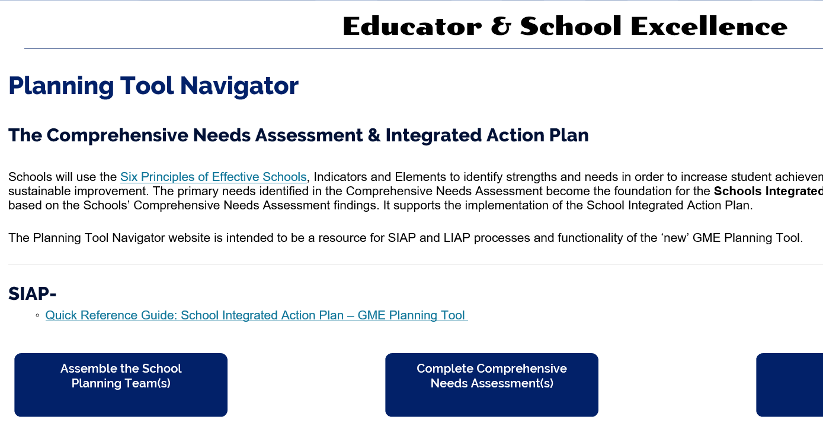
GME Quick Reference Guides
Notes:
Reference documents to Utilize for Step-by-Step directions
Copies to take with you – please follow along with presentation

Slide 6

Your Training Tools
GME Planning Tool Quick Reference Guides
Power Point with Your Notes from Today’s Training
Access to Planning Tool Navigator
School’s CNA
Current Root Cause Analysis Fishbones
Prior SIAP and LIAP from ALEAT
Notes:
Take notes of resources & trianing ideas to build your training toolkit – these are the core items.

Slide 7

Model Functionality and
Independent Practice
Today's Plan -
Notes:
Focus is on Functionality – not creating or writing an IAP.
We will model, then let you play.
Have all participants log in.

Slide 8
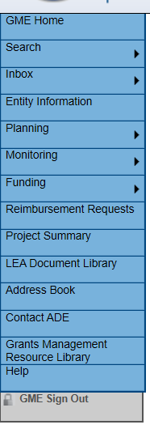
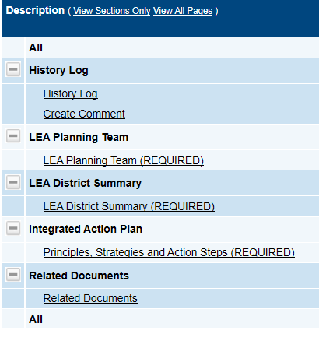
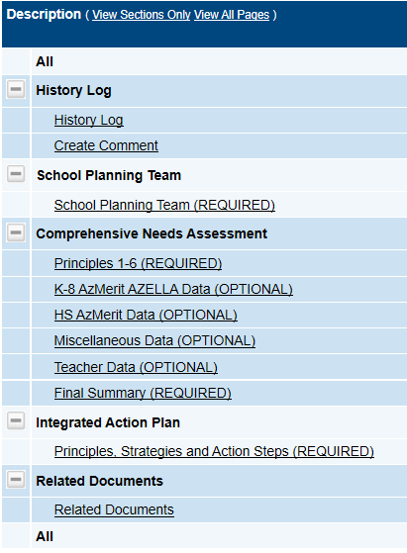
What is familiar? What is new?
FY21 Menu in GME
Change Status to Draft Started
Notes:
Quick Menu options overview
LEA must select FY21 to see LEA & School’s
Planning Workflow Process Big Picture Overview: Planning Team → CNA → IAP
Familiar - Looks like Fiscal GME; History Log; Same Plan Components – CNA, IAP
Note – Fiscal & Planning are not connected → different access
Have participants hit “Draft Started” for school integrated action plan.

Slide 9
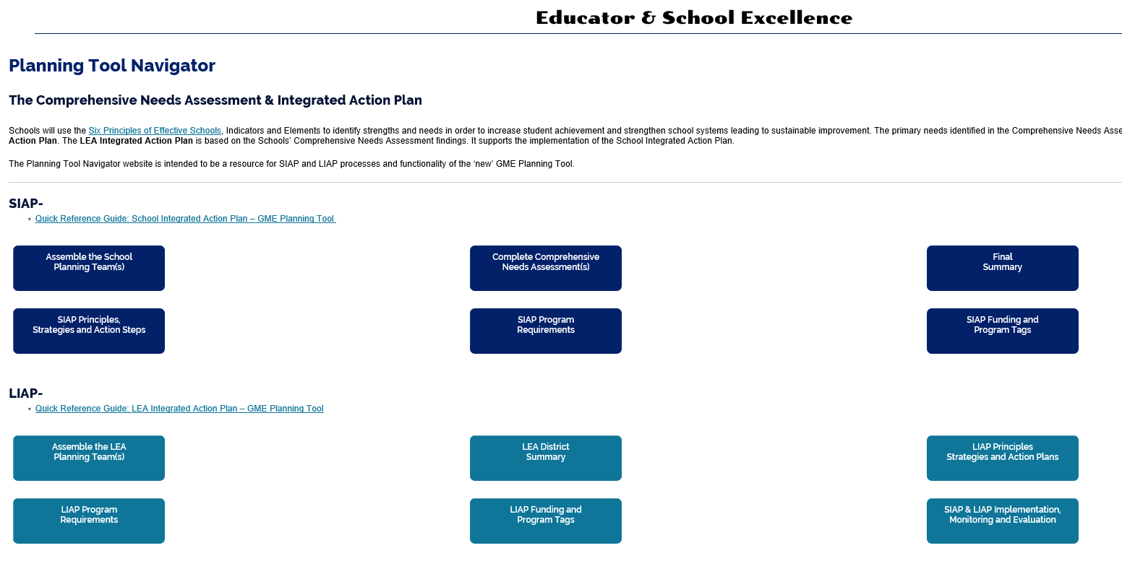

Planning Tool Navigator
Notes:
Planning Workflow Process Big Picture Overview
--> steps aligned GME Planning Tool & today's presentation
**Resources linked to each step/box**
Show live site & resources for Box #1 – Assemble the School Planning Team
Click on Stakeholder Citation
Search “Title I”
Navigator Link:
https://www.azed.gov/titlei/planning-workflow/

Slide 10
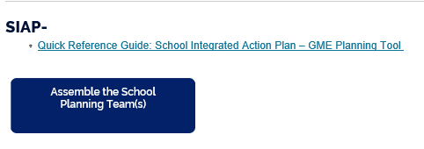
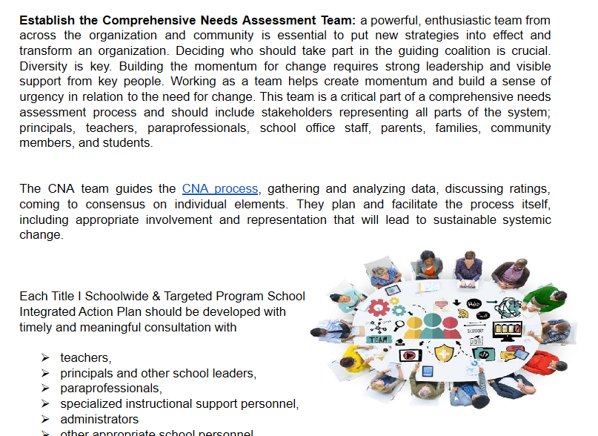
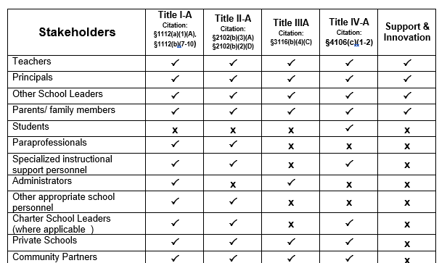
School Integrated Action Plan (SIAP)
Access Planning Tool Navigator
for Resources
Notes:
1st step - Assemble the School Planning Team
Model on Test site inputting team members then allow participants to practice in their own site.
Test site link:
GME test site: https://gmetest.azed.gov/default.aspx?ccipSessionKey=637118576062001509
LEA access is on
egrants5@mailinator.com The password is the same for all log ins: P@ssword1
Add & delete members
Note – 1st line must be completed & cannot be deleted.
--> Participants practice inputting information into GME.

Slide 11
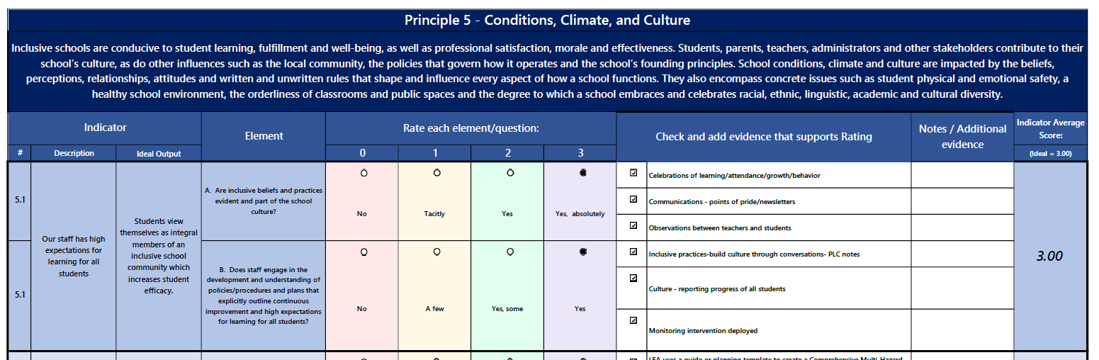
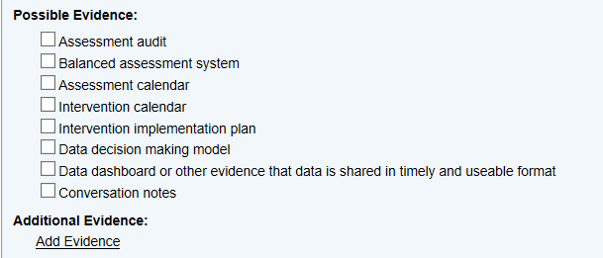

Comprehensive Needs Assessment (CNA)
Transfer CNA Data into GME
Important Notes:
Evidence must be included
Save before leaving page
Save before changing to another principle
Notes:
CNA Spreadsheet – Horizontal view
GME Tool – Vertical Tool
Same information
Still can Utilize Spreadsheet and then Transfer data into GME
Model 5.1 then allow participants to practice in their own site.
--> Participants practice inputting information into GME for Principle 5.

Slide 12
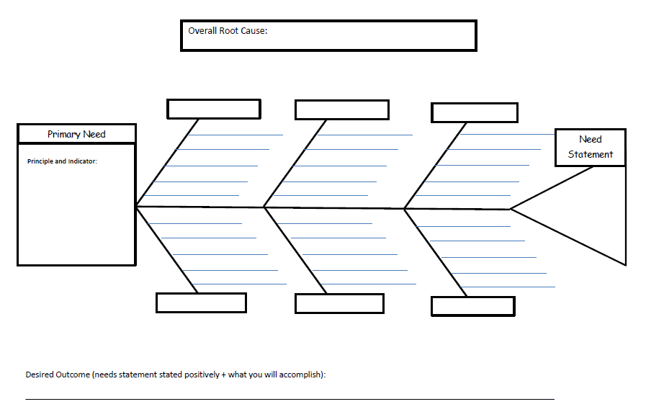
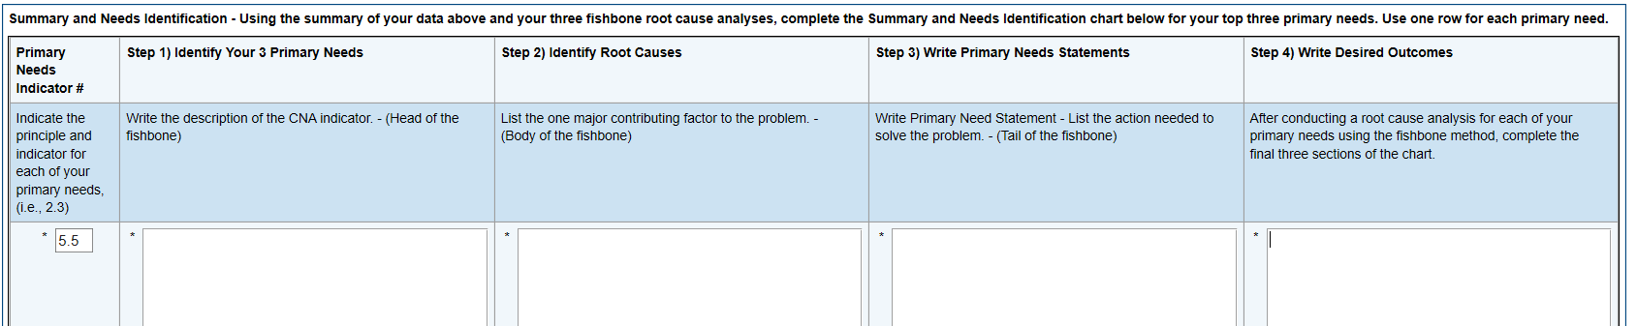
CNA Final Summary
1st stop – Data Review
Also Review Root Cause Analysis Fishbone
Notes:
Open "+" - easy to miss.
3 Fishbones still required – uploaded into Related Documents
Note – May want to Save in Word document to utilize when creating the Principles for the Integrated Action Plan.
Review details in "body" to indicate main root cause which comes from the box on top of the fishbone.
--> Participants practice inputting information into GME for 5.5

Slide 13

3 Take-Aways
Share 3 things you heard that you will include in your training.
Notes:
Short “Stop & Process” activity
“Get up and meet someone new.
Introduce yourself and then share 3 things you heard that you will include in the training you provide to others.”
Have groups share out 1 thing per group.

Slide 14
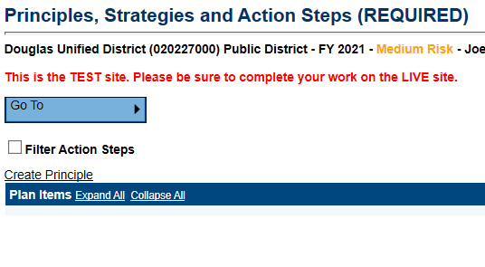
Integrated Action Plan (SIAP)
Create Principle
Notes:
Now it's time to begin building the action plan for the school. This very closely emulates the application in ALEAT. You will need to have the Word document handy with alll of the information you just entered into the Final Summary for the Primary Needs.
Begin by selecting Principles, Strategies, and Action Steps.
ADE has historically required that at least 2 principles are represented in the IAP, but don't let that limit you. You will need to include enough principles to ensure all of the primary needs are addressed, all of the program requirements are addressed, and there are principles, strategies, and action steps for every line item for which you have requested federal funds in the application process.
Start with one Principle from the drop down menu. It doesn't matter which one you select, as we can change the order later. We recommend beginning with your Primary Needs, since those will likely generate the most robust parts of the plan.

Slide 15
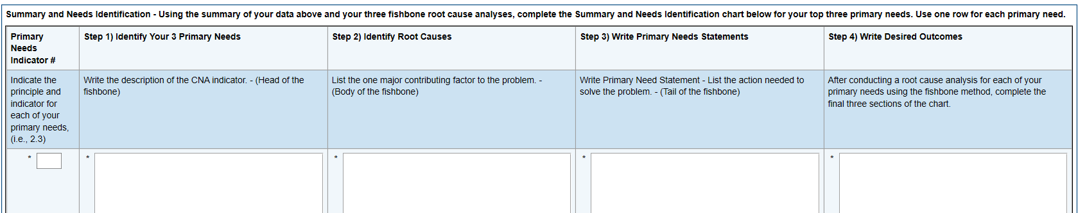
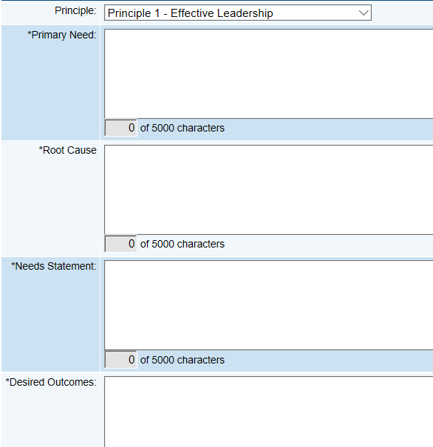
Integrated Action Plan (SIAP)
Transfer Needs Information into Principle
Final Summary
SIAP
Notes:
The first information requested of you for each Principle you add are the same boxes you just completed in the Final Summary, which come directly from the fishbones. If you kept a Word document, you can cut and paste the Primary Need, summary of Root Cause, Needs Statement, and Desired Outcomes.
Please keep in mind that you will still need to enter information into these same fields for Principles in your plan that don't have a Primary Need. So, for example, you may need to include Principle 6 in your plan for your family and community engagement activities, yet there was no Primary Need identified from Principle 6. If it's important enough to include in the plan, and potentially attach to federal funding, we need a written record of the needs and outcomes. Please do your best to complete the fields with accurate information that supports the plan and corresponding expenditures.
Then please notice the save button is at the bottom.
Create a Principal for Every Identified Need.

Slide 16


New for GME IAP
Principles are not already pre-populated;
→ Principles must be created before adding strategies and action steps.
Every Principle requires at least one Strategy and at least one Action Step.
To create a Principle for each Primary Need,
→ Transfer the information from the fishbones/Final Summary.
4. LEA may need to create a Principle, strategy and action step(s) for programmatic requirement(s) and/or fiscal item(s) not aligned to identified Primary Needs.
Notes:
#4 - Example: All identified , needs are in Principle 1 Effective Leadership , but Family/Community Engagement is a requirement, so LEA will need to also create a Principal 6 with corresponding strategy and action step.
We will walk you through all this after these next couple “Overview” information slides.

Slide 17
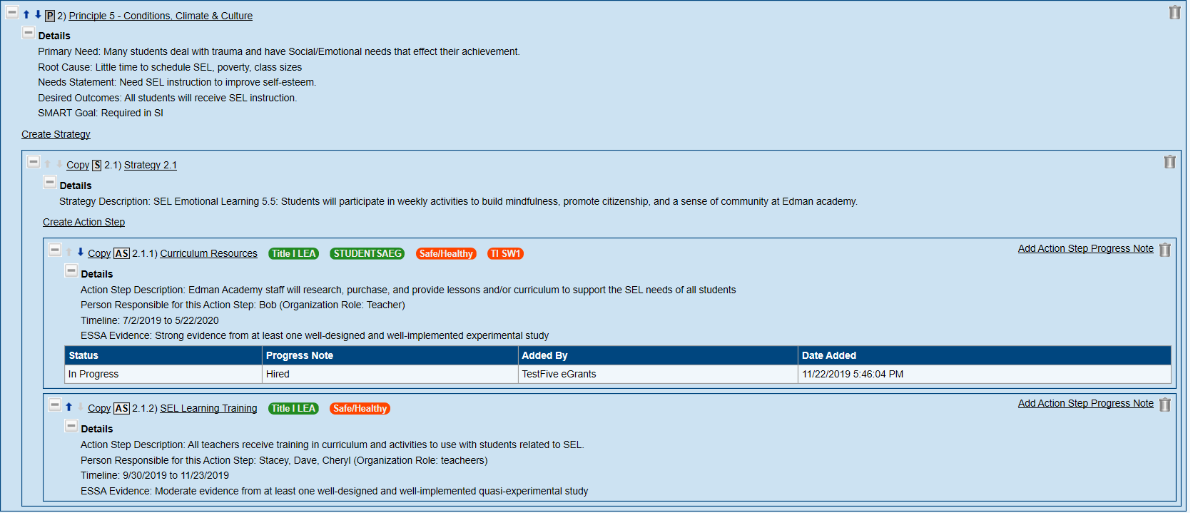
Principles, Strategies, and Action Steps
Notes:
Big Picture Overview -
Looks similar to ALEAT – Principle, Strategy, Action Step, tags.
Here we can view a Principle with one strategy and two action steps. Clearly the Expand All button has been used so we can clearly see all of the details.
I can tell this is the second principle entered by the school. How do I know? (Right – because the strategy is labeled 2.1, even though it is a strategy in Principle 5. This is a difference between GME and ALEAT.)
Note → Live Demo & practice after next few slides.

Slide 18
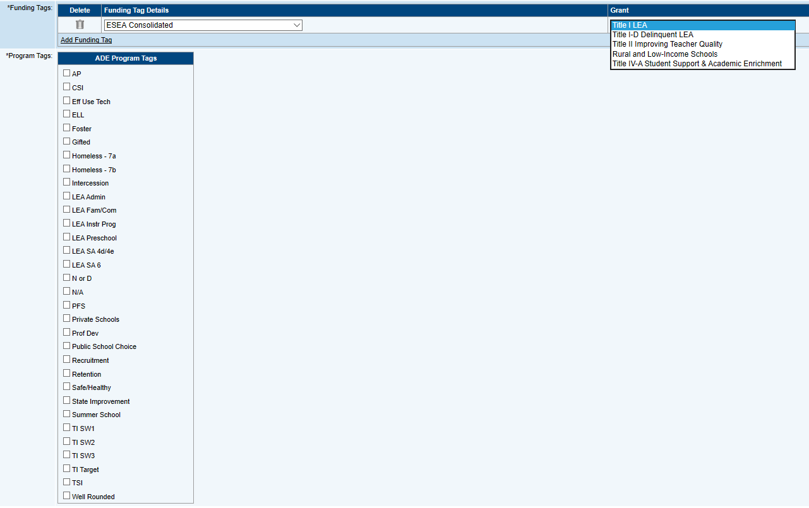

Tags
Funding Tags
Federal
Grant Funding
Source
Program Tags
Funding for Identified Programs
and LEA Set-Asides
Title I LEA
Title I Target
Title I SW1
Title I SW2
Title I SW3
Notes:
Big Picture Overview
Refer to Funding Tags document in the Navigator and/or Handout
Break after tags info → step-by-step IAP to come after break

Slide 19
Live SIAP Demo & Practice
Notes:
I Do – We do – You do
Every principle must have at least one strategy and at least one action step, or you will get an error / “Validation” message within GME. (This is one difference from ALEAT)
Let’s do one together –
We just created a Principle, putting in the Identified Need, Root Cause, Need Statement and Outcomes.
The next step is to open the + sign next to the Principle you just created, which gives you access to the link to "Create Strategy."
The text box that opens is the only one for the strategy. We recommend you begin by naming the Strategy in alignment with its corresponding Principle and Primary Need. For example, begin the text box with "5.5:Social emotional learning" and then write the narrative of the actual strategy. When we finish this strategy, you will better understand why this is important.
Save the Strategy
Now when you see the Principle and Strategy, what is the Strategy named? Because it is the first strategy of the first principle you have entered, it is named by the system "1.1." If you add a second strategy in the same principle, it will be named "1.2" and so on. To know anything about the strategy, you will have to open the Details of it or choose "Expand All" above. Then you can easily see the name YOU gave it, which is descriptive of its content.
Every strategy must have at least one action step. The fields are almost identical to what was in ALEAT with one exception.
Action steps have fields for titles, descriptions, date ranges, persons responsible, etc.
The ESSA Tier of Evidence is new. It is required for schools in school improvement and optional for others.
→ Additional information about the Tiers of Evidence can be found on the Navigator
And then there are tags …. You’ll need to choose the Application Name – ESEA Consolidated. This is new.
Then choose the Federal Funding Source – Green Tag
And the related Red Program Tag. As this is the SIAP, we will not choose any of the LEA Set-Asides, but will choose the Title I Program associated with this school – Targeted or Schoolwide.
Sue will go into more in-depth on tags after we go over the basics of building strategies and action steps in GME.
Save!
Point out the n/a if Not Funded. Do Not Choose a Funding Tag, only a Red Program tag.
Point out Deleting within “Nested” boxes.
Point out changing order of Principals and/ or strategies and/or Action Steps
Give Participants time to “Play” – to create their own Principals, Strategies & action steps
--> participants can utilize their own current SIAP

Slide 20
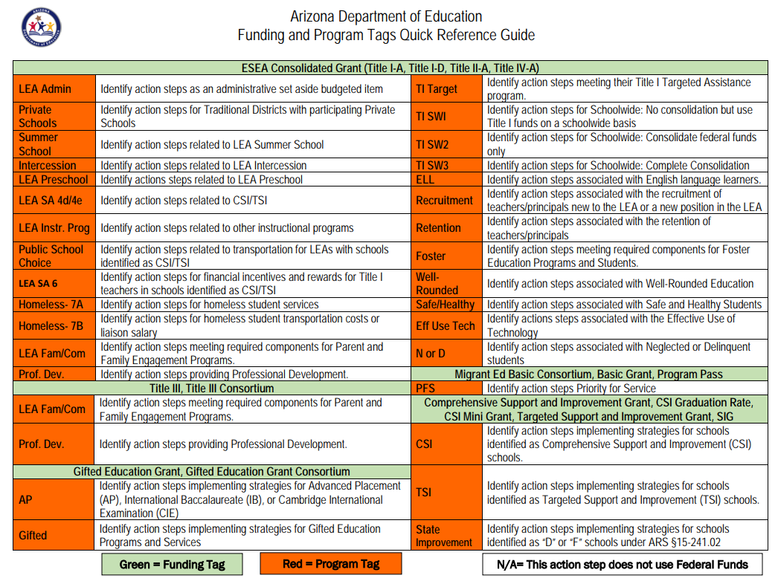
Tags for Action Steps
Notes:
Refer to handout.
Talk about a few of the tag names & a few possible examples of use.

Slide 21
What is similar? What is different?
LIAP VS SIAP
Change Status to Draft or Revision Started
Notes:
Big Picture overview
Similar – History Log; Planning Team; Related Documents
Difference – No CNA (No Fishbones required for LIAP)

Slide 22

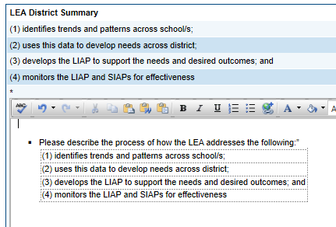
LEA District Summary
Process Description
Notes:
Refer to District Summary Worksheet document in the Navigator and/or Handout
Show worksheet resource live:
Navigator
https://www.azed.gov/titlei/planning-workflow/

Slide 23
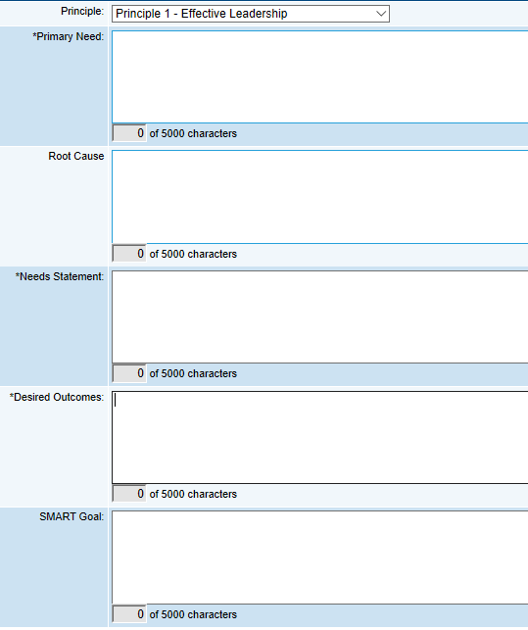
LEA Integrated Action Plan (LIAP)
Notes:
For each Principle aligned to identified needs, LEA will complete Primary Need, Needs Statement, and Desired Outcomes.
Root cause information is best practice, but is optional.
SMART Goals for LEA's in Improvement.

Slide 24
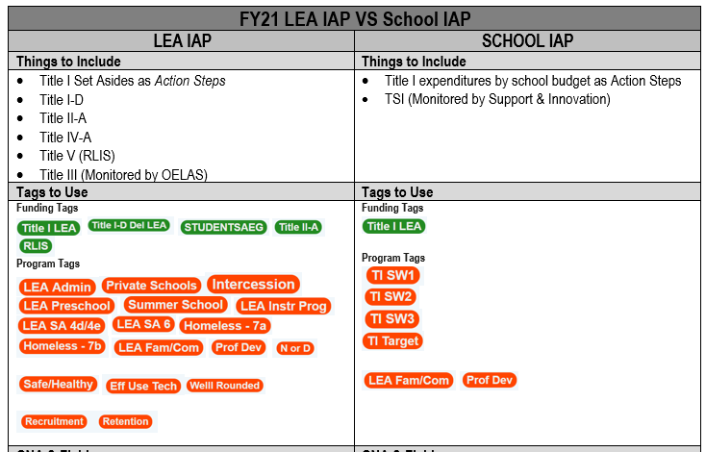
LIAP Tags
Title IV -A LEA
Safe / Healthy
Eff Use Tech
Well Rounded
Notes:
Call out LEA IAP Tags specifically
- LEA Set-Asides
Title II
Title III
- Title IV
Refer to Funding Tags document in the Navigator and/or Handout

Slide 25
Live LIAP Practice
Notes:
Participants create their own Principals, Strategies & action steps - as needed -
--> participants can utilize their own current LIAP

Slide 26





Additional Notes
History Log Protocols
IAP in GME is not in “Live-View” mode
Status change is for LEA to save and revise
Plan revision number will not match Fiscal Application revision number
Notes:
LEA to create their own internal procedures for utilizing SIAP History Log to communicate with LEA.
ADE will be putting notes in the Grant Checklist (as before), and also in the LIAP and/or SIAP as determined by the note content.
ADE can not see plan until Status is changed to “Plan Saved.”
ADE will not be responding when status changes occur in the GME Planning Tool. Saving is not a “submit” action. ADE will review plan when Grant Application is submitted.
LEA is still expected to continually update their Plan, so IAP revision number is expected to be higher than the Grant Application revision number.

Slide 27
Timeline Suggestions
January 2020 Identify Planning Team Members
January - March CNA & IAP
- Collect & Review Data
- Review & evaluate current IAP
- Complete Comprehensive Needs Assessment (CNA)
- Identify Primary Needs
- Complete Root Cause Analysis Fishbones
- Determine Outcomes
- Create Integrated Action Plan (IAP)
March 1, 2020 FY21 ESEA Consolidated Grant Application Opens
May 1, 2020 FY21 ESEA Consolidated Grant Application Due

Slide 28


Training Dates
December 9, 2019 at Washington Elementary
December 20, 2019 at ADE Jefferson location
January 13, 2020 at Pendergast Elementary District
January 15, 2020 at Yavapai County Education Service Agency
January 22, 2020 at Crane Unified School District
January 22, 2020 at The Charter Foundation
January 24, 2020 at Flagstaff Unified School District
January 28, 2020 at Tombstone Unified School District
January 29, 2020 at Pima County School Superintendent’s Office
Register on EMS Calendar of Events
Use “Title I” in the Program Area Field to search

