Slide 1

Notes:
Delete prior to training.

Slide 2
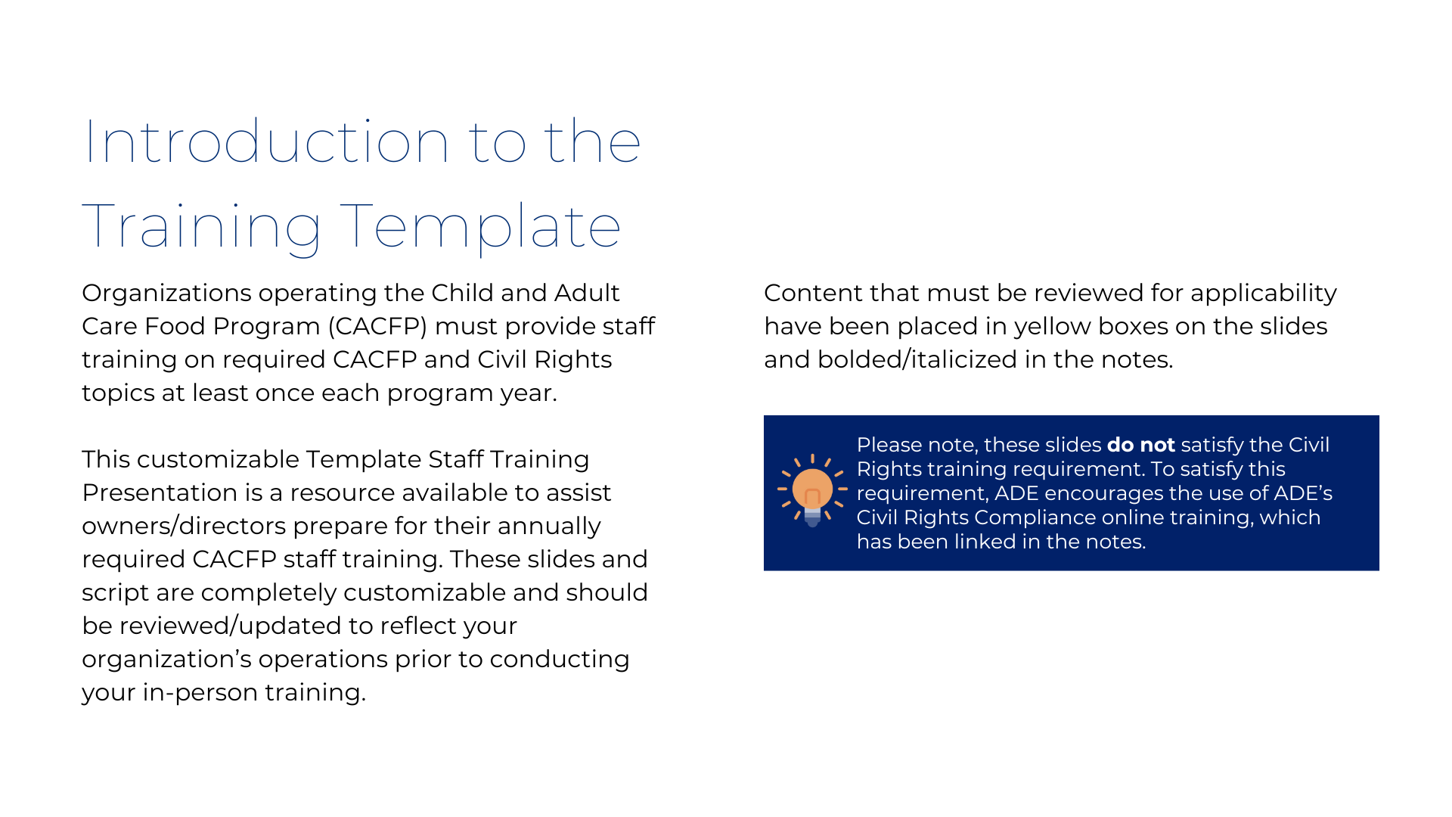
Notes:
Delete prior to training.

Slide 3
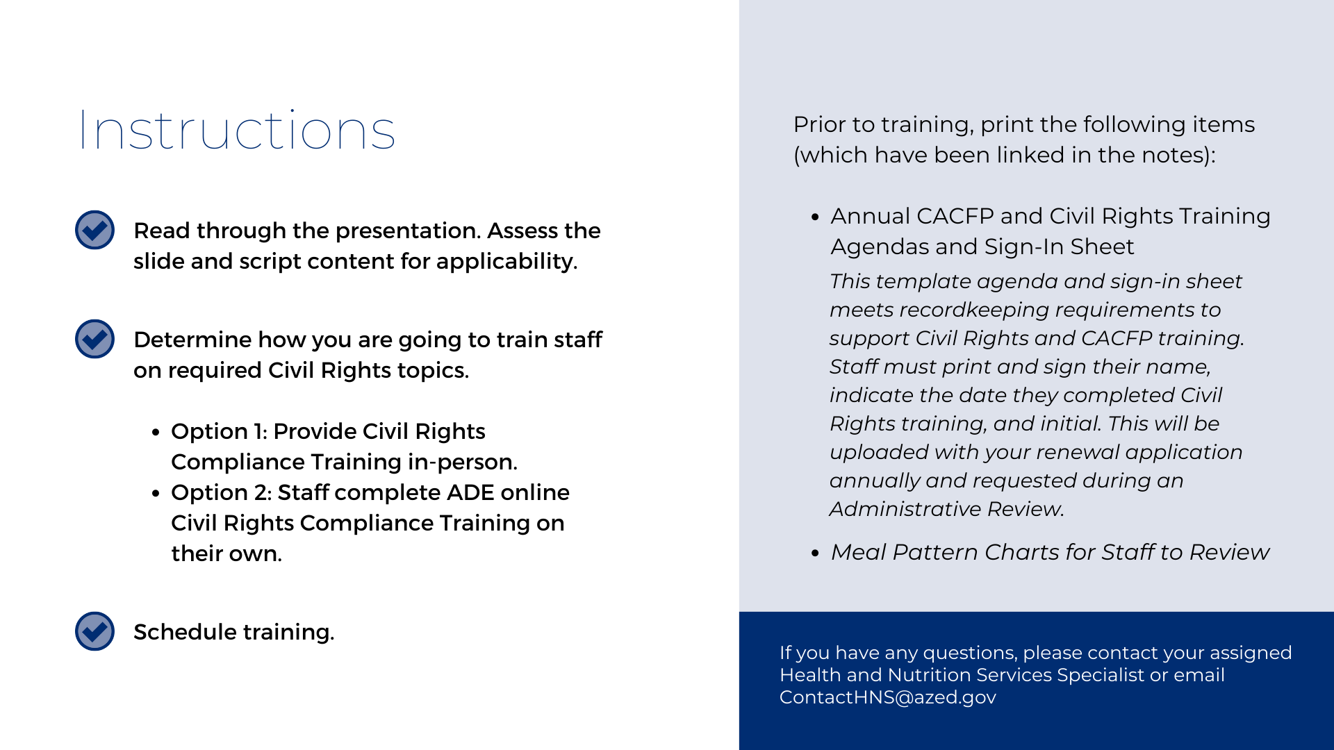
Notes:
Delete prior to training.

Slide 4

Staff Meeting
Annual CACFP Training
Notes:
Thank you all for taking the time out of your busy schedule to be here. Our center proudly participates in the Child and Adult Care Food Program, or the CACFP. By participating in the CACFP, we receive money to help serve nutritious meals and snacks to our participants. These nutritious meals, paired with all of your hard work in the classrooms, contribute to the wellness, healthy growth, and development of the participants we serve.
One of the requirements of participating in the CACFP is to train staff annually, which is what we’re going to be doing today!

Slide 5
Agenda
All staff involved in the food service operations must be trained annually on CACFP Topics and Civil Rights. Required training topics include:
  CACFP Topics | Covered Today
    CACFP Meal Pattern Requirements, Meal Counts, Review Procedures, Recordkeeping Requirements, Claims Submission, Reimbursement System
  Civil Rights Topics | Select either: Covered Today OR Completed Online
    Collection and Use of Data, Effective Public Notification Systems, Complaint Procedures, Compliance Review Techniques, Resolution of Non-Compliance, Requirements for Reasonable Accommodations for Persons with Disabilities, Requirements for Language Assistance, Conflict Resolution, Customer Service
Notes:
To ensure our food program operations thrive, USDA requires we train on these CACFP and Civil Rights topics. Today, we are going to cover all of the required CACFP topics and…
…OPTION 1: Civil Rights topics.
…OPTION 2: briefly recap what was covered in the online Civil Rights training.
If you have not yet completed the Civil Rights training presentation online, please do so by <insert the date>. The slides and link for the training were included in the email sent out last week.

Slide 6
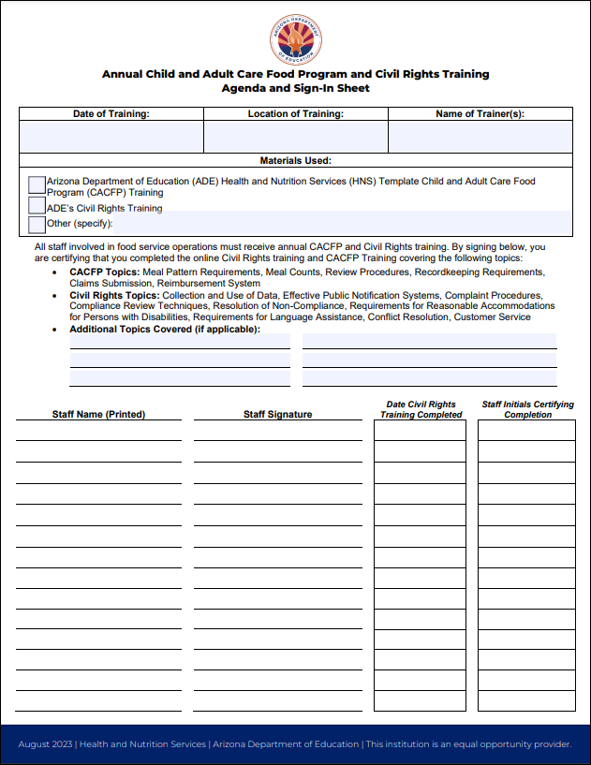
Required Training Documentation
Today’s Training Sign-in Sheets and Agenda
Please sign the sign-in sheet/agenda prior to leaving training today.
Notes:
To demonstrate that all staff received the required training, we must maintain this sign-in sheet. By printing your name and signing, you are certifying that you are attending this training today. Please also record the date you completed the Civil Rights training with your initials to validate it was completed. Please be sure to sign it before you leave since I have to submit this to ADE during renewals and it is verified on review as evidence I have trained you.

Slide 7

Civil Rights
Highlights
Notes:
OPTION 1- CIVIL RIGHTS TRAINING IN-PERSON:
If you are covering the Civil Rights training in-person, go through that training presentation now.
OPTION 2 – CIVIL RIGHTS TRAINING COMPLETED INDEPENDENTLY ONLINE
Continue. The followings sentence is ADE’s proposed script:
Being participants in the CACFP, we have to be skilled and know how to treat everyone fairly. The online training helps us know how to do that. We’re now going to briefly recap what to do in the event a complaint is received.

Slide 8
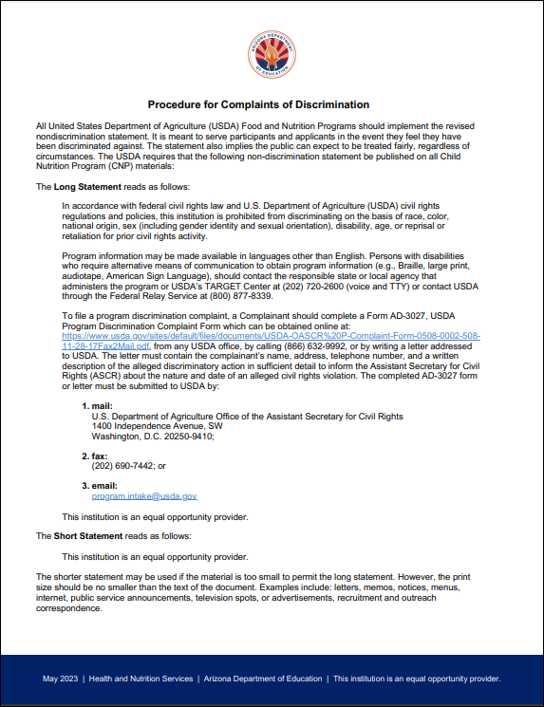
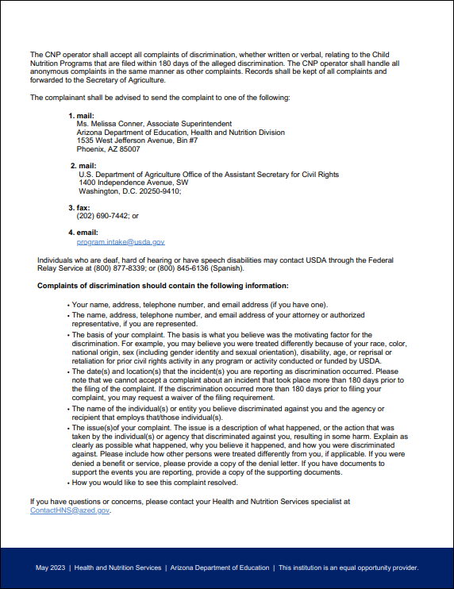
What to do when a complaint is made
Identify if it’s a Civil Rights Complaint.
Six Protected Classes: Race, Color, National Origin, Sex, Age, Disability
Connect with Civil Rights Coordinator.
  Our Civil Rights Coordinator is: <Insert Name/Position of Civil Rights Coordinator>
Follow the steps in Civil Rights Procedures for Complaints of Discrimination.
Procedure for Complaints
of Discrimination
Notes:
Parents, staff, and members of the public are able to make civil rights complaints should they feel they are being discriminated against.
If you are approached with a complaint, first, gather information about the situation. Hopefully, we can address and resolve the areas of concerns. If we cannot provide resolution, we have to assess if it is a civil rights complaint. To be a civil rights complaint, the concern must relate to one of the six protected classes which are Race, Color, National Origin, Sex, Age, and Disability as the six protected classes. If the complaint is related to one of those six items, you’ll want to connect with the Civil Rights Coordinator for support and guidance. Our Civil Rights Coordinator is <insert name/position of the Civil Rights Coordinator for your organization. Note: this is a fancy title for who staff should be contacting if/when a Civil Rights complaint is received.>
With support from the Civil Rights Coordinator, you will advise the complainant to follow the steps outlined on the second page of the Procedure for Complaints of Discrimination document. The steps to submitting a complaint are outlined, in detail, in this document. <Insert where this document can be found – i.e. It is posted on the parent board, located in all of your staff files, and available on ADE’s webpage.>

Slide 9

CACFP
Training
Notes:
Now that we are civil rights experts, let’s transition to CACFP topics.

Slide 10
What’s Covered Today
What’s on the menu
How much of each food should be served
When and how we serve meals
How we receive and spend CACFP money
Forms we are required to keep
What happens when we get reviewed
Notes:
These topics include what’s on the menu, how much food should be served, when and how we serve meals, and your role in how we receive and spend our CACFP money. We will also talk about the forms we are required to keep and what you can expect when we have a CACFP Review.

Slide 11
CACFP at <Insert Site Name>
CACFP aims to improve participant nutrition through daily meal service.
  We are shaping nutrition behaviors for those we love/care for.
  Nutrition and experiences with food are critical to development.
Insert Meal Served – i.e. Our center serves Breakfast, Lunch, Dinner, and 2 snacks.
  For some participants, they receive 2/3 of their food/meals from us. This plays a big role in reducing food insecurity.
We receive funding for each meal we serve to participants, and the meals have to meet specific requirements.
Notes:
We participate in CACFP for <Insert meals served i.e. breakfast, lunch, dinner, and 2 snacks.>
It’s important to remember that we are shaping the nutrition behaviors for our participants and we play a big role in reducing food insecurity in our community.
We participate and follow program rules to receive funding to support our meal program.

Slide 12

CACFP Meal Pattern
What’s on the Menu?
Notes:
Let’s begin with the meal pattern. It shows which foods are required at meals and snacks.

Slide 13
What’s on the menu?
Why is it important for you to know the meal pattern requirements?
Keep us accountable!
Provide feedback!
Insert image of menu.
Notes:
Director: Why is it important for you to know the meal pattern requirements?
First, we want each of you, as staff, to know what should be on the menu to help make sure our <Choose one: children or participants or adults> are receiving the correct foods.
We’re counting on you to help us stay on track. You’re the ones who will be serving the meals and overseeing the meal service. We want you to feel empowered to remind us if something is missing.
Lastly, we value your input! Please feel comfortable letting us know if you have ideas as to how we can improve our menus, if you have any unique menu ideas, if there are foods that go over well, foods that don’t, or any other meal service observations, questions, or concerns.

Slide 14
Infant Meal Pattern
0-5 Months:
(Infants Not Yet Ready for Solid Foods)
Breakfast:
Breastmilk and/or Iron-Fortified Infant Formula
Lunch/Supper:
Breastmilk and/or Iron-Fortified Infant Formula
Snack:
Breastmilk and/or Iron-Fortified Infant Formula
6-11 Months:
(Infants Developmentally Ready for Solid Foods)
  Breakfast:
    Breastmilk and/or Iron-Fortified Infant Formula
    Infant Cereal or Meat/Meat Alternate
    Fruit and/or Vegetable
  Lunch/Supper:
  Breastmilk and/or Iron-Fortified Infant Formula
  Infant Cereal or Meat/Meat Alternate
  Fruit and/or Vegetable
  Snack:
  Breastmilk and/or Iron-Fortified Infant Formula
  Grain
  Fruit and/or Vegetable
Notes:
<Possible to remove if you do not have infants in your care>
First, I will cover the infant meal pattern. It is made up of different food components. From 0 through 5 months, breastmilk or infant formula is the only food component required. The infant meal pattern for babies who are 6 through 11 months includes solid foods as additional food components once the baby is developmentally ready. These additional components include grains, meat and meat alternates, and vegetables and fruits.
Take a few seconds to look at the infant meal pattern chart that is on your table. Pay close attention to the components required and serving sizes.
Some things you may have noticed are:
Breastmilk and formula are required for all infants 0-11 months of age
Foods start around 6 months of age
Food components are offered as part of a meal or snack, but since babies do not eat on a set schedule, the components may be offered throughout the course of the morning or afternoon. For example, a baby may eat part of her breakfast at 9 a.m. and more of her breakfast at 10:30 a.m. This is still reimbursable as the breakfast meal.
- You may have also noticed a serving size with a range starting at 0. Infant teachers, please remember that a serving size of 0 does not mean it’s optional – it means it is based on the developmental readiness for solid foods. How do we know when an infant is ready? We’re going to discuss that now.

Slide 15
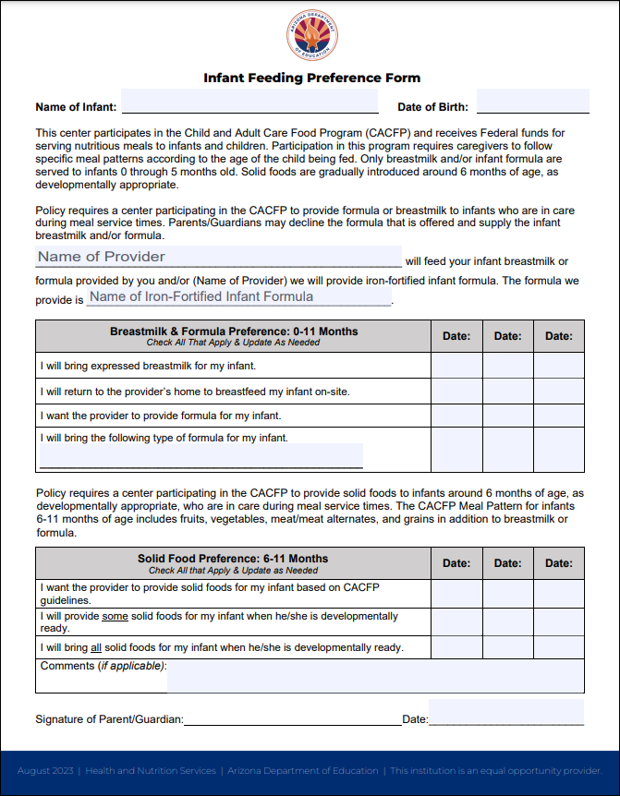
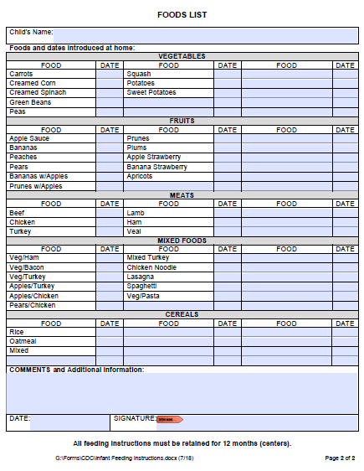
Documenting Developmental Readiness
Available on ADE’s webpage
azed.gov/hns/cacfp/programforms/
Infant Feeding Preference Form:
Documents how the parent/ guardian would like their infant to be fed while in our care.
DHS Solid Food Introduction Form:
Documents solid foods that have been successfully introduced at home and therefore must be offered while the infant is in our care.
Notes:
<Possible to remove if you do not have infants in your care>
Every infant is different. While we love our infants and know them really well, we rely on parents/guardians to communicate their infant’s feeding habits. We use these two record keeping forms to ensure we have good communication with the parents/guardian.
(Best Practice) The first is the Infant Feeding Preference Form which ADE encourages centers to use. It documents how parents/guardians would like their infant to be fed while they’re in our care. It also has a space for parents/guardians to communicate if they’re going to be providing their own food for their infant. This is important for us to know because when parents provide more than one component, like breastmilk and fruit, we cannot include this meal on our reports for ADE.
(Required if infants are in care) The second is the DHS Solid Food Introduction Form. This form documents solid foods that have been successfully introduced at home and therefore must be offered while the infant is in our care.

Slide 16


Infant Feeding Resources
Feeding Infants in the CACFP Handbook
Infant Room Staff are encouraged to review USDA’s Feeding Infants in the CACFP handbook.
Notes:
<Possible to remove if you do not have infants in your care>
Infant teachers, as you know, USDA has issued a guide that provides a detailed overview of Feeding Infants in the CACFP. <Indicate where infant teachers can access this guide. i.e. Two copies are available in the Infant room and you are strongly encouraged to review this handbook and communicate any questions or concerns that may arise.>

Slide 17
Child & Adult Meal Pattern
Breakfast
Milk
Grain*
Vegetable, Fruit, or Both
Lunch/Supper
Milk
Grain
Vegetable
Fruit or Vegetable #2*
Meat/MA
Snack*
Milk
Grain
Vegetable
Fruit
Meat/MA
*Allowable: Substitute Meat/MA for Grain up to 3x Per Week
*Allowable: Serve a second serving of a different vegetable in lieu of a fruit
*Choose two components
Notes:
<For centers with infants> Now let’s talk about what’s on the menu for children ages 1 and up. There are five main components in the CACFP meal pattern.
<For centers without infants, including preschools, at-risk afterschool programs and adult day programs> Now let’s talk about how our menu aligns with the meal pattern.
The five components are:
Milk
Grain
Vegetable
Fruit
Meat/Meat Alternate
The required components vary by meal type.
At breakfast, we must serve fluid milk, a bread/grain OR meat/meat alternate like scrambled eggs or yogurt, and a fruit or vegetable or combination of both.
At lunch and supper, we must serve all five components. Occasionally, you may notice we serve two different vegetables instead of a fruit and vegetable. This flexibility is allowed so we can provide our participants more opportunities to try foods they may not get at home.
At snack, we have the ability to pick any two of the five components to serve.

Slide 18
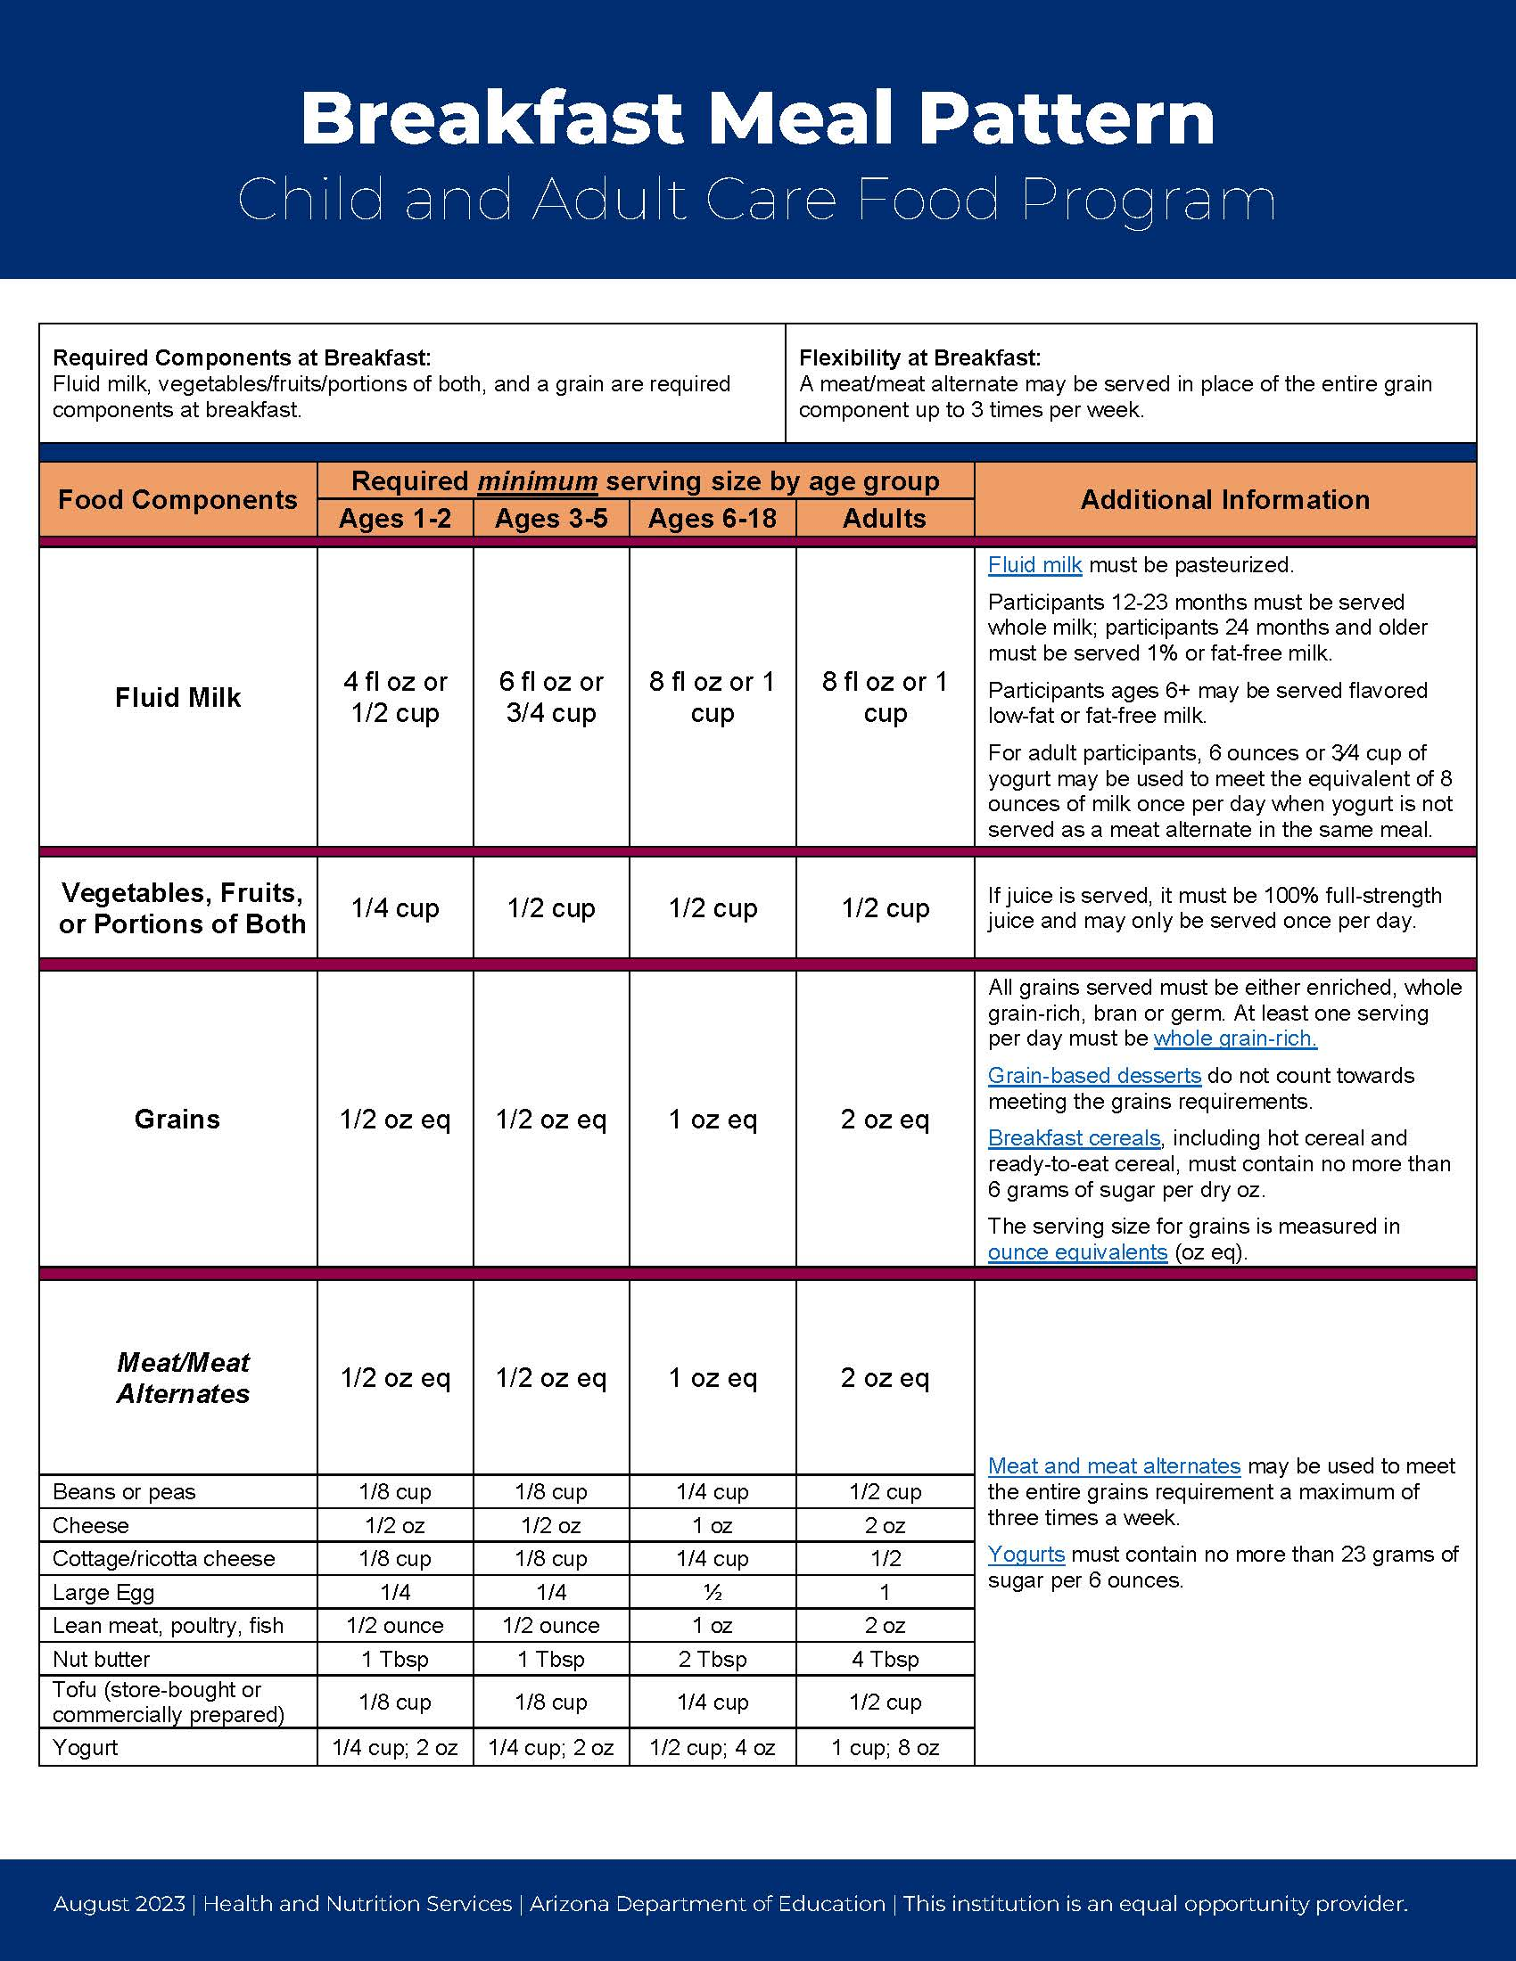
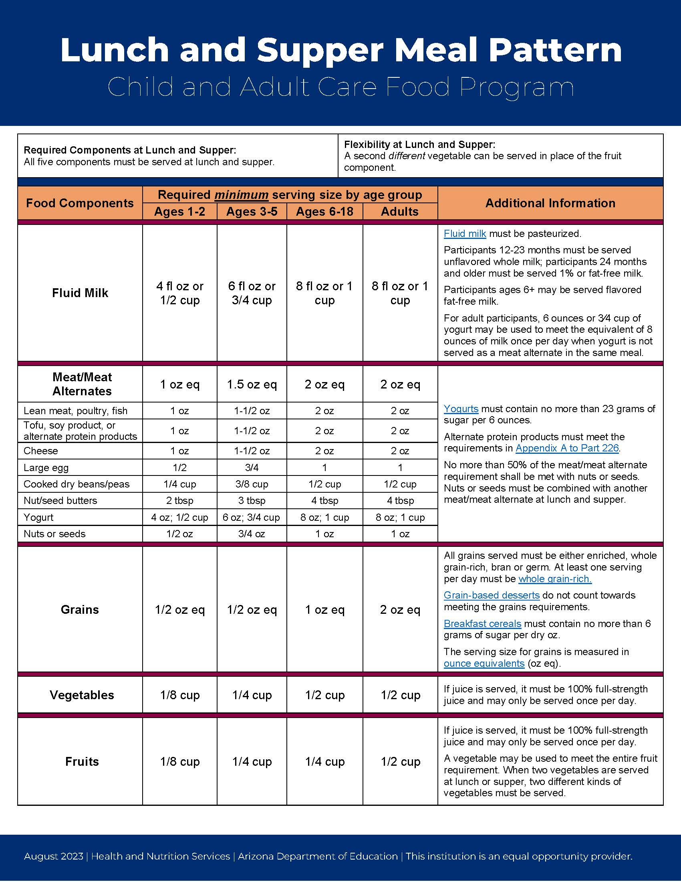
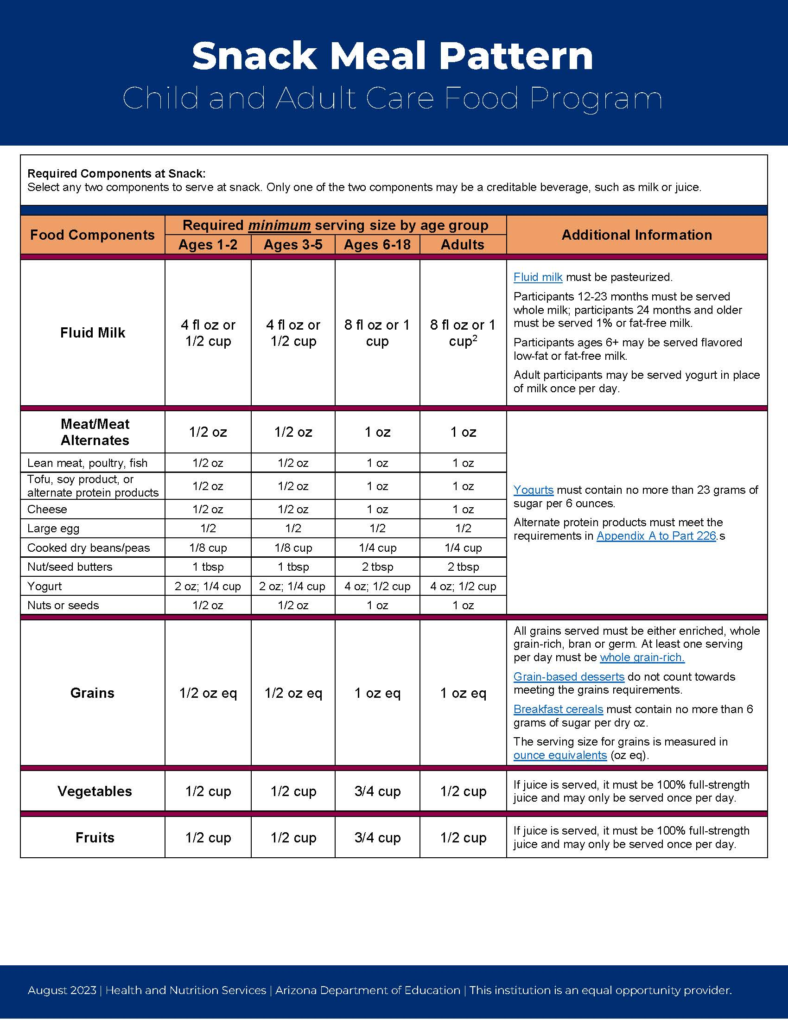
Serving Sizes
Take a moment to review the meal pattern charts.
Notes:
<You can delete any of the meal patterns that don’t apply to you. You can also modify some of the script if you don’t serve different age groups as defined in the meal patterns >
Take a moment to review your meal pattern charts.
Notice that serving sizes increase with age and vary by meal type. The serving sizes on this chart are the minimum required serving sizes for the CACFP meal pattern. We are always able to serve more than the serving sizes listed, but we cannot serve less. If you feel your classroom did not receive enough food to meet the serving sizes, we want you to feel empowered to communicate with the cook and request to receive more food.
These meal pattern charts are posted in each room for you to reference what foods should be served and in what serving sizes.
The next few slides will show us what these serving sizes look like on a plate.

Slide 19
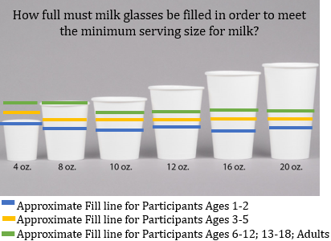
Serving Milk in the CACFP
What type of milk must be served?
  Participants 12-23 months must receive whole milk.
  24 months and older must receive 1% or skim milk.
How much milk must be served?
Notes:
Milk is one the five components and is required at breakfast, lunch and supper. It is important that we not only serve the correct type of milk, but it is important we serve enough milk to meet the minimum meal pattern requirement.
What type of milk must be served?
<Centers serving children>Participants 12-23 months must receive whole milk. 24 months and older must receive 1% or skim milk. All children under 6 years of age must receive unflavored milk.
<Centers serving at-risk after schoolers ONLY> All of our participants must receive 1% or skim milk.
<Centers serving adults> All of our participants must receive 8 oz of 1% or skim milk except we are allowed to serve 6 ounces of yogurt in place of milk once per day when yogurt is not served as a meat/meat alternate in the same meal. In addition, milk is optional at supper.
We use <insert cup size i.e. 10 oz cups – adjust the image on the slide so the correct size cup is circled>. Looking at this image, identify approximately how full you should be filling the cup in order to meet the minimum meal pattern requirements for the children in your classroom. (advance slide – lines w/ marks on cup will appear) (Acknowledge how full the cup will need to be for each age group.)

Slide 20
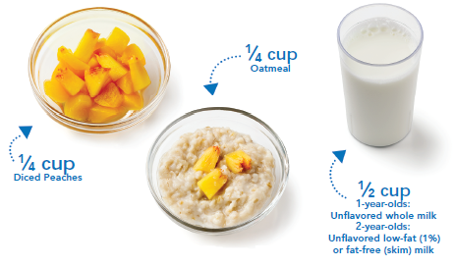
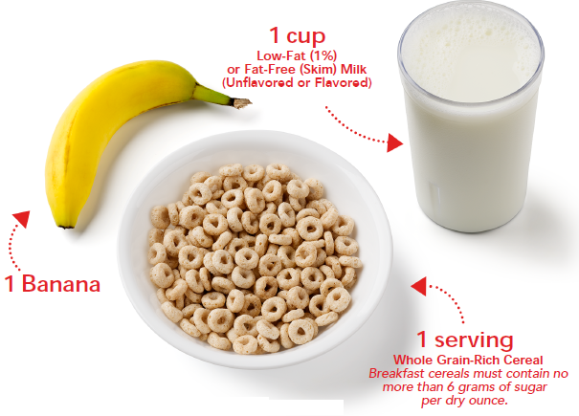
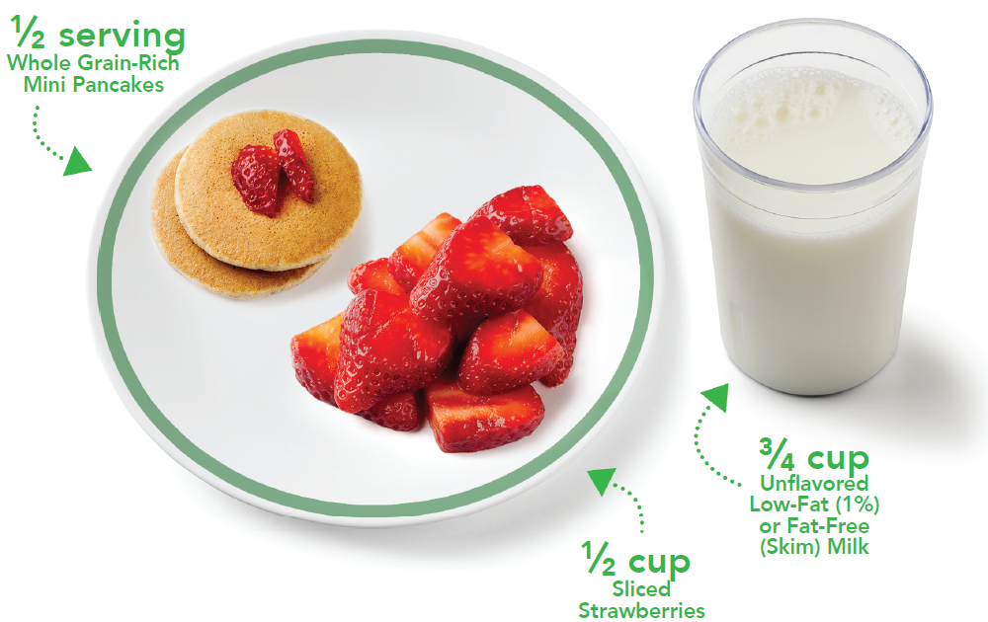
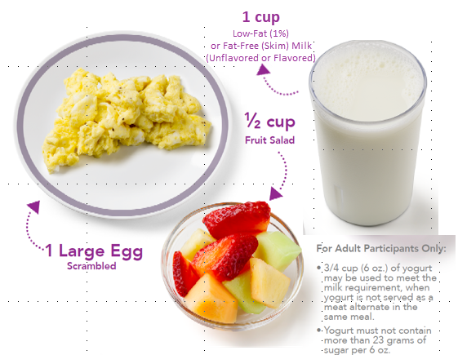
Sample Breakfast for Ages 1-2:
Sample Breakfast for Ages 6-12; 13-18:
Sample Breakfast for Ages 3-5:
Sample Breakfast for Adults:
Notes:
These are all examples of a CACFP compliant breakfast.
<Depending on the age groups you serve, you can delete the pictures you don’t need and make the remaining pictures bigger.>
<For centers with children of various ages> Notice the portions required for each age group on this slide. Look at the differences between ages 1 +2 and ages 3-5. The fruit offered changes from ¼ to ½ cup.
<If you only serve at-risk after school children or adult day participants> Notice what the portion size looks like for our participants. Recall we must serve a bread/grain at breakfast at least 3 times/week, but can serve a meat/meat alternate in place of the bread/grain twice per week. We must serve a ½ cup of fruit or a vegetable and we must serve 8 ounces of milk. <Adult Day, you can add the caveat about serving yogurt in place of milk once/day, but this was covered on the previous slide>

Slide 21
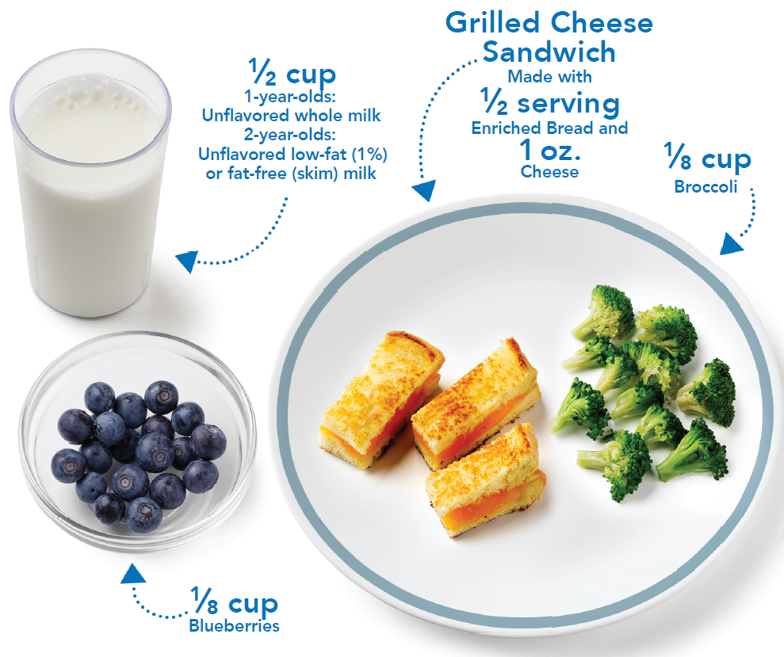
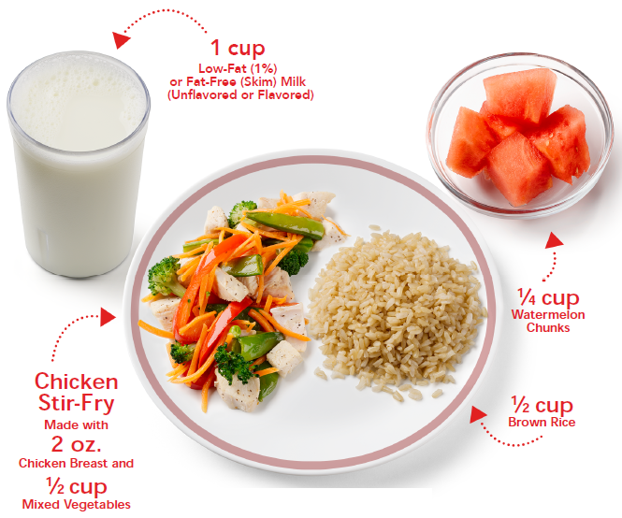
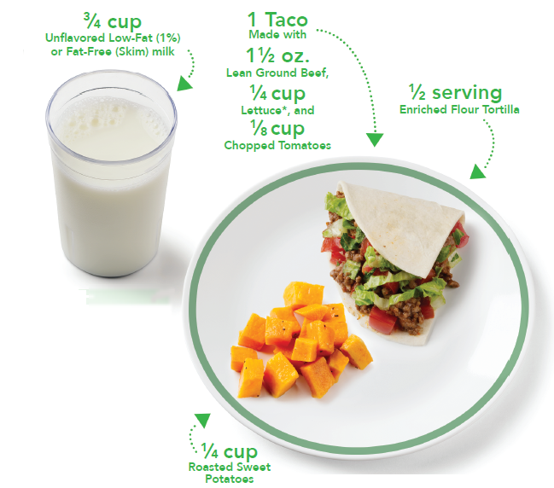
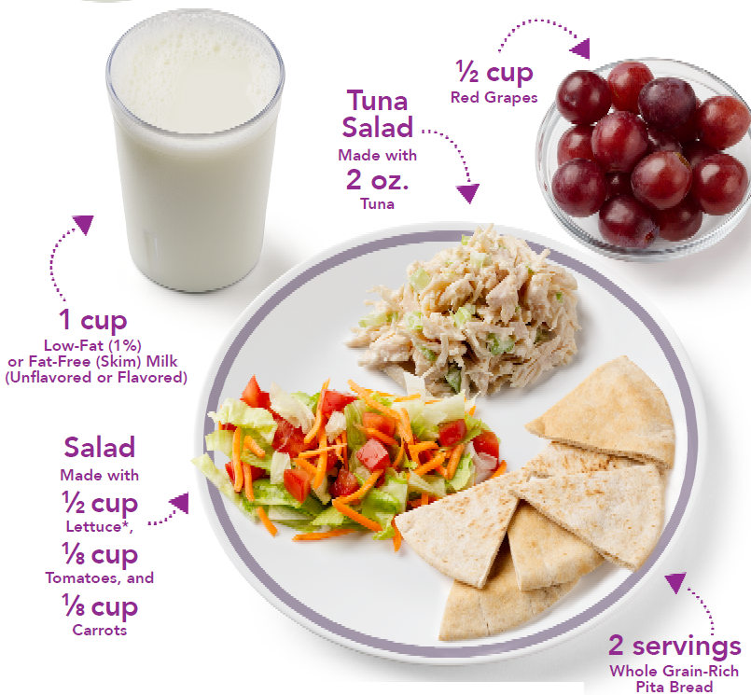
Sample Lunch/Supper for Ages 1-2:
Sample Lunch/Supper for Ages 6-12; 13-18:
Sample Lunch/Supper for Ages 3-5:
Sample Lunch/Supper for Adults:
Notes:
Here are pictures of what lunch or supper might look like. Remember, all five components are required at lunch and supper.
<At-Risk after school and adult centers can keep all of the pictures and the script because the points made below are only displayed on the 3-5 age group. Even though the serving size does not apply to your group, the picture for 3-5 year-olds displays a meal with 2 vegetables instead of 1 fruit and 1 vegetable.>
As I mentioned, we have the flexibility to serve two different vegetables in place of a fruit and vegetable at lunch and supper. The meal for participants ages 3-5 is an example of this flexibility in practice – serving sweet potatoes and lettuce with tomatoes.
The serving size for raw leafy greens must be doubled. As a best practice, we always pair lettuce with another vegetable to meet the vegetable component just like this 3-5 age group meal did.

Slide 22
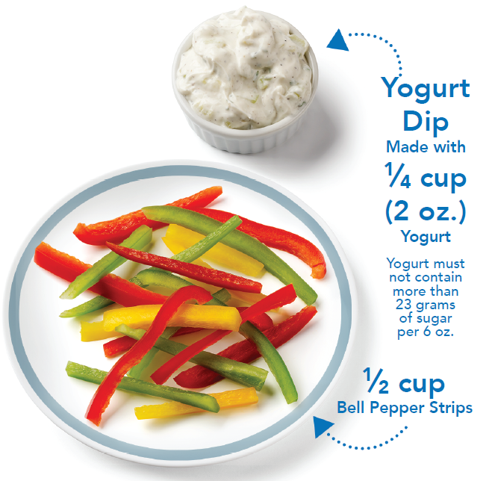
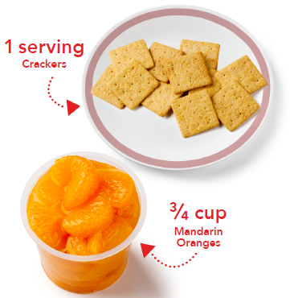
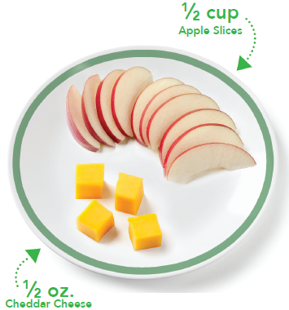
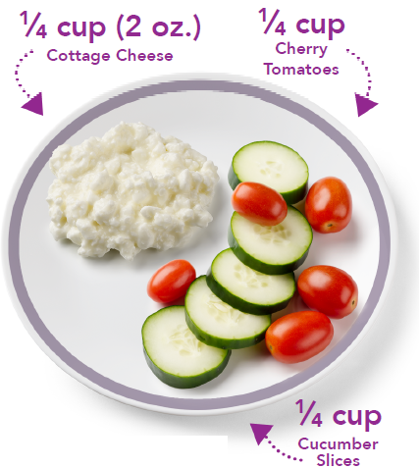
Sample Snack for Ages 1-2:
Sample Snack for Ages 6-12; 13-18:
Sample Snack for Ages 3-5:
Sample Snack for Adults:
Notes:
<At-Risk after school and adults can keep all of the pictures if you’d like just to show more options.>
Lastly, these are images of the serving sizes at snack. We are able to serve any two components at snack but they must be two different components.

Slide 23

Keeping Participants Safe at Mealtimes
Choking hazards:
  Avoid popcorn, chunks of peanut butter, nuts and seeds
  Use caution – must be cut to appropriate size:
    Quarter - hot dogs
    Quarter - grapes
    Shred - meat and cheese
    Shred/Cook - raw vegetables
Texture: May have to be modified for infants
Notes:
<Delete this slide if you serve adults; next slide is for you. If you only serve at-risk after schoolers, you may delete this slide; your choice.>
In addition to paying attention to serving size and ensuring meals served are following the CACFP meal pattern, we must pay attention to choking hazards and food texture to keep our participants safe. Some foods we serve are potential choking hazards for participants and should be cut to an appropriate size or might be microwaved for a few seconds to soften the item. For example, when grapes are on our menu, the cook knows to quarter the grapes for the toddler rooms.

Slide 24

Keeping Participants Safe at Mealtimes
Choking hazards:
  Avoid popcorn, chunks of peanut butter, nuts and seeds
  Use caution – must be cut to appropriate size:
    Quarter - hot dogs
    Quarter - grapes
    Shred - meat and cheese
    Shred/Cook - raw vegetables
Texture: May have to be modified for some adults
Notes:
<Delete this slide for child care and at-risk centers; it is only for adult day.>
In addition to paying attention to serving size and ensuring meals served are following the CACFP meal pattern, we must pay attention to choking hazards and food texture to keep our participants safe. Some foods we serve are potential choking hazards for participants and should be cut to an appropriate size or might be microwaved for a few seconds to soften the item.

Slide 25

Menu Modifications
  What to do when a parent/guardian requests something different be served…
  Common Requests
  Milk Substitution
  Avoid Pork or Nuts
Notes:
<Adult Day, delete this slide; use next slide.>
<Child care and at-risk centers> If a parent or guardian asks you to serve their child something different from what is on the menu, direct them to me. I will partner with the parent/guardian to identify how to best meet that child’s needs. To document and support a modification request, I will ask them to complete ADE’s Menu Modification Form. I will then let you know when a child in your classroom is going to be served something different.

Slide 26

Menu Modifications
  What to do when a guardian requests something different be served…
  Common Requests
  Milk Substitution
  Avoid Pork or Nuts
Notes:
<Delete this slide if you serve children or at-risk after schoolers>
<Adult day centers> If a guardian asks you to serve a participant something different from what is on the menu, direct them to me. I will partner with the guardian to identify how to best meet that person’s needs. To document and support a modification request, I will ask them to complete ADE’s Menu Modification Form. I will then let you know when someone in your room is going to be served something different.

Slide 27

Activity!
Think: Does this meal meet the CACFP meal pattern?
No!
If not, why not?
It is missing the grain component.
What should you do?
Grab or request a grain item from the kitchen.
It’s lunchtime.
Today’s Menu
Peaches
Chicken
Broccoli
Milk
(Whole Milk for participants 12-23 months; 1% or Skim for participants 2+)
Notes:
It’s time to put our knowledge to the test with a quick little activity with the following scenario:
It’s lunchtime. Today for lunch, the kitchen provides peaches, chicken, broccoli, and milk.
With the person sitting next to you, discuss:
(advance slide to make questions appear)
Does this meal meet the CACFP meal pattern?
(Advance slide)
If not, why not?
-Pause-
Question: What did we decide – does this meal meet the CACFP meal pattern?
Answer: <No!> (advance slide to have answer show up on the slide)
Question: Why doesn’t it meet the meal pattern?
Answer: <Missing the grain component> (advance slide to have answer show up on the slide)
<Advance Slide – last question will appear.>
Question: What’s something you could do if this were to occur?
Answer: <Ask the cook for a bread or a grain>
I want you to feel empowered to have open communication with me and the kitchen staff to ensure we are meeting the nutritional needs of our participants.

Slide 28

Serving CACFP Meals
Meal Service
Notes:
Now that we know WHAT to serve, let’s review what to do WHILE it’s being served!

Slide 29
Times of Meals
Approved Times:
Update to reflect YOUR meals served and mealtimes.
Breakfast
Morning Snack
Lunch
Afternoon Snack
Supper
7:00 am - 8:30 am
9:00 am - 10:00 am
11:00 am - 1:00 pm
2:00 pm - 3:00 pm
4:30 pm – 5:30 pm
Notes:
These are the CACFP meals and snack times we have chosen at our center. This means that when we serve a participant a reimbursable meal or snack, it must be in these timeframes for us to claim it for reimbursement, or money, from ADE.

Slide 30

Meal Time Expectations
Update slide and script to reflect your meal time expectations.
The template is applicable for sites that serve Family Style and have teachers take the point of service meal counts.
All participants wash their hands with soap & water
Serving bowls and pitchers are on every table
All components are served at the same time
Participants serve themselves & teachers assist when needed
Teachers take point of service meal counts
Teachers sit & eat the same meal with the participants
Notes:
<Modify the text to reflect your policy. Adult day, you may need to change the language a little more on the slide and script to better suit your situation.>
All meals and snacks are served family style. All teachers and staff should know what is being served for each meal; please review the menu every morning as you enter the building. Teachers, please ensure all participants wash their hands with soap and water before each meal and snack. This is a good time to have the kids singing songs while in line and assisting with setting the table after they wash up.
While the cook will provide bowls of food and pitchers of milk to all classrooms at each meal, it is your responsibility to put the bowls and pitchers on each table and serve all components at the same time. Help the participants serve themselves, encouraging each person to take the full required portion of each food item. When serving is finished, take your meal counts and then serve yourself and eat with the group.

Slide 31
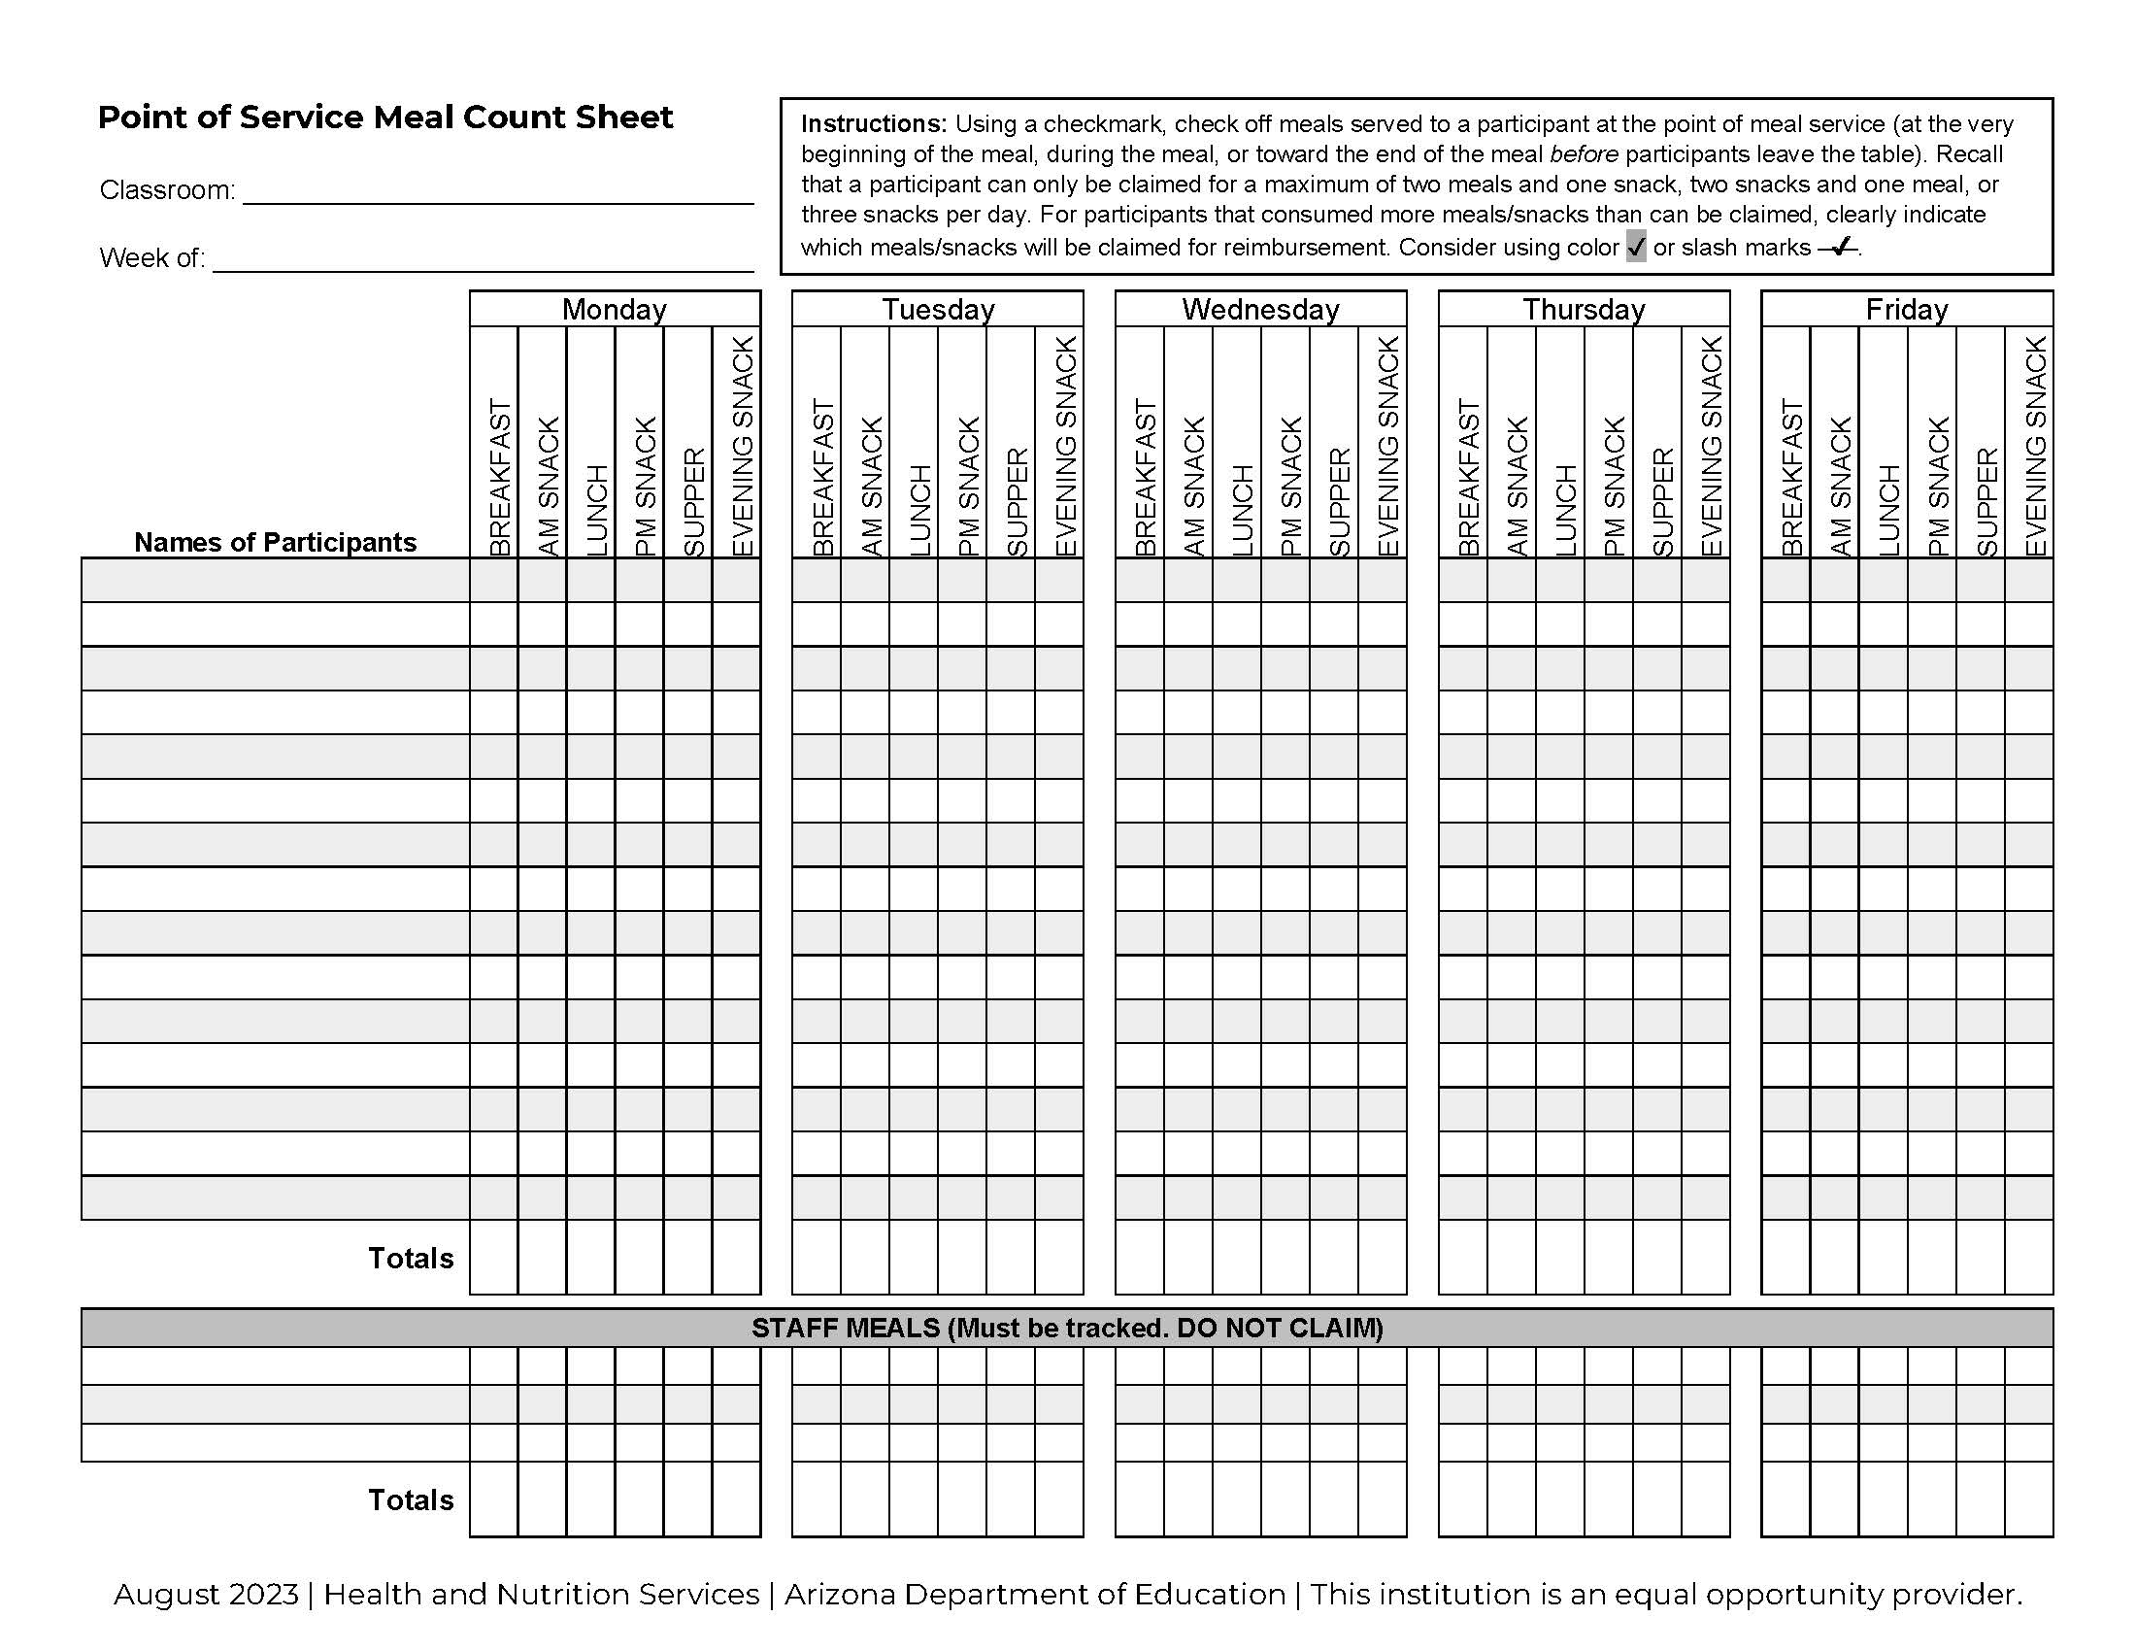
Meal Counts
  When do we complete meal counts?
At the beginning of the meal when participants are seated around the table
During the meal while participants are eating
Towards the end of the meal before participants leave the table.
Point of Service Meal Count Sheet
Notes:
<If you are an at-risk after school program, delete this slide. Child and adult centers, modify slide and script to better suit your practices.>
<Child and adult centers>We’ve just covered the meal service expectations, now let’s discuss one of those very important points, taking meal counts. We have to keep track of how many meals we’ve served each day. We do this by completing a POS meal count sheet (shown here). There is a weekly meal count sheet in each room with the names of the enrolled participants listed. Shown are the three times when you are able to take meal counts, however I would like you to take them at the beginning of the meal service when the participants are seated around the table. At the bottom of the page, please indicate how many teachers or staff ate each meal type.

Slide 32
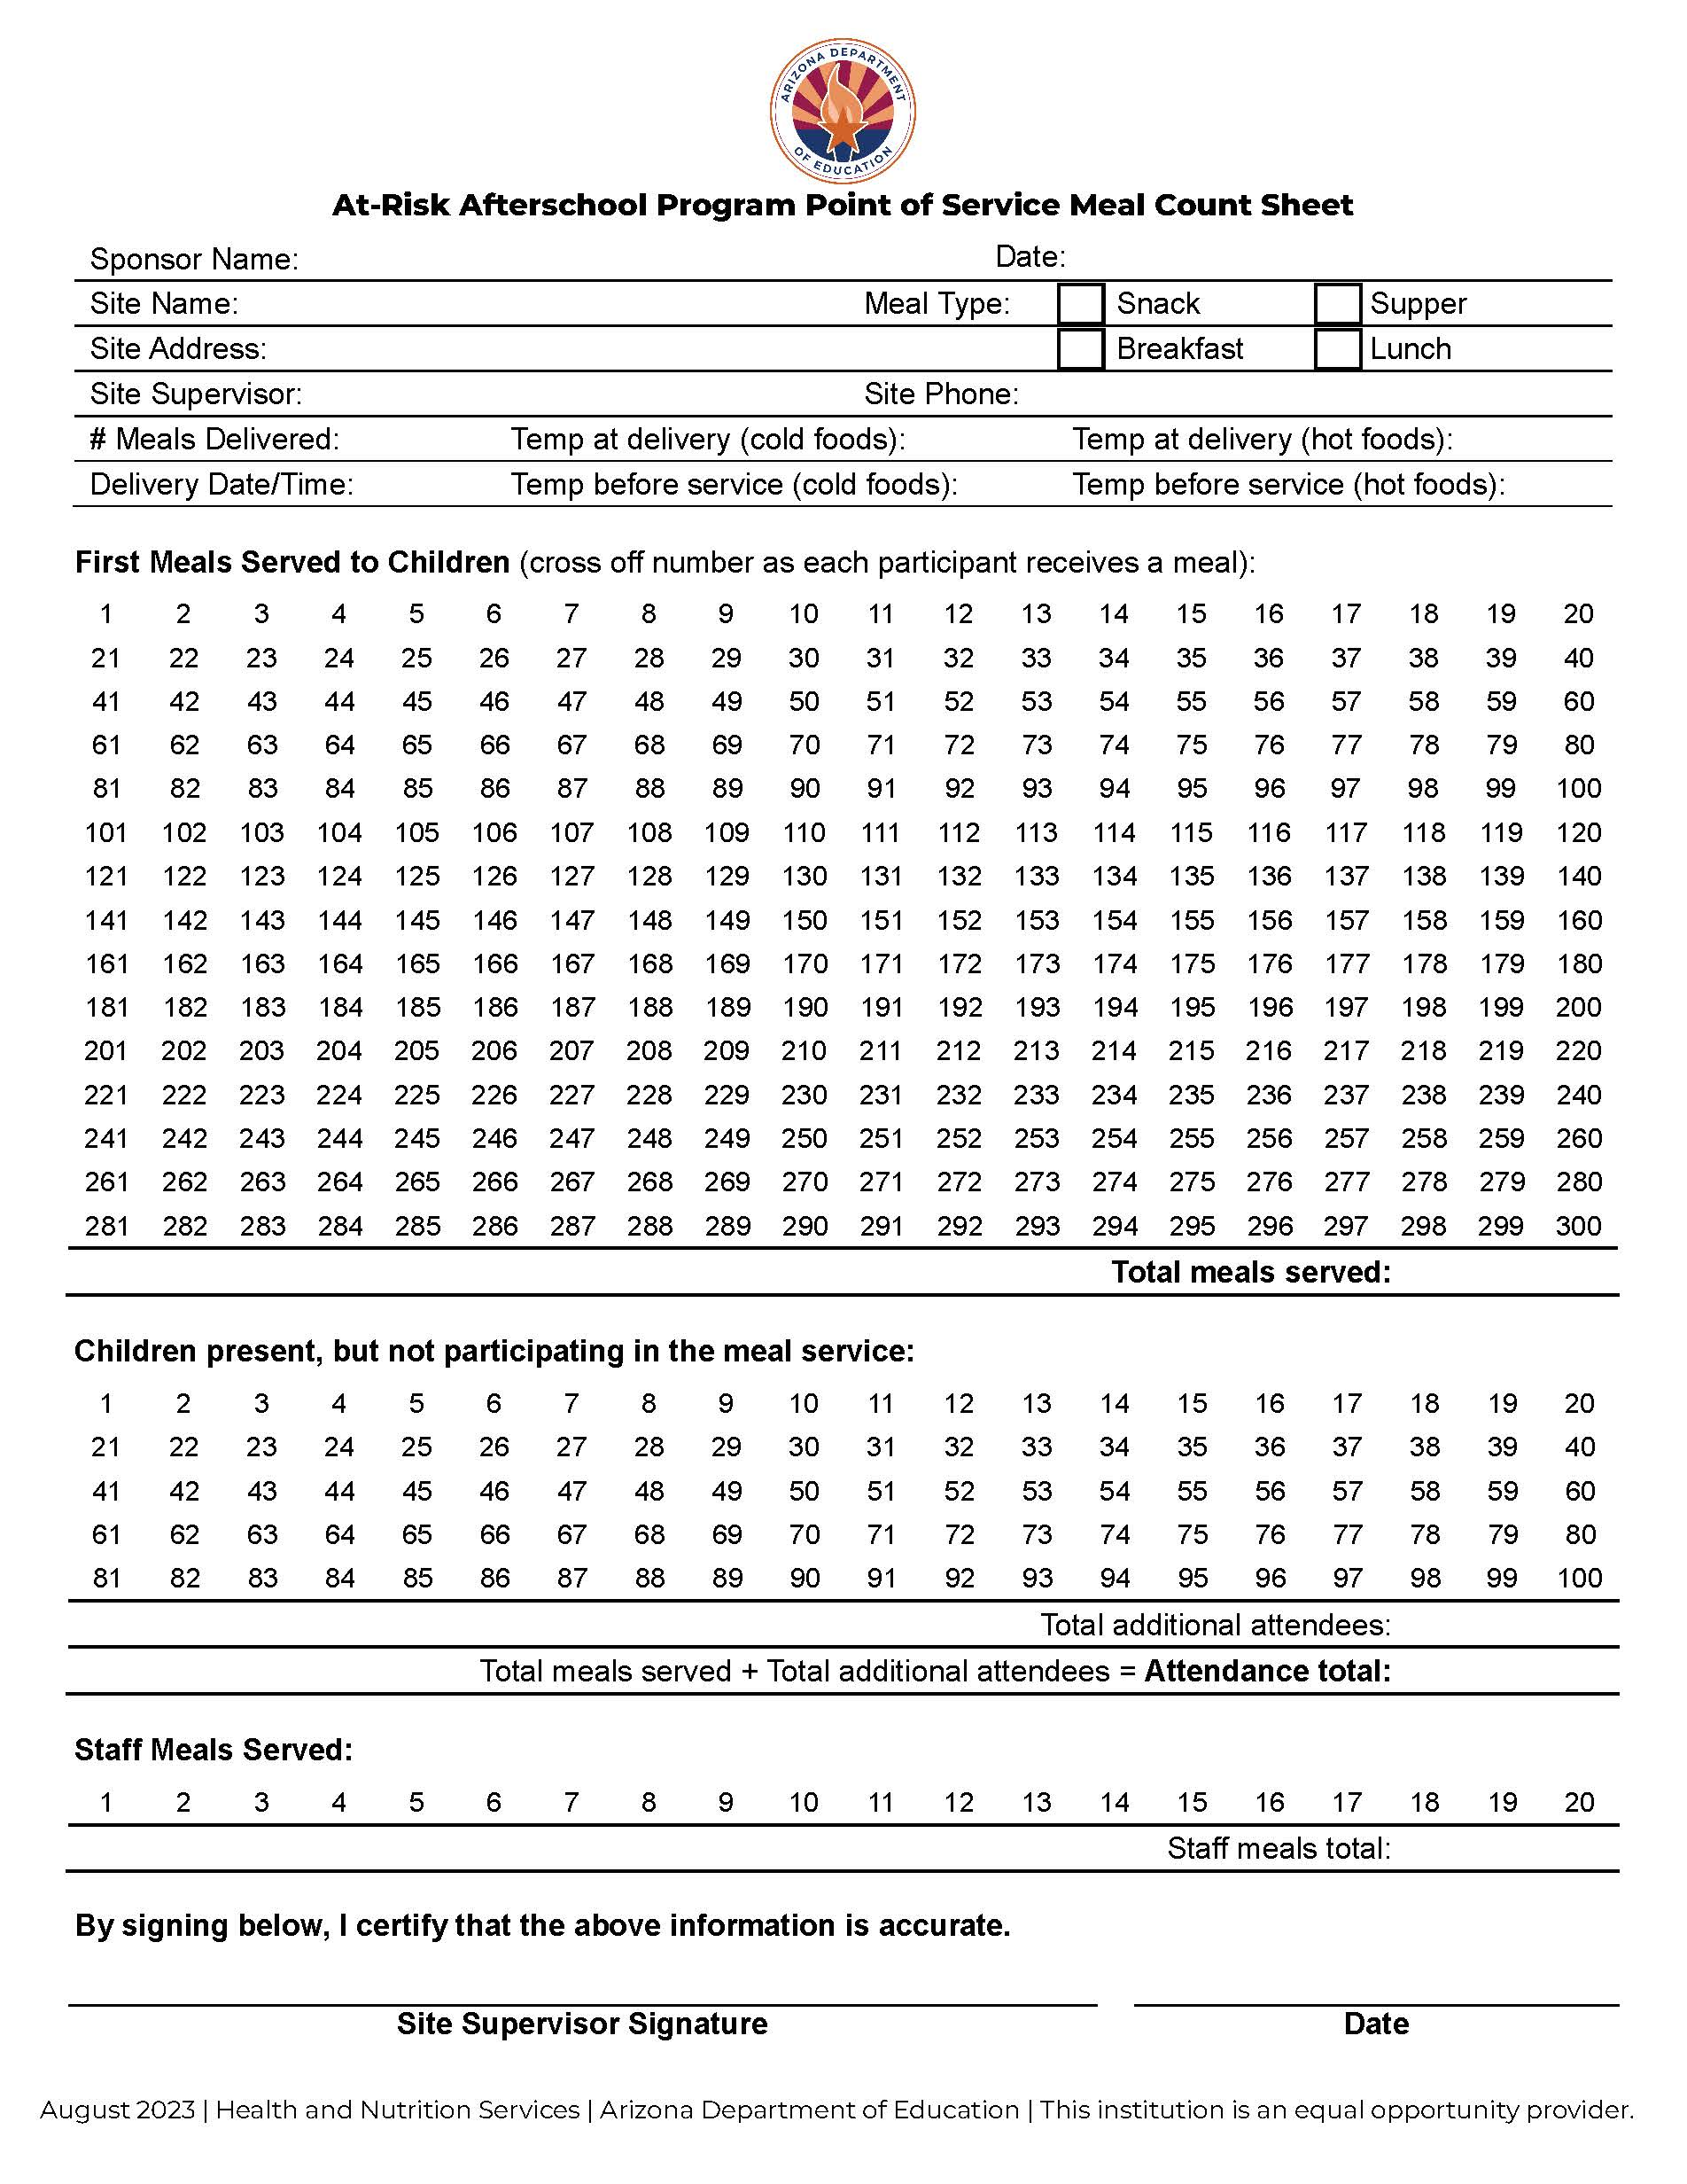
Meal Counts
  When do we complete meal counts?
At the beginning of the meal when participants are seated around the table
During the meal while participants are eating
Towards the end of the meal before participants leave the table.
Point of Service Meal Count Sheet
Notes:
<If you are a child care or adult center, delete this slide. If you are an at-risk center, modify the slide and script to better suit your practices.>
<At-risk afterschool institutions>We’ve just covered the meal service expectations, now let’s discuss one of those very important points, taking meal counts. We have to keep track of how many meals we’ve served each day. We do this by completing a POS meal count sheet (shown here). You will take the POS count when you hand out a reimbursable meal to each participant. Cross off the number 1 when you hand out the first meal. With the next meal, cross off the number 2 and so on. Please do not skip any numbers or just circle the final number. I’d also like you to indicate how many children are present, but did not participate in the meal service. Finally, be sure to indicate the number of staff who took a meal.

Slide 33
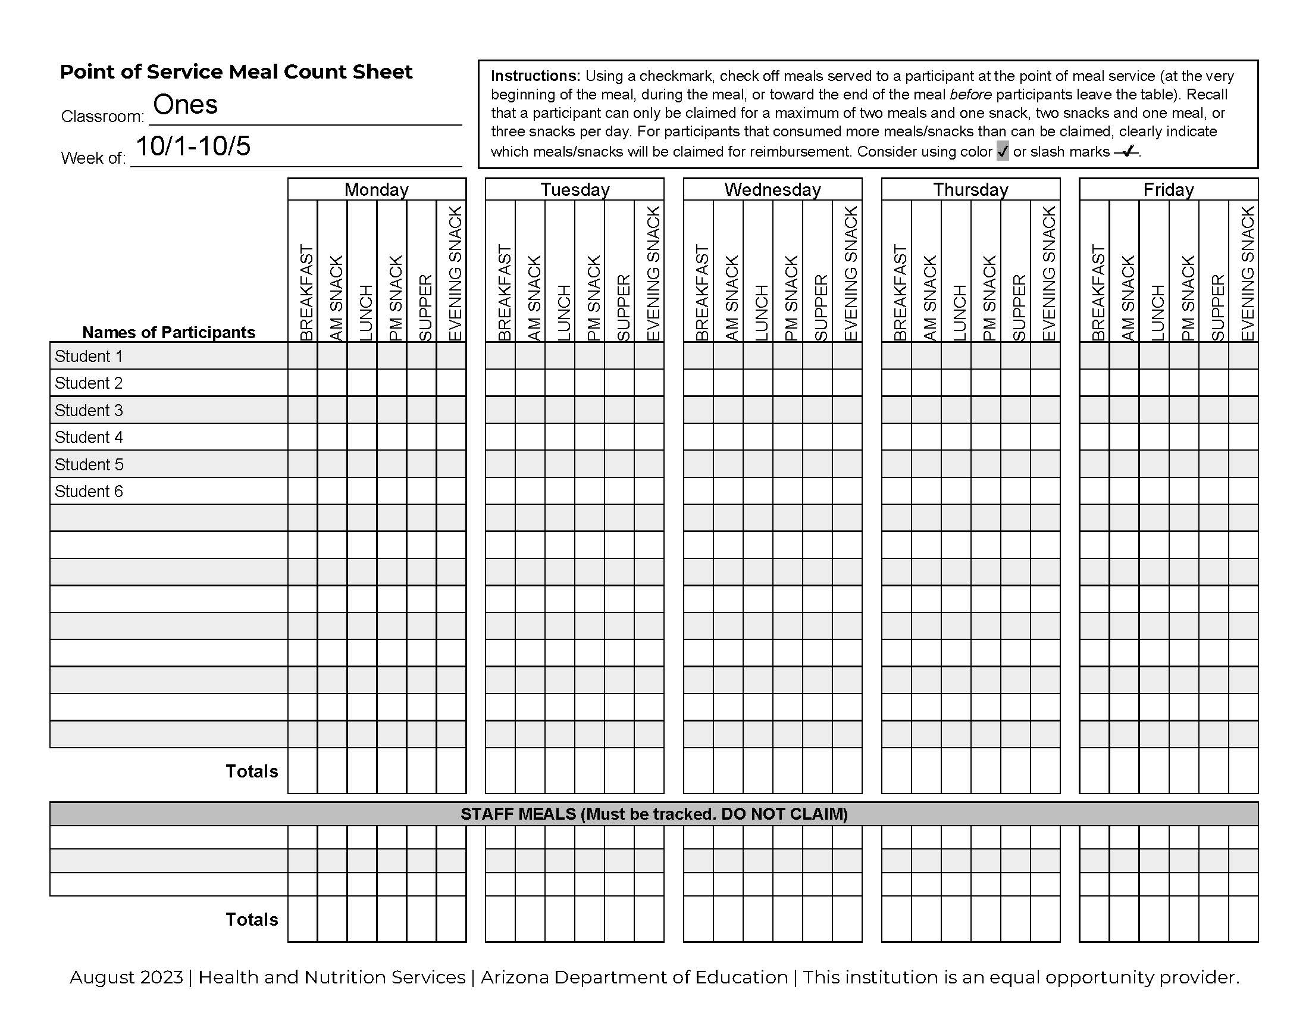

Meal Counts
How do we complete them?
Identify the participants who are offered a meal
Verify the following:
  During approved meal time
  Child came to the table
  Correct components and portions
3. Write a checkmark next to the participants names
3
3
4
3
2
1
Notes:
<At-risk- delete this slide.>
So how do we complete this form?
You will identify the participants who were offered a meal at the table during the meal time.
Please make sure that all of these requirements are being met before you add a checkmark next to the participant’s name:
The meal is served within the approved meal time,
The participant came to the table, and
All components were served together and in the correct portion
Remember that meal counts are not based on consumption. So, if you serve John his meal, but he chooses to not finish his apple, that meal can still be counted.
Once complete, these sheets will be turned in weekly to the front office.

Slide 34
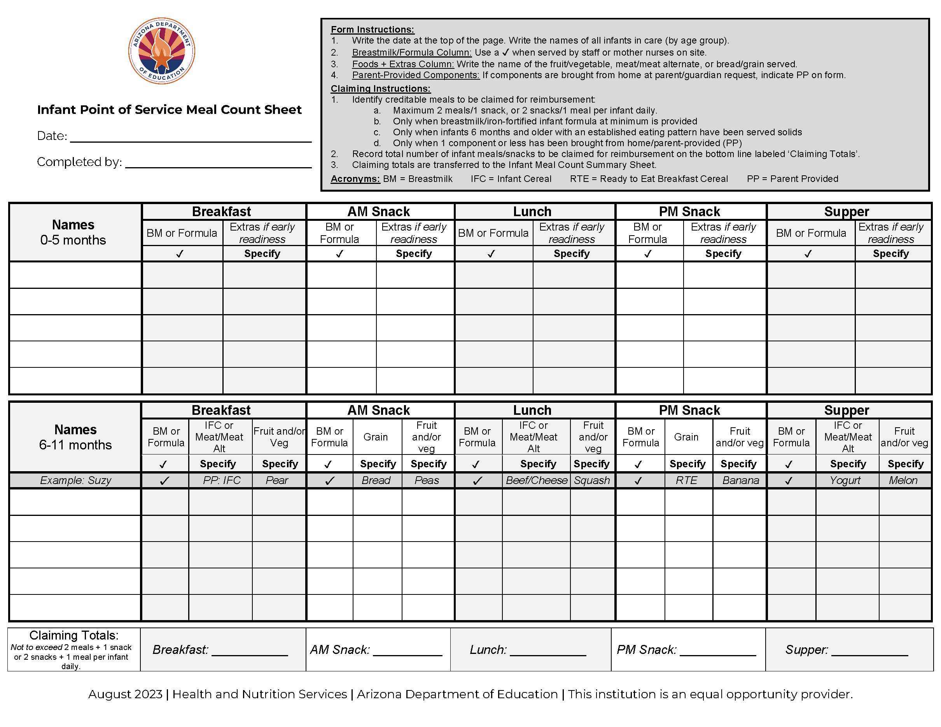
Infant Meal Counts
Notes:
<Possible to remove if you do not have infants in your care>
Infant room teachers, your counts look different. Unlike the weekly child POS meal count form, you have a daily infant POS meal count form in your classroom. All infants (under the age of one) will be listed on this form. This sheet allows you to check off each infant that has been served a meal, separating them into two age groups: 0-5 months and 6-11 months.

Slide 35
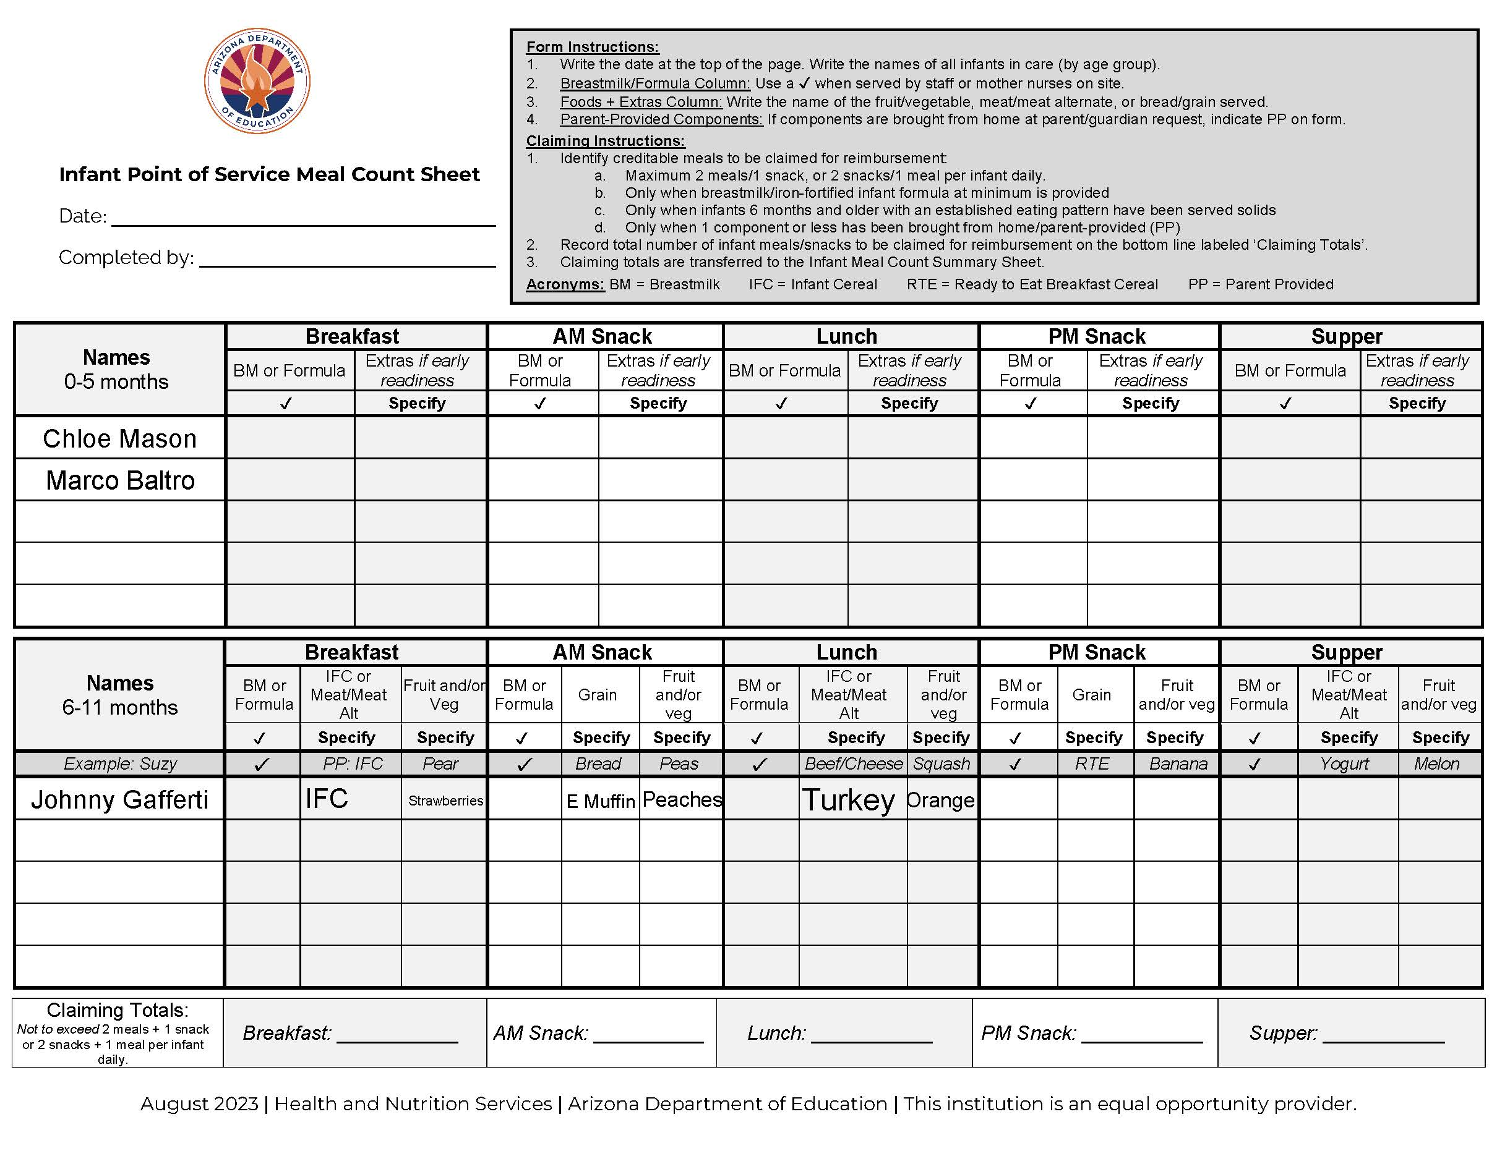
Infant Meal Counts
How do we complete Infant Meal Counts?
Formula or Breastmilk must be checked for all 0-11 month old infants.
Once an infant is developmentally ready for solids, record the specific kind of:
  fruit/vegetable
  meat/meat alternate
  bread/grain served
2
2
2
Notes:
<Possible to remove if you do not have infants in your care>
Since we have already covered the infant meal pattern and you know what to serve, let’s review how we document this.
Next to the infant’s name, use a checkmark to indicate when the infant was served formula or breastmilk. This is the only time that you are able to use a checkmark on this form. Remember, all infants must be served breastmilk or formula at every meal and snack.
For the infants who are receiving solids, the other boxes require specific foods be written down. For example, at breakfast you would write IFC for Iron Fortified Cereal and Strawberries in those two boxes.
For older infants who are mainly eating foods from the child menu, please make sure you’re meeting the infant meal pattern. For example, if you chose to feed a 10 month old a bagel for breakfast, make sure you also offer a Meat/MA because the infant meal pattern requires a Meat/Meat Alternate for breakfast, not a bread/grain.
Occasionally, we have one year-olds who are still in the infant classroom because they are not walking yet. The CACFP meal pattern is based on age, so once they turn one year old, their meals and snacks are recorded on a weekly child point of service form, not a daily infant form.

Slide 36


Partner Share
What did you learn about the meal service?
30 seconds ✔
Start
Notes:
Now that we are done discussing the meal service, take 30 seconds to take turns sharing information you learned about the meal service with your shoulder partner.
(Advance slide – 30 sec timer will appear)

Slide 37

Recordkeeping
If it’s not documented, it didn’t happen
Notes:
We have talked about what, when, and how we serve healthy meals and snacks. We also have to document that we do this. It is not enough to know we are in compliance – we must also SHOW we are in compliance!

Slide 38
Recordkeeping
Serve Meals
Document
Get Money $$
Spend Money $$
Document
Notes:
Our recordkeeping policies and procedures are how we document everything we do in the CACFP. First, we serve meals to enrolled participants. We document this, report it to ADE, and get money. Then, we spend this money on the food program, which again, is documented.

Slide 39
Recordkeeping
Serve Meals
Document
Get Money $$
Spend Money $$
Document
Notes:
<Child and adult centers> We have to document how many meals we serve and to whom we serve them. We do this using Point of Service meal counts, a meal count summary sheet, and enrollment information.
<At-risk institutions> We have to document how many meals we serve and to whom we serve them. We do this using Point of Service meal counts, a meal count summary sheet, and attendance information.

Slide 40

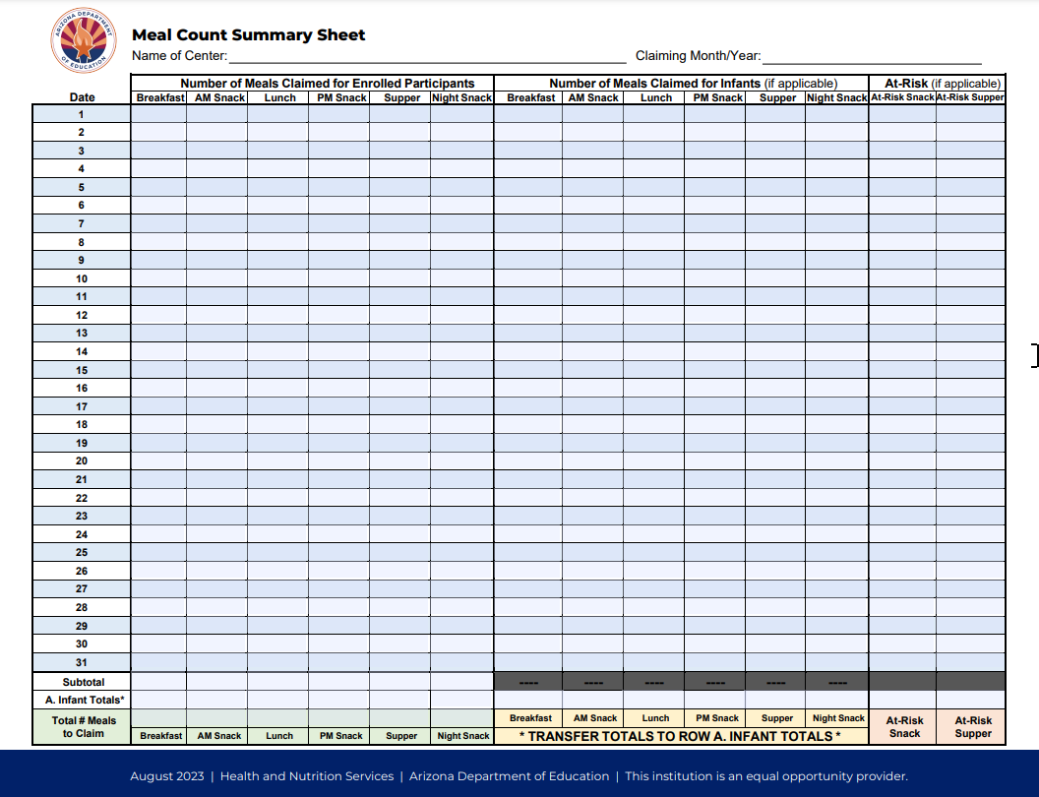
Recordkeeping: Supporting Meals Served
Meal Counts are totaled monthly based on the Point of Service Meal Count sheets completed in the classroom
Records used: Point of Service Meal Counts, Meal Count Summary
All the meals served are totaled and entered on ADE’s Meal Count Summary Sheets.
Point of Service Meal Count Sheets
Meal Count Summary Sheet
Notes:
<At-risk, delete this slide.>
<Child and adult centers> To document how many meals we serve, the assistant director and I total your point of service meal count sheets, write the total on the Meal Count Summary sheet and submit the total number of meals to ADE. Accuracy is extremely important, so to prevent errors, we always have two people involved in this process. One of you may be called in to assist if one of us is out of the office.

Slide 41
Recordkeeping: Supporting Meals Served
Meal Counts are totaled monthly based on the Point of Service Meal Count sheets completed in the classroom
Records used: Point of Service Meal Counts, Meal Count Summary
All the meals served are totaled and entered on ADE’s Meal Count Summary Sheets.
Point of Service Meal Count Sheets
Meal Count Summary Sheet
Notes:
<Child and adult centers, delete this slide.>
<At-risk institutions> To document how many meals we serve, the assistant director and I total your point of service meal count sheets, write the total on the Meal Count Summary sheet and submit the total number of meals to ADE. Accuracy is extremely important, so to prevent errors, we always have two people involved in this process. One of you may be called in to assist if one of us is out of the office.

Slide 42
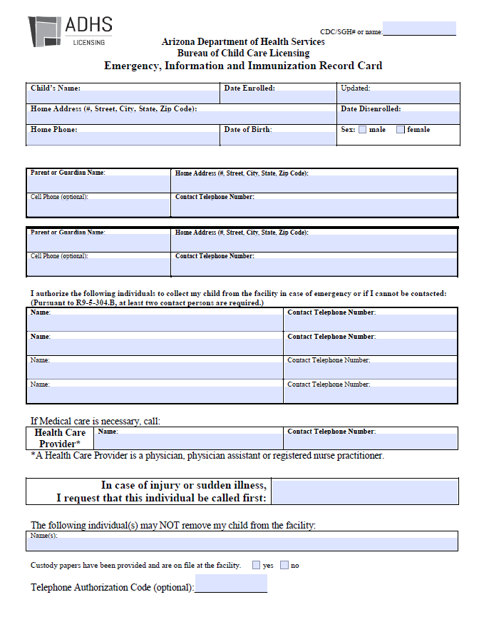
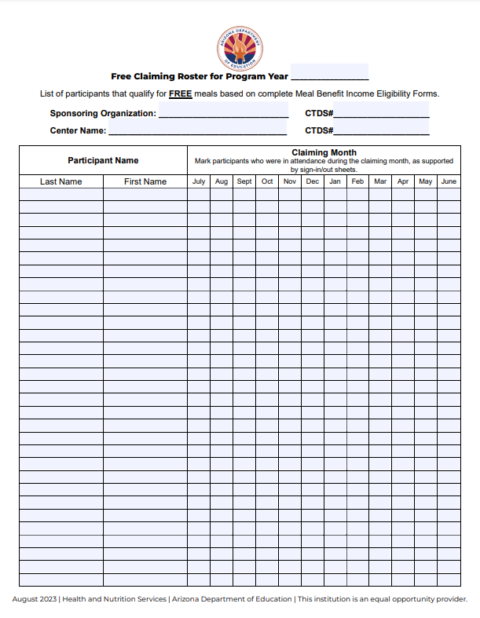
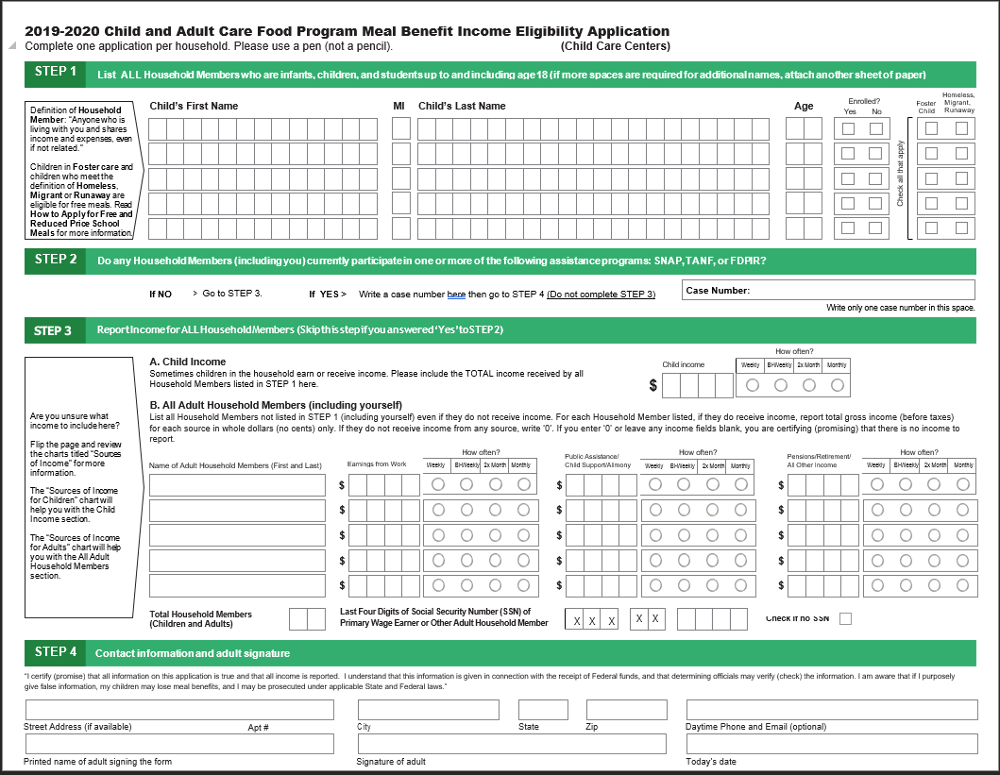
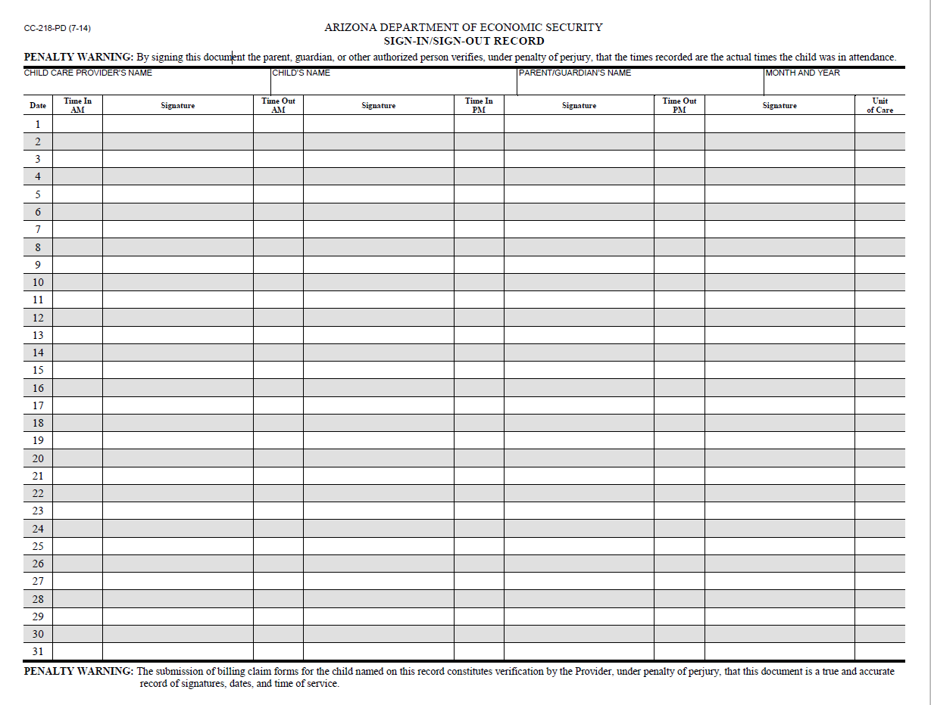
Recordkeeping: Enrollment
Emergency “Blue” Card
Claiming Roster
Sign-in/Sign-out
Meal Benefit Form
Notes:
<Head Starts: Meal Benefit Forms and Claiming Rosters do not apply. You must maintain a list of participants signed by a Head Start official establishing eligibility of all Head Start enrollees. You can replace any of the pictures with your own forms.
Emergency Shelters: Meal Benefit Forms and Claiming Rosters do not apply. You must maintain a list of names, dates of birth, and dates of residency for each participant claimed. You can replace any of the pictures with your own forms.
At-Risk: Delete this slide.>
<Child and adult centers> To document who we serve meals to, we use these four enrollment documents: Emergency “Blue” Cards, Meal Benefit Forms, Claiming Rosters, and Sign In/Out Sheets.
Emergency “Blue” Forms and Meal Benefit Forms are given to every household to complete when they first enroll and every June.
2. The assistant director and I create monthly CACFP claiming rosters from the meal benefit forms and sign-in and out records.
Teachers - you can help by reminding parents/ guardians to complete these forms.

Slide 43
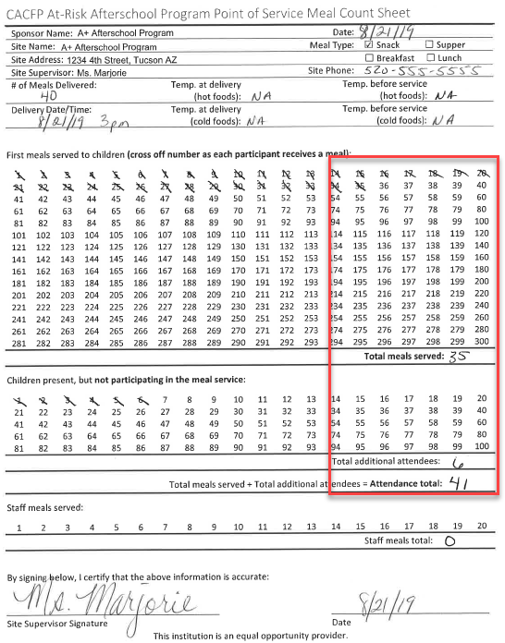
Recordkeeping: Attendance
Notes:
<Child care and adult centers, delete this slide.>
<At-Risk- some of you track attendance with sign-in sheets, some have attendance rosters in the classroom and others have no real way of tracking attendance so ADE has provided a basic way for you to indicate how many kids ate and how many were there, but didn’t eat to get a total attendance number. You can insert a picture of your attendance method on the slide>
USDA requires at-risk institutions to maintain daily attendance rosters or sign-in sheets. Here’s how we track attendance: <You’ll have to write this>

Slide 44
Recordkeeping
Serve Meals
Document
Get Money $$
Spend Money $$
Document
Notes:
I will now explain how those forms translate into receiving money.

Slide 45
CACFP Reimbursement
How does CACFP Reimbursement work?
  Meal Counts x Enrollment = $
  We can receive up to approximately:
    $2.00 for each breakfast
    $1.00 for each snack
    $3.50 for each lunch/supper
Notes:
The money, or reimbursement, we receive is based on our meals served and number of enrolled participants. Roughly speaking, USDA provides us up to almost $2 for each breakfast, almost $1 for each snack, and around $3.50 for each lunch and supper.

Slide 46

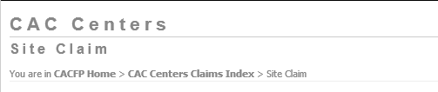
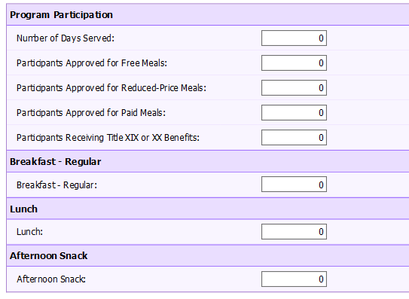

Recordkeeping: CACFP Claims
Claiming Roster
Meal Count Summary Sheet
Notes:
To receive money, I use the meal count summary and claiming rosters to submit our total meal counts and total number of participants in a report to ADE. This report is called a site claim and looks like this (point to screen)

Slide 47
Recordkeeping
Serve Meals
Document
Get Money $$
Spend Money $$
Document
Notes:
Each month I spend this money on the food service and document how we spent it. We have to spend all of the money that we receive on the food program and at least 50% on quality food purchases.

Slide 48
Spending CACFP Reimbursement
Time Distribution Reports
Food & Supply Receipts
Notes:
We keep a lot of records to show how we spend money, but there are two that are important to you. The first is the time distribution reports.

Slide 49
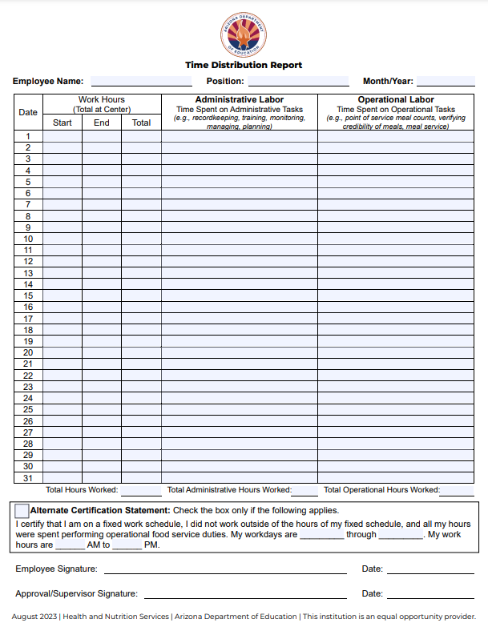
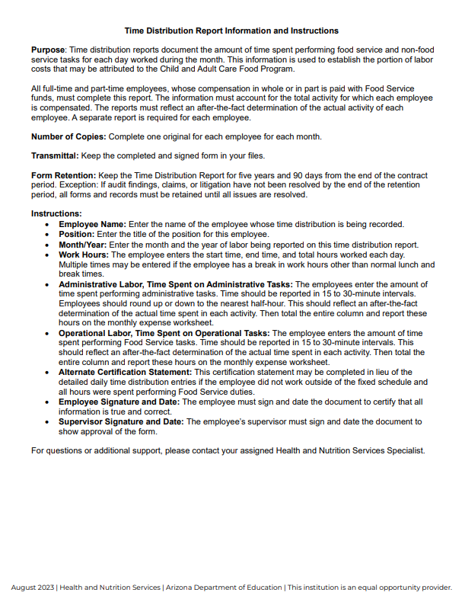
Time Distribution Reports
Cook/Kitchen Staff: Typically, whole day.
Purchasing Food
Preparing Meals
Serving Meals
Cleaning
Infant Room Teachers: Maximum of 2 hours per day.
Preparing infant foods
Feeding infants
Teachers: Maximum of 30 minutes per meal, 15 minutes per snack
Engaged in meal service
Page 2: Instructions
Page 1: Form
Notes:
<Review the content of this slide and template script to ensure it applies to your organization. If you do not include labor on your monthly claim, you may remove this slide. Adult day and at-risk, you’ll have to modify more of the script than others.>
Our cooks, infant teachers, and teachers complete time distribution reports daily. This form documents how much time you spent performing CACFP duties.
- Cooks, you track how much time you spent purchasing food, preparing meals, serving, and cleaning. This is usually your entire workday.
- Infant teachers, you track how much time you spent feeding infants, up to a maximum of 2 hour per day.
Teachers, I have new information for you. You are now able to track how much time you spent engaged in the family style meal service. This should be entire time that the participants are seated at the table for all meals and snacks.
Share with your shoulder partner what you think “engaged” in the meal service means?
I hope most of you came up with things like talking to the children about the food you’re eating, the colors of the food, and what you like about it. I want you and the children to enjoy the meal and this includes pleasant conversation surrounding the meal service.

Slide 50
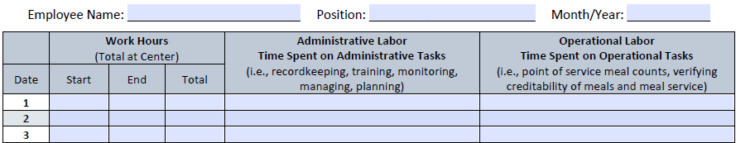

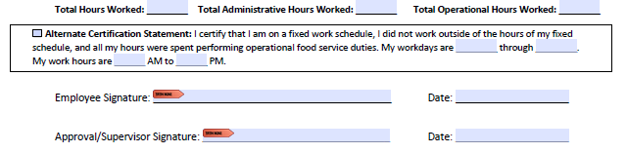
Time Distribution Reports
Time In
Time Out
Total hours worked daily
Daily hours spent performing CACFP duties – Administrative or Operational
Monthly Totals
Alternate Certification Statement – COOK ONLY
Sign and Date
Notes:
<Review the content of this slide and template script to ensure it applies to your organization. If you do not include labor on your monthly claim, you may remove this slide.>
To make sure we’re all on the same page, when you complete this form, you’ll first report the time you started and ended work, as well as your total work hours for the day. The next section is for administrative labor which is only completed by the assistant director and me. Teachers, the final column is where you will report the amount of TIME you spent performing operational labor in 15 minute increments. You are not reporting the activities you completed.
(Point to the alternate certification statement.) The cook is the only person who is able to complete the certification at the bottom instead of itemizing their daily time spent on CACFP duties.
At the end of the month, please sign the form and turn it into the front office by the 5th of the following month so I can approve it and calculate how much we spent on CACFP labor costs.

Slide 51



Food & Supply Receipts/Invoices
Insert who receipts should be given to.
Notes:
Any time you purchase CACFP food and supplies, I need the receipt. Please turn them into <insert who they should be giving receipts to> when you get back to the center.

Slide 52
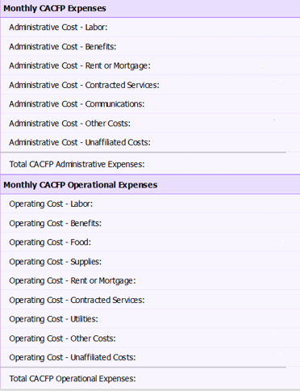
Recordkeeping: Claiming
Notes:
At the end of each month, I take all of our documented food program expenses, like our time distribution reports, receipts and invoices, and submit the total dollar amount in a report to ADE. This report is called the sponsor claim and is used to make sure we are on track with spending our CACFP money.

Slide 53
Recordkeeping Policy
CACFP Recordkeeping Policy
  Type of Records
  Location of Records
It is posted on the drawer in my office labeled “CACFP.”
Insert image of YOUR Recordkeeping Policy.
Input where the Recordkeeping Policy is stored/posted.
Notes:
<Update the content of this template script to reflect your organization’s process.>
We are required to keep multiple documents to support our CACFP operations. Our recordkeeping policy lists the type and location of our records. In the event you need to reference this policy, it is <Indicate location of recordkeeping policy i.e. posted on the CACFP drawer in my office>. Some of the records contain personal information and must be kept confidential. The location of the key is identified in the policy.

Slide 54

Compliance Reviews
Notes:
Alright, we’re half way there! I’m just kidding. We’re almost done!
Everything we do is for a reason, and all of our records are kept to validate our compliance in the CACFP. ADE comes to our center to review our records and operations. Reviews are important and beneficial to us all. They provide our center with useful tools, tips, and guidance for a successful CACFP. In addition, these reviews are required to help ensure and document that CACFP taxpayer dollars are being used appropriately so Congress will continue to fund the program.

Slide 55
Program Reviews
ADE/USDA/External Auditors
  Agencies must show employee photo ID
  During regular business hours
  Announced or Unannounced
  Minimum 1x every 3 years
Insert image of YOUR Recordkeeping Policy.
Reviewers will look at:
  Documents
  Public Postings
  Kitchen
  Meal Observation
  Infant Classroom Observation
Notes:
<Adult day and at-risk institutions, delete item “5. Infant classroom observation” on the slide.>
Reviews can be announced or unannounced and all reviewers should have employee photo ID. ADE reviews are required every three years; however, they can happen at any time.
When ADE comes out for review, I will be busy pulling CACFP records. I will let you know that they are here, but please continue to operate as usual.
If I am not on site, please find a space for the reviewer to sit and use the recordkeeping policy to locate the documentation they request. Don’t be surprised if they are here all day.

Slide 56
During the Review
Public Postings
  Menu
  DHS License
  Building for the Future
  And Justice for All
  Kitchen Permit
Kitchen
  Meal Preparation
  Food Inventory and Proper Storage
  Refrigerator and Freezer Temperature
  Cleanliness
  Food Safety
  County Sanitation Requirements
Notes:
<Modify slide and script to match requirements that apply to you. For example, if you are alternately approved, delete reference to the DHS license. If you use a vendor, you can delete the refrigerator and freezer temps.>
ADE will review required public postings such as menus, the DHS License, Building for the Future, And Justice for All poster, and our kitchen permit. Cooks, remember, if you made any changes to the menu, write it on the posted menu.
You’ll see them walking around the kitchen, opening up the refrigerator, and looking through our storage cabinets. They are looking at proper storage of our food inventory, general cleanliness, food safety and county sanitation requirements.

Slide 57
Meal Observation
All participants wash their hands with soap & water
Foods are served during the approved meal service time
Foods served matches the foods listed on the menu
All components are served at the same time
Correct portion is available for every participant
Point of service meal counts taken properly
Notes:
Director: ADE will review our entire meal service, beginning with handwashing.
The reviewer is looking to make sure we serve all required components in the minimum portion sizes for each age group. And will look to ensure you took your point of service meal counts and that they are accurate.
We understand there are days when it feels as if nothing is going as expected. The reviewers are not looking for perfection, they want to see that you are aware of and are able to resolve a situation when it arises. You can resolve issues in the moment, as you usually do. If a component does not come to your classroom, call the kitchen and ask for it.

Slide 58
Infant Classroom Observation
Infant Feeding Practices
Center-provided formula and foods
Documentation:
- Infant Point of Service Meal Counts
- Caregiver Communication of Solid Foods
Notes:
<Possible to remove if infants are not currently in your care.>
ADE also wants to make sure we are feeding infants appropriately. This means they want to see you interacting with the babies when they are awake, feeding babies when they are hungry, and safely preparing, handling and storing infant formula and breastmilk.
The reviewer will also be looking at what formula and infant cereal we provide, as well as texture appropriate foods for our older infants.
They will ask to look at the infant point of service meal count sheets and your form that shows communication with each parent about their baby’s readiness for solid foods. You can tell them that both of these forms are on the infant’s clipboards.

Slide 59
Results of the Review
3 Results:
  No Findings = No Corrective Action
  Findings = Required Corrective Action
  Findings + Fiscal Action = Required Corrective Action and we pay back $$
How is staff affected?
Notes:
Reviews provide us with guidance to help improve our program and highlight the great things we are doing. We will receive a letter from ADE after the review letting us know the result. Of course we aim to have no findings which means we won’t have any corrective action and we won’t owe ADE any money, but there’s always a chance they will identify areas in need of improvement and/or they may disallow meals which will result in us having to pay back money.
If our corrective action requires we fix something that impacts your day to day tasks, I will provide training on the new procedures. We are expected to implement corrections immediately and I appreciate your cooperation in this.
If we are doing something incorrectly or we are missing documentation, we may have fiscal action and have to pay back funds. This is why accurate documentation is so important.
How are you affected?
We need to ensure any new procedure is implemented and permanently followed. If we don’t maintain the new procedures and the same findings are identified during the next review, it can result in losing our CACFP program.

Slide 60

THANK YOU!
Notes:
This concludes your annual CACFP training. I appreciate all you do to help us maintain Program compliance. Let’s continue feeding our participants nutritious and delicious meals with CACFP funds while maintaining all of the necessary documentation we need to have a great review every time! Thank you!

Slide 61
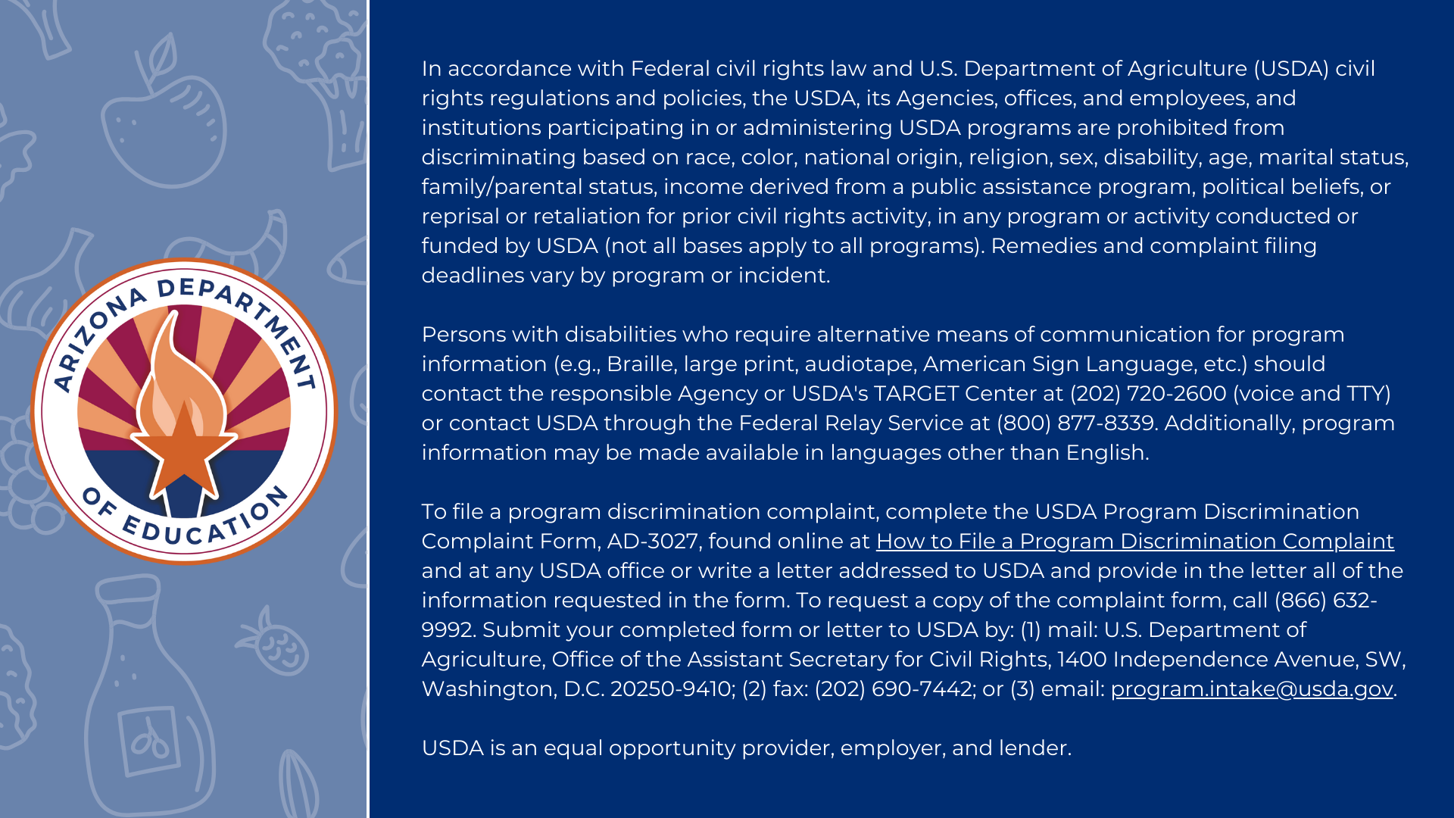
Notes:
Non-discrimination statement

