Slide 1
Academic Instruction for Students with Significant Cognitive Disabilities
June
2019
Bethany Zimmerman
Director of Alternate Assessment

Slide 2
Outcomes

Slide 3
Norms
High Expectations
Focus on what students can do
Avoid “They can’t” statements
Maintain student confidentiality

Slide 4
How to teach State Standards to Students Who Take the Alt. Assessment
By Diane Browder, Shawnee Wakeman, and Claudia Flowers
https://cms.azed.gov/home/GetDocumentFile?id=5866dbe1aadebe085c4de5b4
See excerpt

Slide 5
LASSI and MASSI
https://wiki.ncscpartners.org/index.php/Language_Arts_Sample_Systematic_Instruction_Script_(LASSIS):_Elementary_Vocabulary_and_Acquisition
https://wiki.ncscpartners.org/index.php/Elementary_Data_Analysis_MASSI

Slide 6
Tara’s Skills
Has social skills and observable communication
Enjoys stories, can recall
Makes simple sets

Slide 7
Tara’s Instruction
ELA
High interest story
Object representation
Adapted text
Functional Skills: making a choice, following directions
LASSI incorporates functional reading
Mathematics
Data sets (graphs)
Uses concrete objects
Concurrent with one-to-one correspondence
Functional Skills: following directions, counting, number recognition

Slide 8
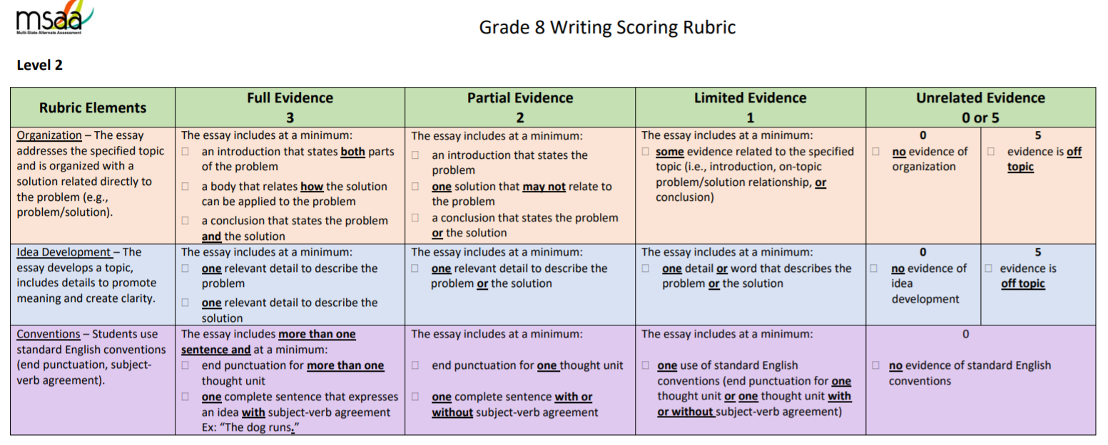
Example
Actual MSAA Scoring Rubric
Standards: 8.WI.o1 (Core Content Connector)
8.W.4 (Arizona English Language Arts Standard)

Slide 9
Writing
What accommodations would you use with a student who cannot physically write?
What focus on in the rubric would help your student get the highest score on the test?
How can you incorporate functional writing skills into instructional activities for this standard?
What resources can you use to teach these writing skills?
https://wiki.ncscpartners.org/index.php/Curriculum_Resource_Guide:_Writing

Slide 10
Response
Level 2 writing prompts have sentence starters.
Directions walk the student through the writing process.
Response could receive a score of 2, 2, 2 with a total of 7 words and one period.
Hole shoes
Buy red shoes.
Need shoes

Slide 11
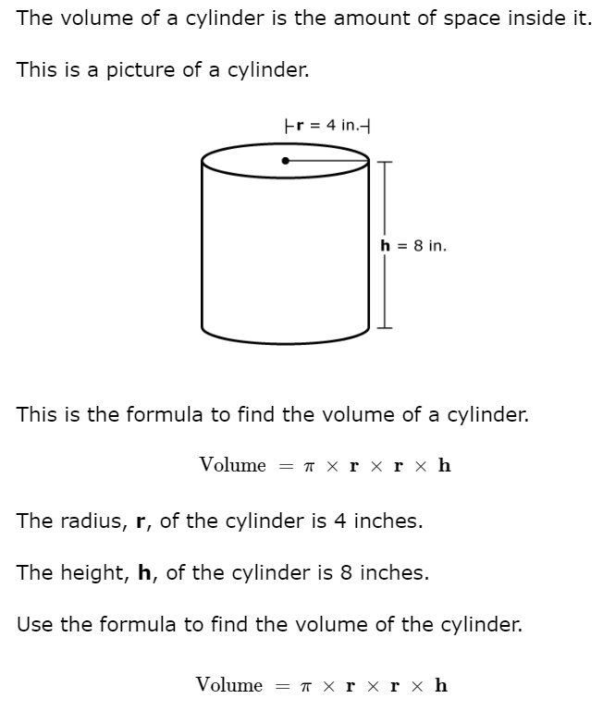
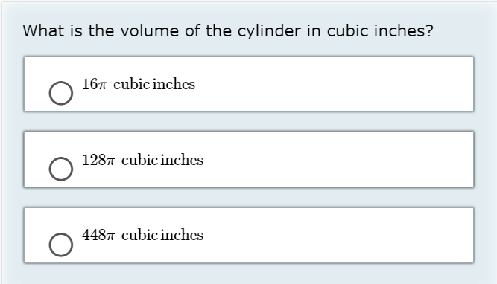
Math Sample
8.ME.2d2 (Core Content Connector)
8.C.G.9 (Arizona Mathematics Standard)

Slide 12
Math
What accommodations would you use?
What would be the content focus?
How can you incorporate functional math skills into instructional activities for this standard?
What resources can you use to teach these math skills?
https://wiki.ncscpartners.org/index.php/Curriculum_Resource_Guide:_Measurement_and_Geometry

Slide 13
Your Turn
Think about how you would design a lesson for ELA standard 8.RI.8.
Delineate and evaluate the argument and specific claims in a text, assessing whether the reasoning is sound and the evidence is relevant and sufficient; recognize when irrelevant evidence is introduced.
Core Content Connector:
8.RI.k4 Identify an argument or claim that the author makes.
https://wiki.ncscpartners.org/index.php/English_Language_Arts_Sample_Systematic_Instruction_Script:_Middle_School_Informational_Text

Slide 14
Reflection
What did you learn?
What can you apply to your instruction?
Did you find yourself limiting the student’s exposure to content standards or potential?
What difficulties did you experience?

Slide 15
Feedback
Please take the survey!

Slide 16
Thank You!
Bethany Zimmerman

