Slide 1



Notes:
Dustin: The Arts Advisory & Action Committee or A3C is an advocacy initiative created by the Arizona Department of Education (ADE). Having numerous iterations over the years, the current A3C convening is centered on gathering arts education stakeholders together in a shared space allowing ADE to better engage with the supporting of the needs and challenges of this specialized group of educators. ADE is committed to logistically scheduling, communicating meeting times and agendas to constituents, and securing meeting locations.
To receive the most comprehensive feedback possible, ADE’s Arts Education Specialist, along with a representative from the Arizona Commission on the Arts (ACA), will tour the state and engage stakeholders within their communities as we have identified that only certain members can meet at a centrally located venue.
This work is important for the field of Arts Education. Gathering a diverse perspective of needs from across the state allows for an informed and equitable response that is reflective of each individual region.
Supporting this initiative by providing additional leadership and analysis of gathered A3C data, is a new group: “Round Table Advisory Committee” or RTAC. Consisting of Arts Education Leaders from the various Professional Arts Education Support Agencies, (representing each artistic discipline) RTAC members will meet quarterly to process and respond to the needs gathered through the A3C process.

Slide 2
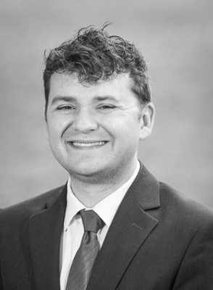

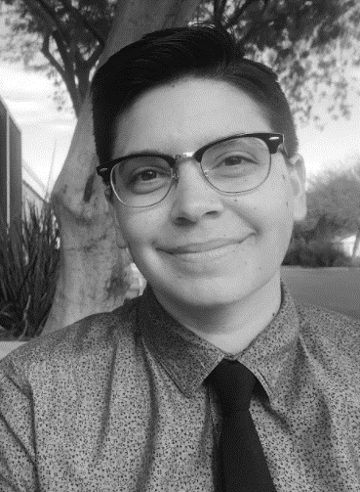


Dustin Loehr
Director of Arts Education & Title IV-A
Arizona Department of Education
Anastasia Freyermuth
Arts Learning and Evaluation Coordinator
Arizona Commission on the Arts
Elisa Radcliffe
Arts Learning Manager
Arizona Commission on the Arts
Notes:
All: Introductions….

Slide 3


Community Conversation: Arts Education in Arizona
Winter Regional Tour
Flagstaff
Prescott
Yuma
Tucson
Globe
Coolidge
Scottsdale
94 Participants
Notes:
Dustin: What Arts Education Challenges are present in your community?
We began this work with an initial meeting in our Central Region in August. There, we asked participants to collectively explore challenges that relate to their work in and around Arts Education. The results of this initial meeting encouraged us to ask similar questions across the state.
Anastasia: Who’s doing the work?
This past winter, we visited 7 communities: Flagstaff, Prescott, Yuma, Tucson, Globe, Coolidge, and Scottsdale. These communities were selected in order to offer a geographically dispersed perspective in our efforts to better understand what challenges existed for arts education throughout the state. In addition to this, we wanted to ensure that the perspectives from a spectrum of the individuals and stakeholders who make arts education happen in these communities was also offered. After visiting Flagstaff and Prescott, we realized that a more intentional call needed to be placed to welcome a spectrum of voices at these convenings. In this updated call, we encouraged students, teachers, teaching artists, community arts workers, administrators, parents, and policymakers to attend. We wanted to hear their insights, questions, and concerns in order to more fully comprehend the challenges to arts education for their community, but also allow us to learn more about the opportunities that may already exist within these communities related to arts education.

Slide 4

Winter Tour
Overview of Title IV-A Program
Notes:
Dustin:
Also during our first meetings, we spent a portion of time discussing Education Policy updates with ESSA including the new funding source Title IV-A or the Student Support & Academic Enrichment Grants. Since this time, Title IV-A has been increased from a national allocation of $400 million to $1.1 Billion. While still not the full appropriation, this increase should be celebrated as it serves as the single largest increase for well-rounded and Arts Education in a VERY long time. In response to this increase, the importance well-rounded education programs are for our students, ADE has created a new Title IV-A Program Area which will consist of an interdisciplinary team of content experts representing the various aspects of Title IV-A approved activities. I am VERY excited to share that I have been selected to lead this team as ADE’s Director of Arts Education & Title IV-A.

Slide 5
Winter Tour
Snapshot of Needs
School
Sector
Community Sector
Governmental Sector
Notes:
Anastasia: We found early on in the planning for the first tour that there were three sectors we needed to pay particular attention to: School, Community, and Governmental. In addition to learning more about the general challenges each community experienced as it related to arts education, we wanted to ensure that these convenings be a time where participants could collectively brainstorm the specific needs required in each of these three sectors.
To do this, participants were asked to rotate between each of these three sectors, identifying arts education needs within each sector. Participants were then asked to identify the top needs within each sector. The information we collected through this exercise informed the content for our follow up spring tour which I will speak about in more detail later on in this webinar.
The other driving purpose for this exercise was to inspire arts education stakeholders to be better equipped to self-advocate for themselves and their students as well as to see how these sectors are interconnected. Through this exercise we wanted to show the importance that advocacy efforts span all three of these sectors.

Slide 6

Community Conversation: Arts Education in Arizona
Spring Regional Tour
Yuma
Flagstaff
Prescott
South Tucson
Tucson
West Valley
East Valley
Globe / Miami
Coolidge
Phoenix
141 Participants
Notes:
Elisa: This spring, we continued our conversations about arts education in Arizona schools. We visited ten communities including Yuma, Flagstaff, Prescott, South Tucson, Tucson, Peoria, Gilbert, Globe, Coolidge and Phoenix. We engaged with students, teachers, teaching artists, administrators, parents and policy makers and learned about the challenges and opportunities they see for arts education in their community’s schools.

Slide 7
Spring Tour Questions
How can we develop an understanding and value of arts education from decision makers?
How can we increase access to arts programming geographically, across social-economic levels, for all abilities, and communities?
How do we close the gap between policy and practice in arts education?
Notes:
Anastasia: As mentioned earlier, this tour was a follow-up to the one that we conducted last winter. At the winter convenings, we asked participants to write down and provide what they saw as challenges and needs for the field of arts education within the three main sectors of the arts educational landscape (school, community, and political- or policy). We then took this feedback that was provided and synthesized these challenges into three region specific questions that were presented to these same communities in our return visit. Participants during our return visit were asked to vote on which of the three questions they wanted to speak to and from there we participated in guided discussion that would lead to specific action steps around the question we were discussing. Interestingly enough, we found many of the communities we visited wanting to discuss and focus on three questions in particular:
“How can we develop an understanding and value of arts education from decision makers (Policy Makers, Governing Board, District Administrators, Site Administrator, etc.)?”
“How can we work to increase access to arts programming geographically, across socio-economic levels, for all abilities and communities?”
“How do we close the gap between policy and practice in arts education?

Slide 8


Action Steps
To research more about education policy and learn how to speak educator language.
Survey parents concerning what they value in the arts and our public schools.
Research funding streams for arts ed in schools.
Have my students exhibit their art at a local event in our community.
Contact state legislators.
Notes:
Elisa: At the end of convening we asked the participants to create Action Steps. These were attainable steps that they could take to advocate for arts education in their communities. Some solutions and strategies that were discussed during our group meetings have spanned from developing a pan arts discipline community grown coalition, to establishing youth arts councils, to seeing a need for more parent engagement within the arts and arts education specific events.

Slide 9
Action Steps
Listserv
Vlog
Summative Report
Infographic
Notes:
Dustin: Discuss Vlog and Summative Report.
Anastasia: Listerv
Elisa: Infographic
Dustin: Discuss Vlog and Summative Report.
As a team, we also created Action Steps. Our Action Steps are based on the ideas that were shared in all of the A3C conversations.
Listsev – Many participants we heard from said they wanted to keep the conversation going somehow. To do this, we will be developing a listerv comprising of those who attended the A3C convenings as well as an ongoing rotation for new members. The purpose of this listerv will be to offer a platform where communities throughout the state can come together and share questions, concerns, and successes related to their work in arts education. In addition to this, we see this listerv as an opportunity for our agencies to share out relevant and current information about arts education. Participation in this listerv will be completely voluntary and members can unsubscribe at any time.
Vlog- In an attempt to reach as many A3C Participants and communities as possible, we are committed to hosting a monthly vlog that will share updated Arts Education updates, calls to action, tips and tricks, and serve as a regular digital check in.
Infographic – We heard from many participants that clear data and information to present to decision makers would be a helpful tool. Using updated information for the Arts Education Data Project for the 2015/16 School Year, we will be creating an infographic for teachers, parents and students to use in conversations with principals, district administrators and decision makers.
Report- Located on the A3C Portal, you can find our Summative Report of this year’s convenings. A mixture of qualitative and quantitative data, the report is intended to paint the picture of Arts Education throughout the state of Arizona, directly from the community who works within the field each day. Highlights from the report include: a one-page summery of findings, detailed project overview, a snapshot of community identified needs, and a thematic representation of advocacy points to consider. We also share state level action steps and the entire document has been vetted and approved by our Round Table Advisory Committee on Arts Education.
The report by the numbers include:
18 Regional and in-person convenings
276 participants from across the state
Several communicated Action Steps by community members
And a commitment from both state agencies to continue A3C partnership work into next year.

Slide 10
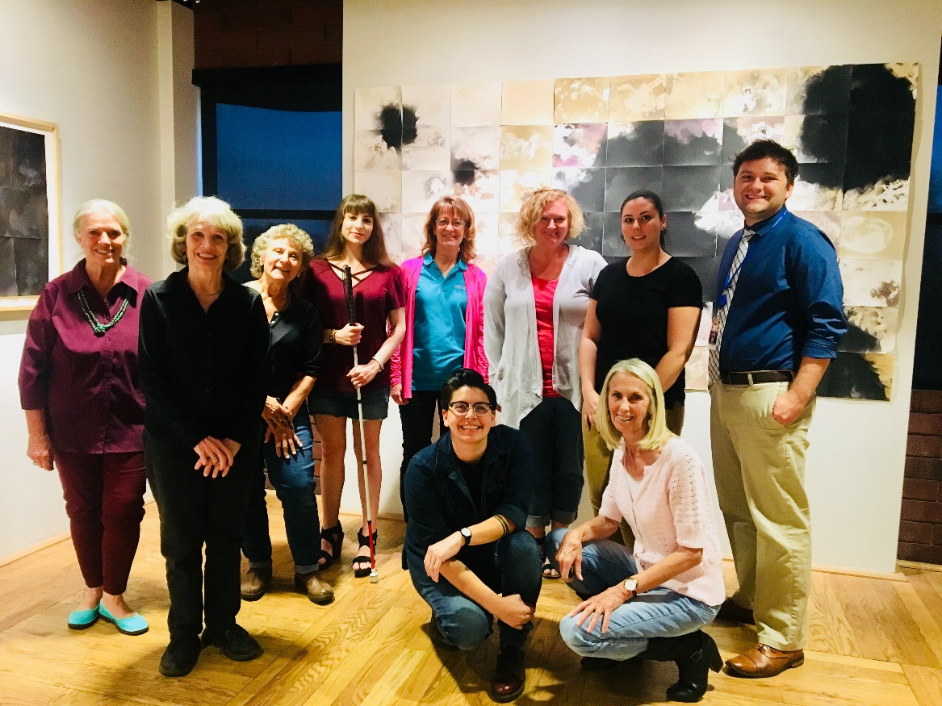
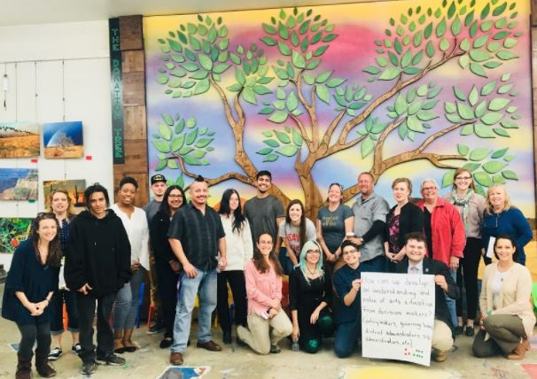
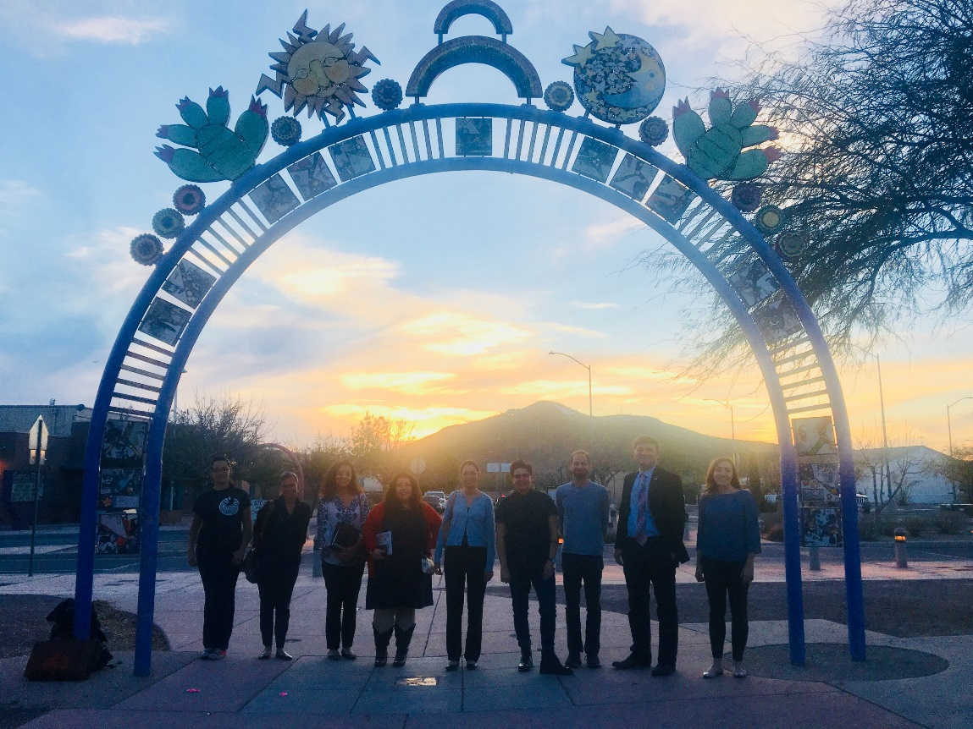
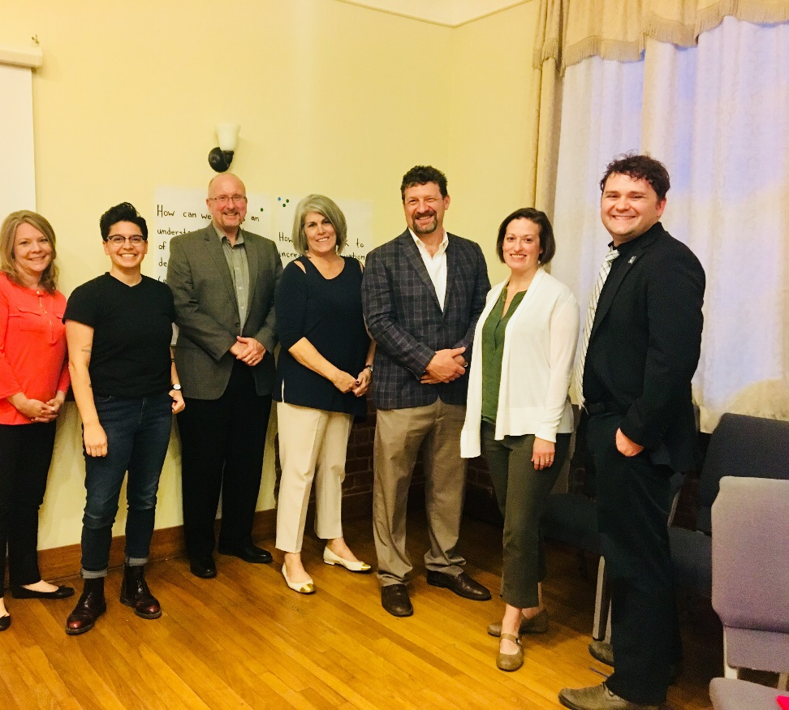
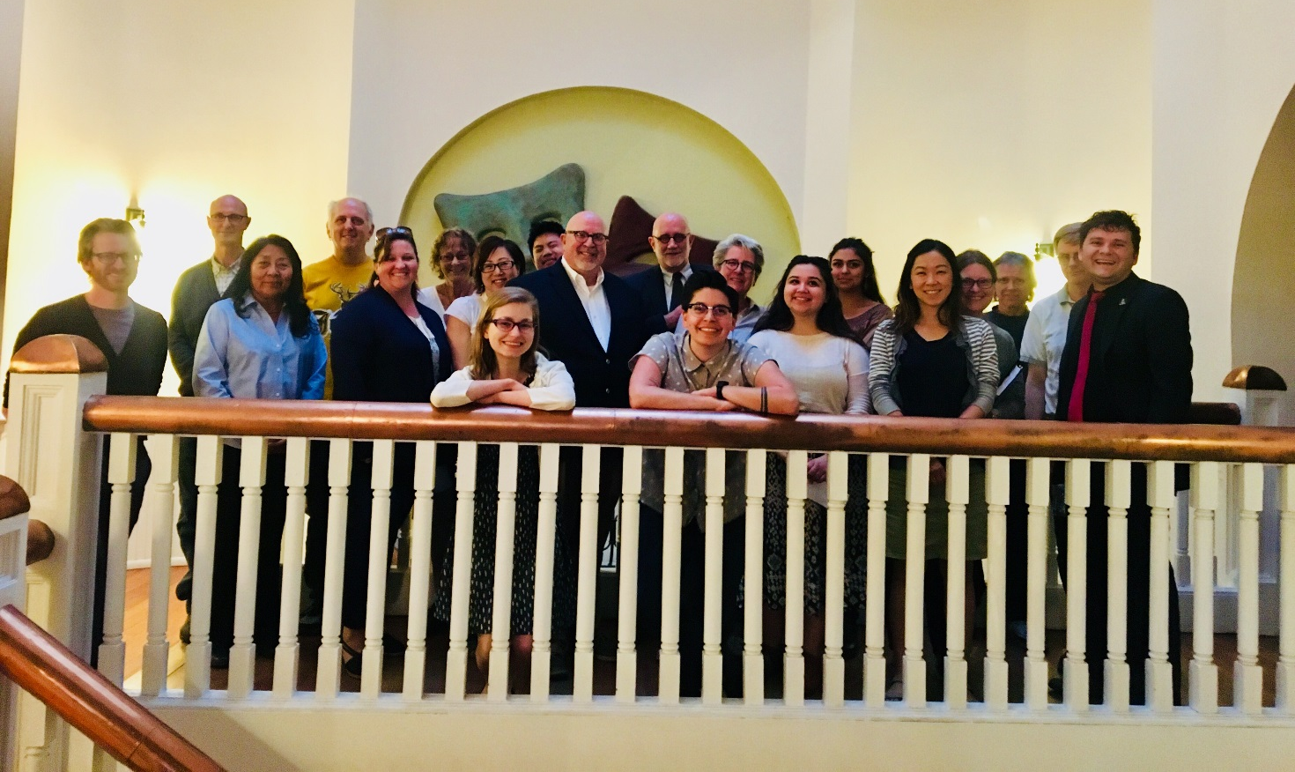
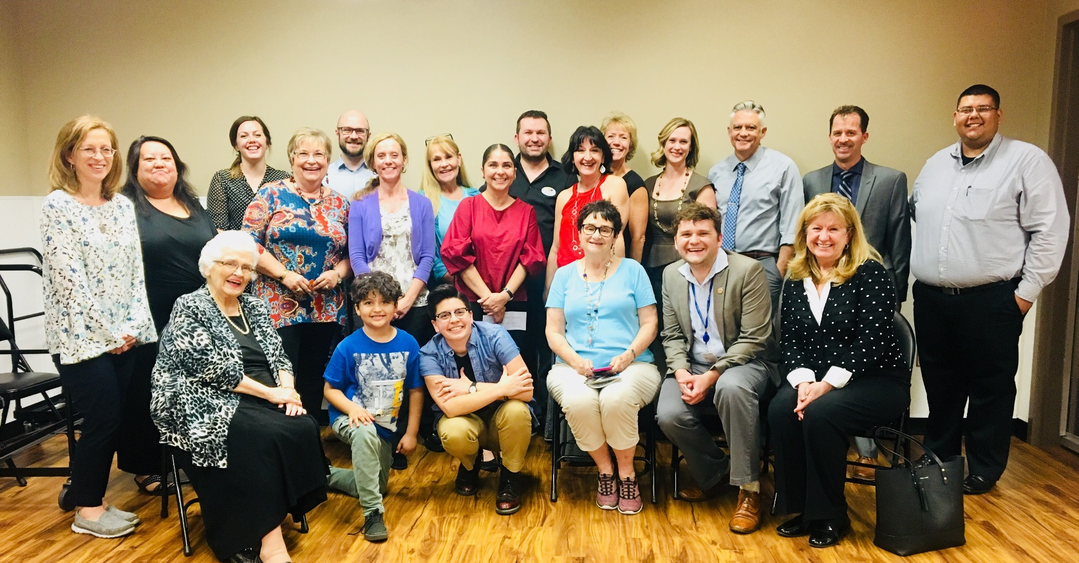
Notes:
Thank you!

