Slide 1
Evidence-Based Practices (EBP) Walkthroughs
Tool and Process

Slide 2
Overview
Tool and Process

Slide 3
Learning Walks

Slide 4
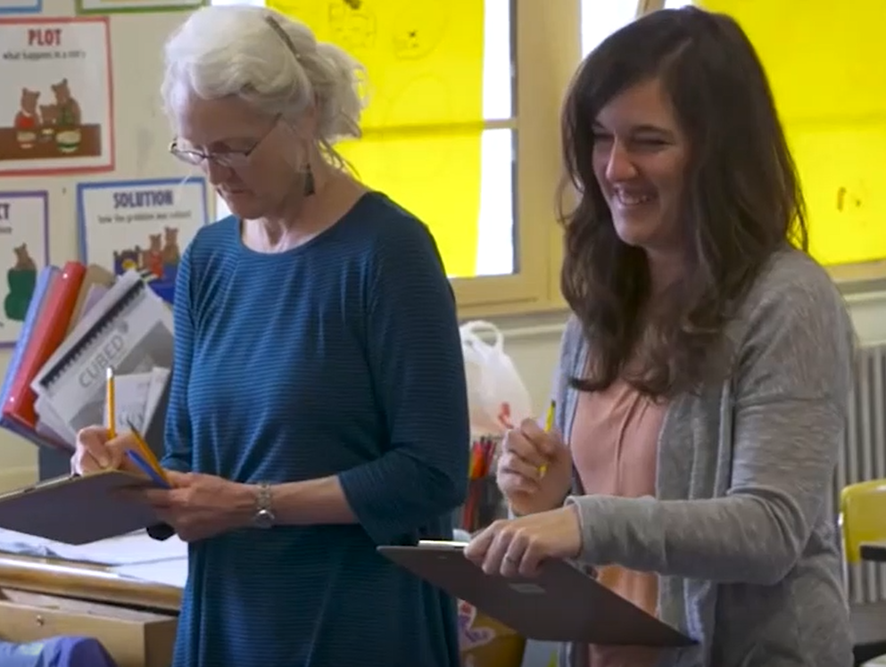
EBP Walkthroughs
Performing Learning Walks
Using the EBP Diagnostic Tool

Slide 5
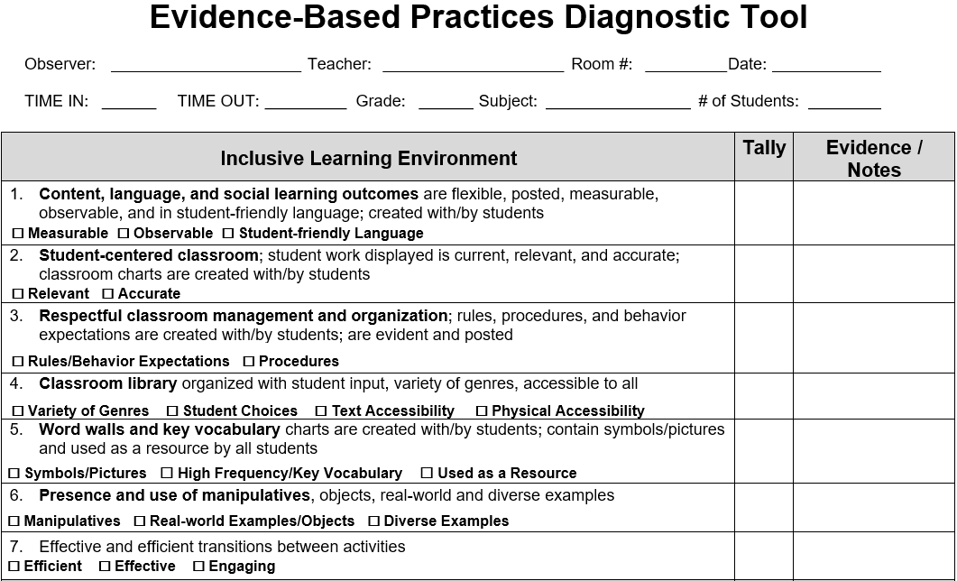
Evidence-Based Practices Diagnostic Tool
Notes:
Take out one of the EBP Diagnostic Tool docs

Slide 6
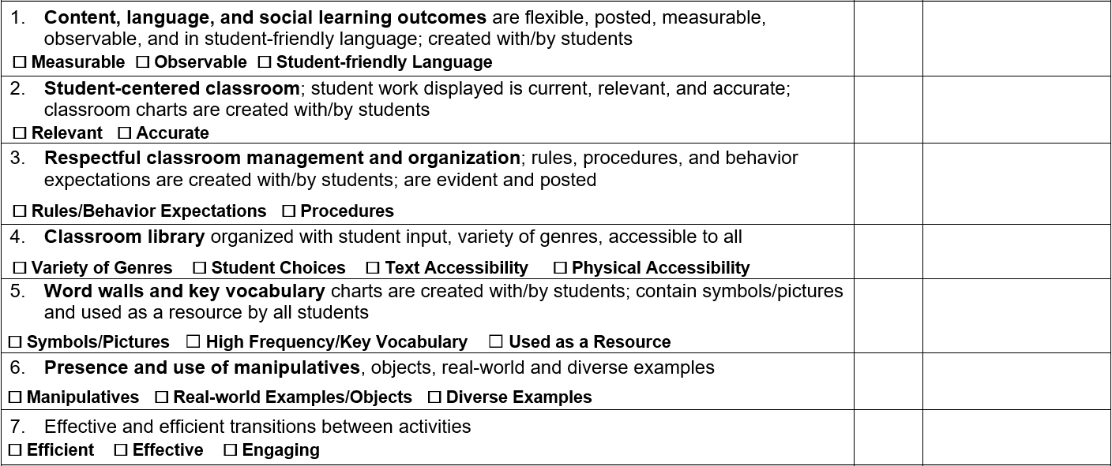
Quadrants and Indicators
There are four quadrants, and each quadrant contains seven indicators.
As we go through the presentation, consider which Quadrants or Indicators that you are most comfortable with, both as an instructor and an observer.

Slide 7
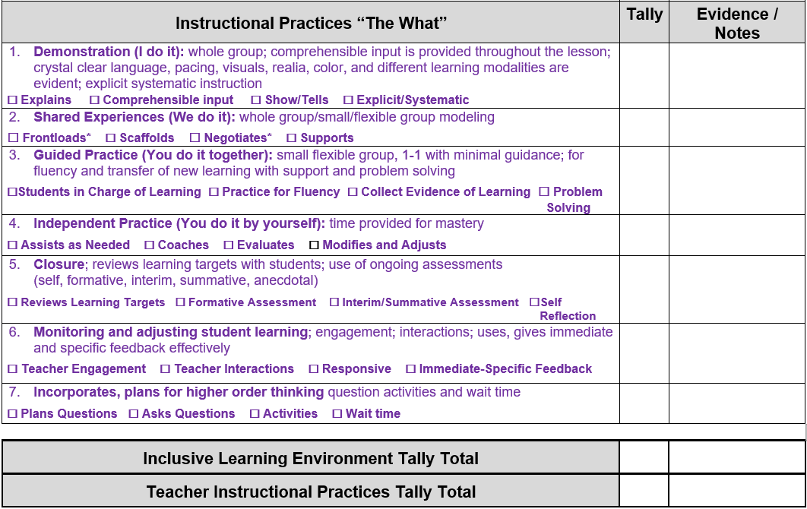
Indicators and Practices
Each Indicator contains a group of evidence-based classroom practices.
The classroom practices will appear in both list and check-box form. You will use the check-boxes in the classroom to indicate when you observe each classroom practice. After our overview, we will take a closer look at these classroom practices.

Slide 8
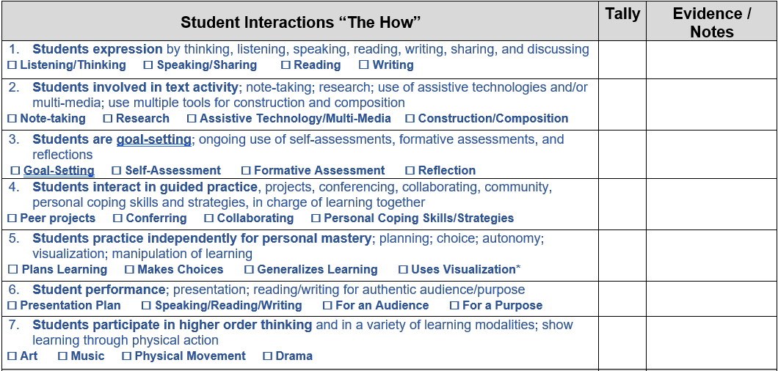
Indicator Counts and Notes
Each Quadrant has a section for a Count and for Evidence / Notes
The Count section is available for adding the total practices for each indicator.
The Evidence / Notes section is available so you can choose to provide context or clarification on some of the Indicators. This will also help to provide specific positive feedback to classrooms upon the completion of the observation.

Slide 9
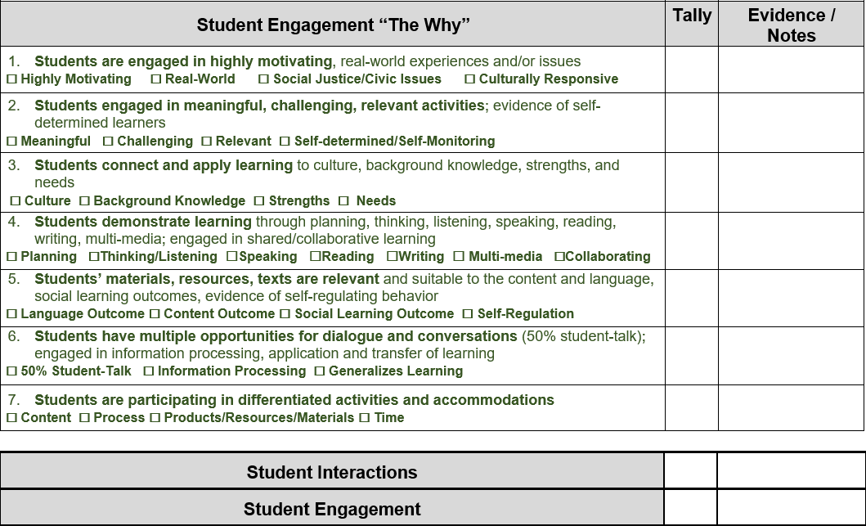
Quadrant Counts and Notes
This part of the Count section is available for the total practices in each quadrant.
You can put summarized evidence or conclusions in this part of the Evidence / Notes section.

Slide 10
Guiding Research HLP
Collaboration
It is aligned with the
High Leverage Practices:
The most critical practices for improving student outcomes
Assessment
Instruction
Social/emotional/behavioral

Slide 11
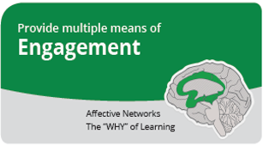
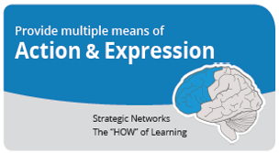
Guiding Research
UDL
The EBP Tool is aligned with the
Universal Design for Learning: Providing multiple means of stimulating our brains in diverse ways.

Slide 12
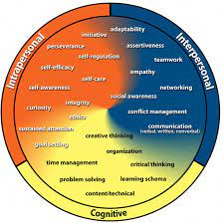
Guiding Research CCC
It is aligned with the
College & Career Competency Framework:
Supporting educators and families in developing resilient, collaborative, and self-regulating learners

Slide 13
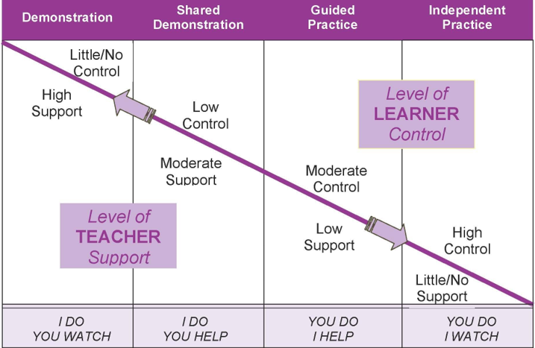
Guiding Research OLM
The EBP Tool is aligned with
the Optimal Learning Model:
Scaffolding from guidance to independence

Slide 14
Systemic Improvement:
Pedagogy, EBPs, and Outcomes
The EBP Tool is a comprehensive collection of evidence-based classroom practices.
Rather than expecting to see all practices in a brief walkthrough, the process provides the opportunity to highlight and celebrate where evidence-based practices have been effectively implemented.
Further, by connecting the data to a process of development, it provides a framework for strengthening evidence-based classroom practices and making a connection to student outcomes.

Slide 15
The EBP Process Possibilities for Development
Observation #1
Observation #2
Peer Observation (General-Targeted)
Professional Development
Professional Learning Communities
Growth Analysis
Connection to Student Outcomes

Slide 16
The EBP Tool
Evidence-Based Classroom Practices

Slide 17
Optimizing Reliability
Which evidence-based practices will we be looking for?
We can improve the reliability of our process by collaborating before we observe. Let’s see if we have any questions about what we will be looking for, before we go on our walkthroughs.
How do I know that I’ve seen a particular evidence-based practice?
We can improve the reliability of our results by collaborating after finish our observations. You can combine your separate observations on a single observation document.

Slide 18
Asynchronous Learning: Quadrant 1
Read Individually - Discuss Together - Reference Links/Resources
Practices
Support Links
Topics
Practices
Interactions
Engagement
The Process
Notes:
Note: The following slides are for the purpose of gaining a deeper or more common understanding of certain practices. Therefore, after each group member has had an opportunity to read through the quadrant, members can choose which practices and slides might need to be discussed, and the subsequent seven slides can be used for clarification. For additional clarification, group members can also refer to the EBP Examples and Non-Examples document.

Slide 19
Q1.1
click to return
You should not only be able to observe some lesson outcomes in written form, but, more importantly, an observer should also be able to see the awareness of these outcomes by the learners through the lesson. These outcomes should be measurable, so you can tell whether and to what extent students are reaching these learning outcomes.
Presenting outcomes that are student-friendly means that they are communicated from the student’s perspective. These outcomes should also be presented with accessibility in mind. In this context, accessibility means that any student in the classroom will be able to understand the language of these outcomes, whether written or spoken.
I will be able to connect three or more supporting details to the main idea using a graphic organizer.
Ex: p. 2

Slide 20
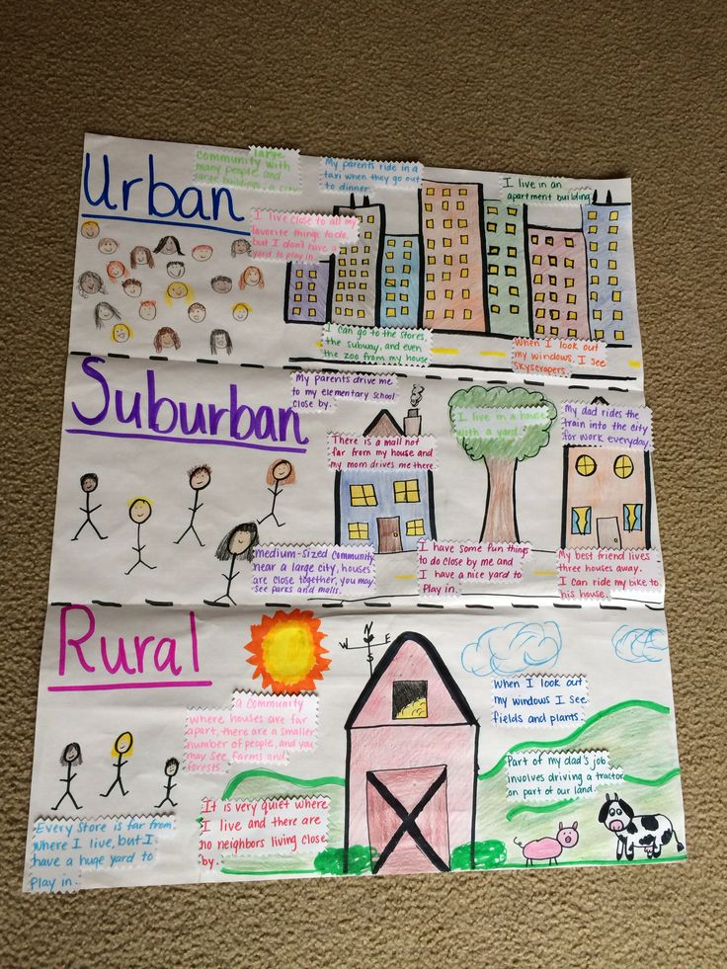
Q1.2
click to return
You can look for accuracy in the same way. While a few pieces of student work may show evidence of incidental inaccuracy, as long as these inaccuracies are superficial and incidental, the student work can be marked as being accurate.
If you see student work on display in or around the classroom, you can take a closer look. If you do not see any pervasive issues with its relevance to community development or learning goals, then you can mark the student work as being relevant.
Ex: p. 3

Slide 21
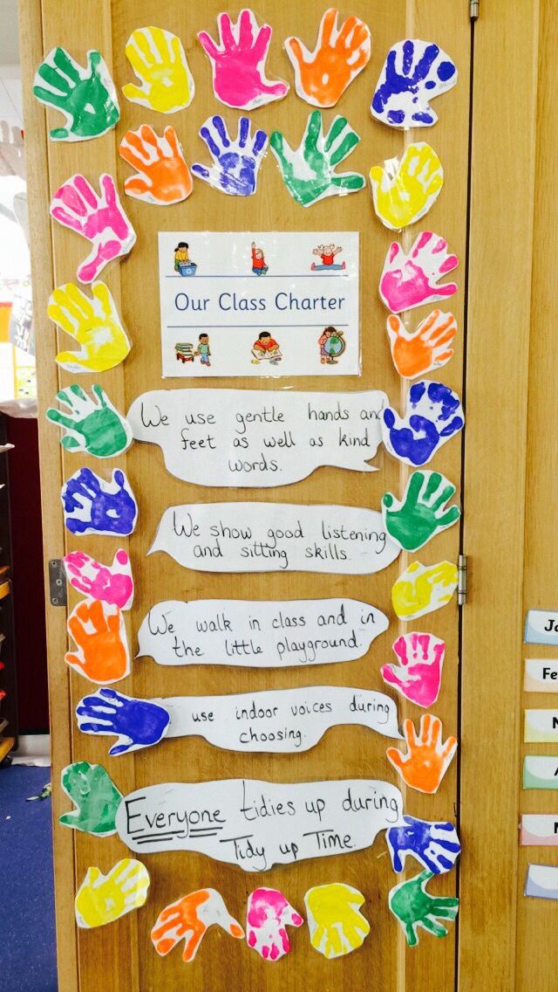
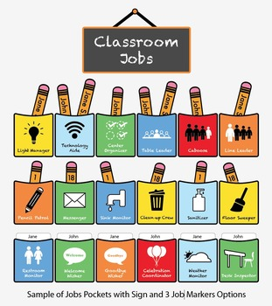
Q1.3
click to return
A common example of displaying procedures is to have a job board evident. Also, for a reminder, students should have an accessible reference for rules and behavior expectations.
Ex: p. 4

Slide 22
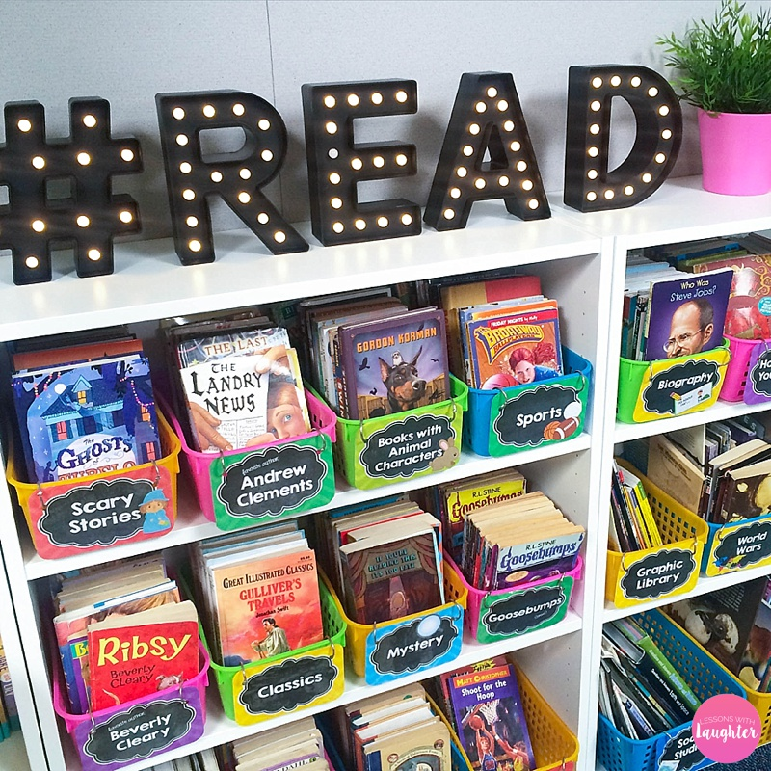
Q1.4
click to return
Variety of Genre Examples: Fiction; Non-Fiction; Historical Fiction; Chapter; Reference; Graphic Novel
Student Choices: Interest examples – cars; animals; relationships; dinosaurs; bugs; pets
Text Accessibility: students of all reading abilities have a variety of choices
Physical Accessibility: The library is in a location that students can reach, and the area is organized and inviting.
Ex: p. 5

Slide 23
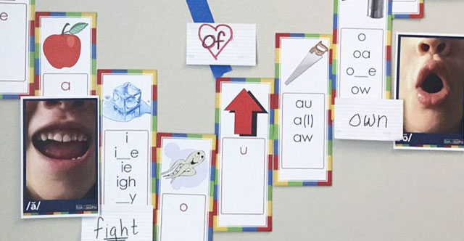
Q1.5
click to return
When your words are high frequency and contain key vocabulary, they have greater utility for students. When they are accompanied by symbols and pictures, as well as when they are sorted by category, they can be used most effectively as a resource.
For example, Social Studies does not make the category as useful as Exploring (image-ship/binoculars). Especially at lower grades, struggling students can benefit from a classroom that has a sound wall to support learning by sound-to-letter, rather than letter-to-sound. For example, in a letter-to-sound classroom, the struggling student may incorrectly reference the word “about” under the letter-u on a word wall, because “u” makes /u/. Digraphs like “sh” and “ch” can also be more complicated for struggling students when using word wall organization.
Ex: p. 6

Slide 24
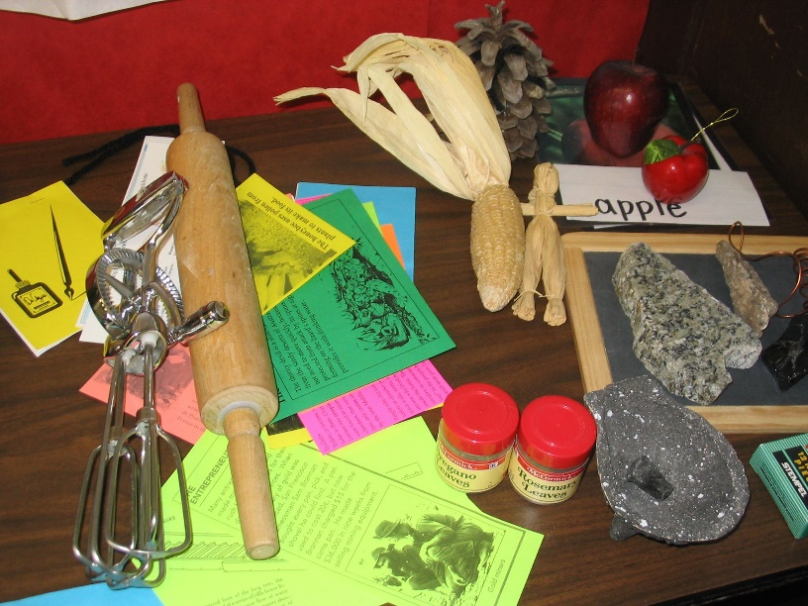
Q1.6
click to return
Students have access to use manipulatives, in order to make abstract concepts such as numbers and grouping, more concrete.
Students have the opportunity to clearly see a/o feel objects of realia to bridge the gap from abstract description to concrete visualization.
Whenever possible, realia is closet to its form that can be seen in real life, and when diverse examples appear in real life, diverse examples are offered through realia.
Ex: p. 7

Slide 25
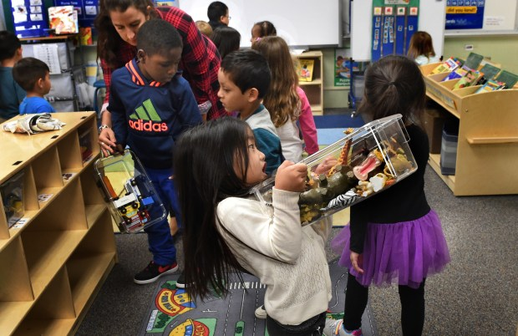
Q1.7
click to return
If clearly directed and monitored, transitions between lessons and activities should be efficient and effective as a result. While timing may vary, you should be able to observe students staying on-task having the desired result as directed.
Engaging transitions are not only a part of a learning community that students enjoy, but it can also serve to break up monotony. In addition, this can be a good time to get the blood flowing with a wiggle-break that lasts up to five minutes (efficient) and helps students refocus afterward.
Ex: p. 8

Slide 26
Asynchronous Learning: Quadrant 2
Read Individually and Discuss Together for Common Understanding
Practices
Support Links
Topics
Environment
Interactions
Engagement
The Process
Notes:
Note: The following slides are for the purpose of gaining a deeper or more common understanding of certain practices. Therefore, after each group member has had an opportunity to read through the quadrant (using handout), members can choose which practices and slides might need to be discussed, and the subsequent seven slides can be used for clarification. For additional clarification, group members can also refer to the EBP Examples and Non-Examples document (handout).

Slide 27
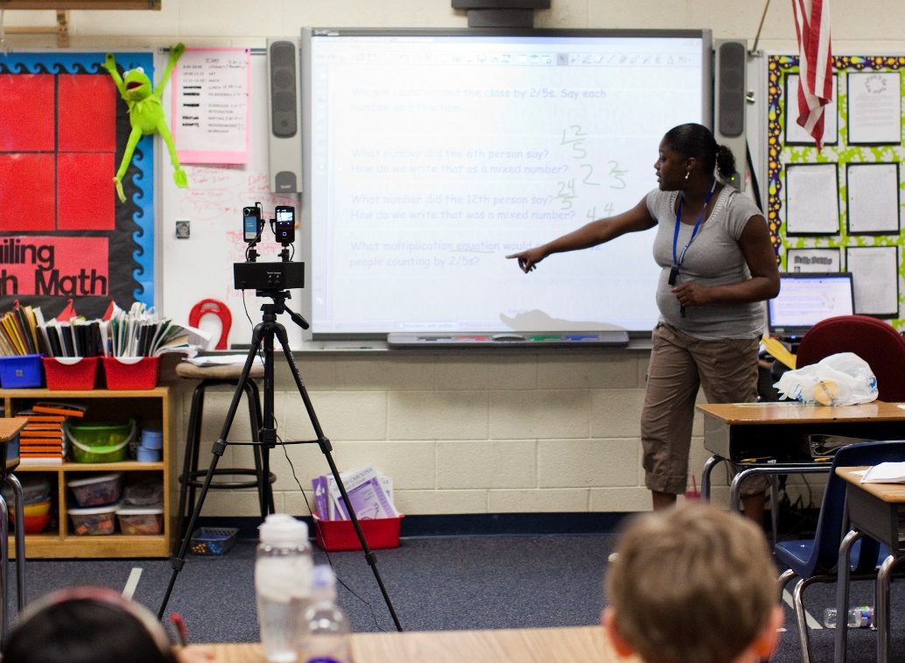
Q2.1
click to return
The foundation of “I do” instruction starts with an explanation of the skill by the instructor. Then to support simply telling students how to perform the skill, the instructor shows how the skill is performed with display.
A good “I do” part of instruction starts with being comprehensible. Beyond that, highly effective instruction is explicit and systematic. It is not only clear, but it progresses in an order and at a pace that is easy for students to digest. It also serves to frontload or lay the foundation for subsequent and higher-order learning.
Ex: p. 9

Slide 28
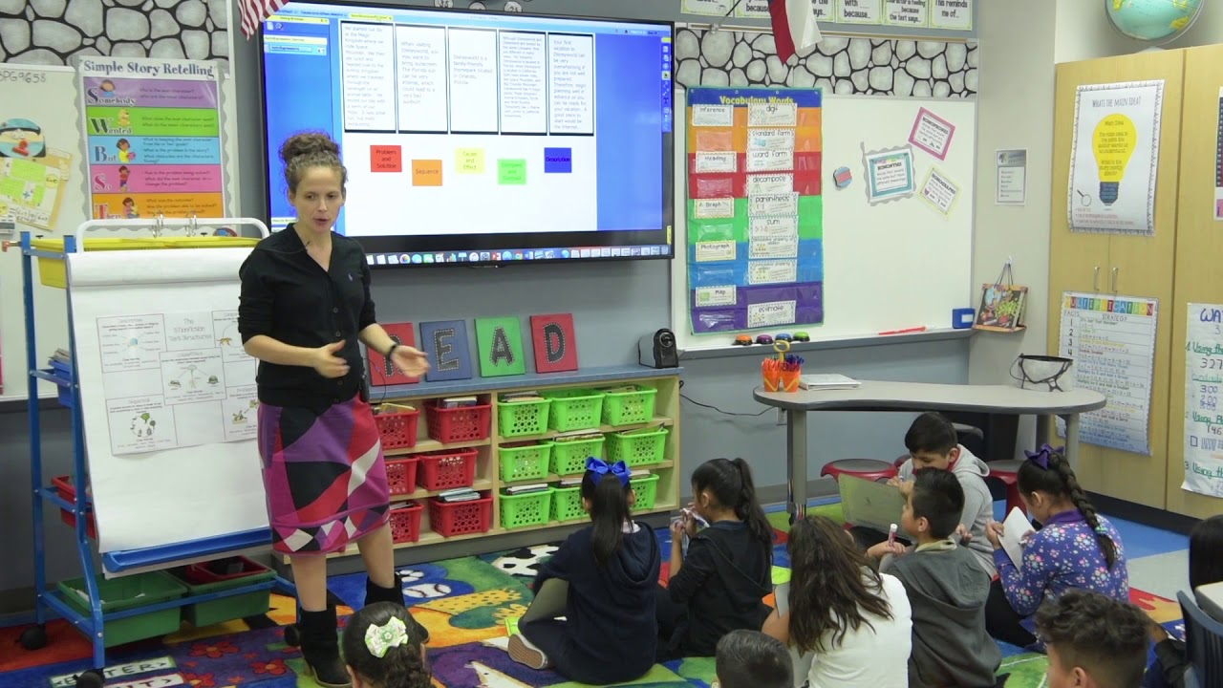
Q2.2
click to return
Scaffolding should be presented so steps in the learning process build upon one another incrementally.
During this process, the teacher is responsive to student feedback, so the progress of the lesson can be negotiated if a substantial proportion of students need their pace of learning adjusted.
The teacher is active in supporting students with positive narration and redirection through the process.
Ex: p. 10

Slide 29
Q2.3
click to return
During the Guided “You Do,” instructors work towards releasing control so students can take charge of the learning process. There is opportunity for reflecting and making choices to further their learning progress.
Important skills should be repeated in practice, so students can gain a level of skill fluency.
Teachers should be monitoring the learning process by collecting evidence and problem-solving any issues to pace and progress.
Ex: p. 11

Slide 30
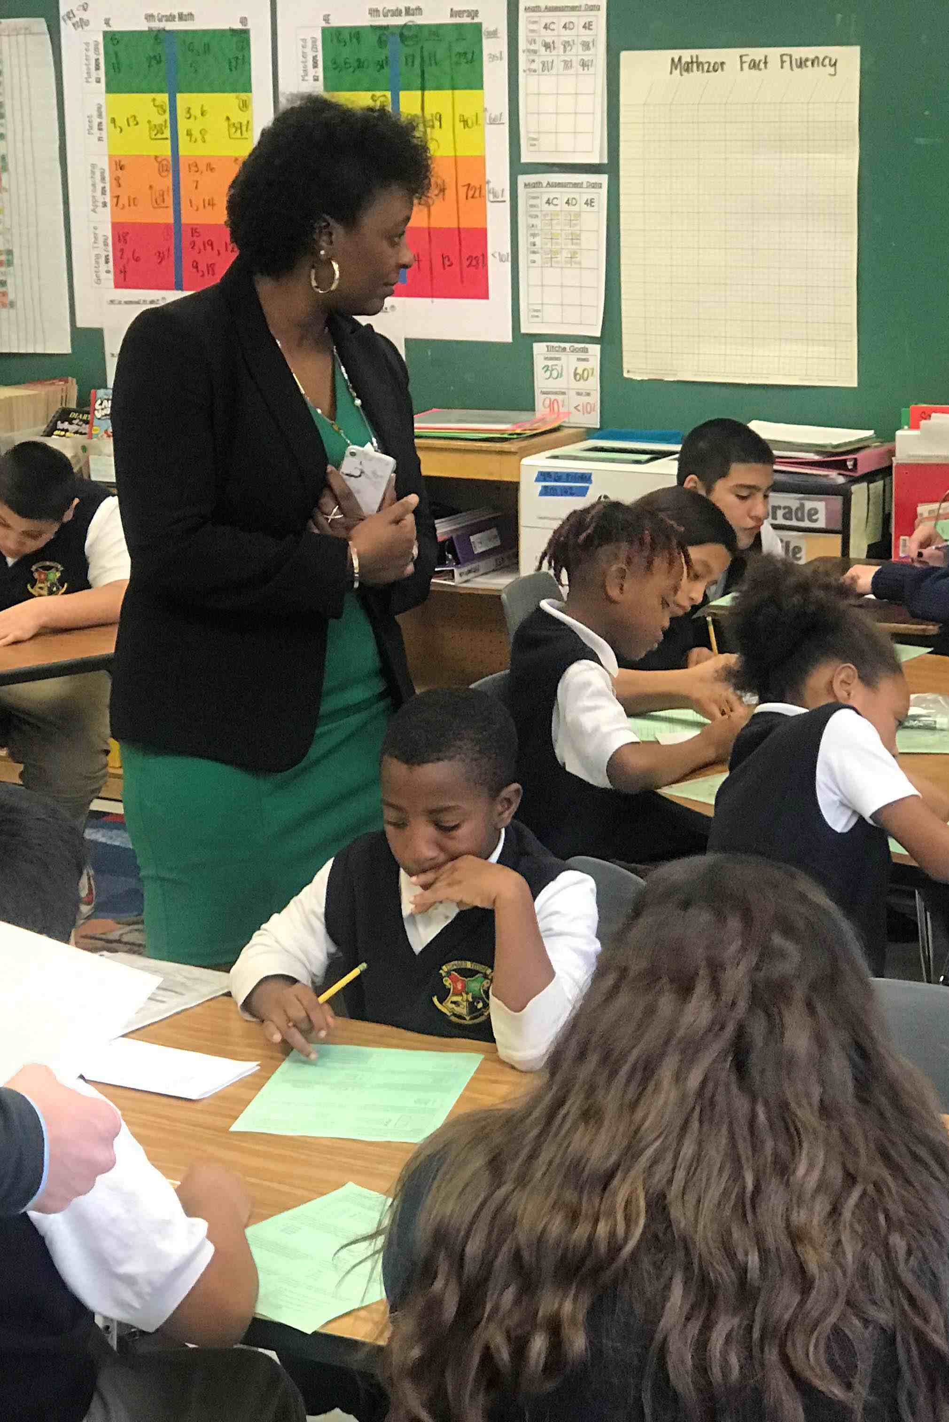
Q2.4
click to return
The Independent “You Do” is where students have almost complete control of the learning process. The instructor allows students to work through problems independently, with peers, and provides assistance when needed. For example, the instructor may find that posing a question is all that is needed to maintain the level of learning independence, while other situations may call for more involved coaching.
Instructors evaluate the level of understanding with individuals and as a class, to make decisions about modifying and adjusting instruction for lesson and unit progression. After feeling comfortable with the learning structure as a whole group, the instructor can begin small group instruction during this part of the lesson.
Ex: p. 12

Slide 31
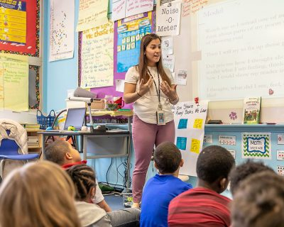
Q2.5
click to return
During lesson closure, the instructor should be reviewing the learning targets and providing opportunities for students to reflect on their progress towards those targets.
In addition, a connection should be made to the overall learning outcomes, which includes formative and summative assessments as evidence of those outcomes.
Ex: p. 13

Slide 32
Q2.6
click to return
Teachers show engagement by being active listeners and observers. They interact with students by circulating within the learning community.
They are responsive to student needs through expression, positive narration, and with feedback that is both immediate and specific.
Ex: p. 14

Slide 33
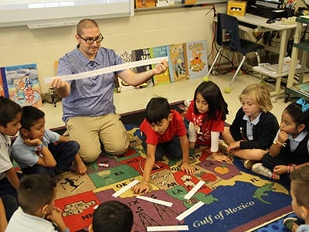
Q2.7
click to return
To provide students with opportunities for higher order thinking, teachers can deliberately embed lessons with points of questioning, structures like mind maps, and activities that involve creation and problem-solving.
While providing opportunities for questioning, the teacher gives adequate think time for consideration before asking students to share their thoughts.
Ex: p. 15

Slide 34
Asynchronous Learning: Quadrant 3
Read Individually and Discuss Together for Common Understanding
Practices
Support Links
Topics
Environment
Practices
Engagement
The Process
Notes:
Note: The following slides are for the purpose of gaining a deeper or more common understanding of certain practices. Therefore, after each group member has had an opportunity to read through the quadrant, members can choose which practices and slides might need to be discussed, and the subsequent seven slides can be used for clarification. For additional clarification, group members can also refer to the EBP Examples and Non-Examples document.

Slide 35
Q3.1
click to return
Students can really develop their communication and metacognition skills by having numerous classroom opportunities to listen, to read, and to think about ideas and concepts.
Students then have the opportunity for interaction and expression through such forms as speech and writing.
Ex: p. 16

Slide 36
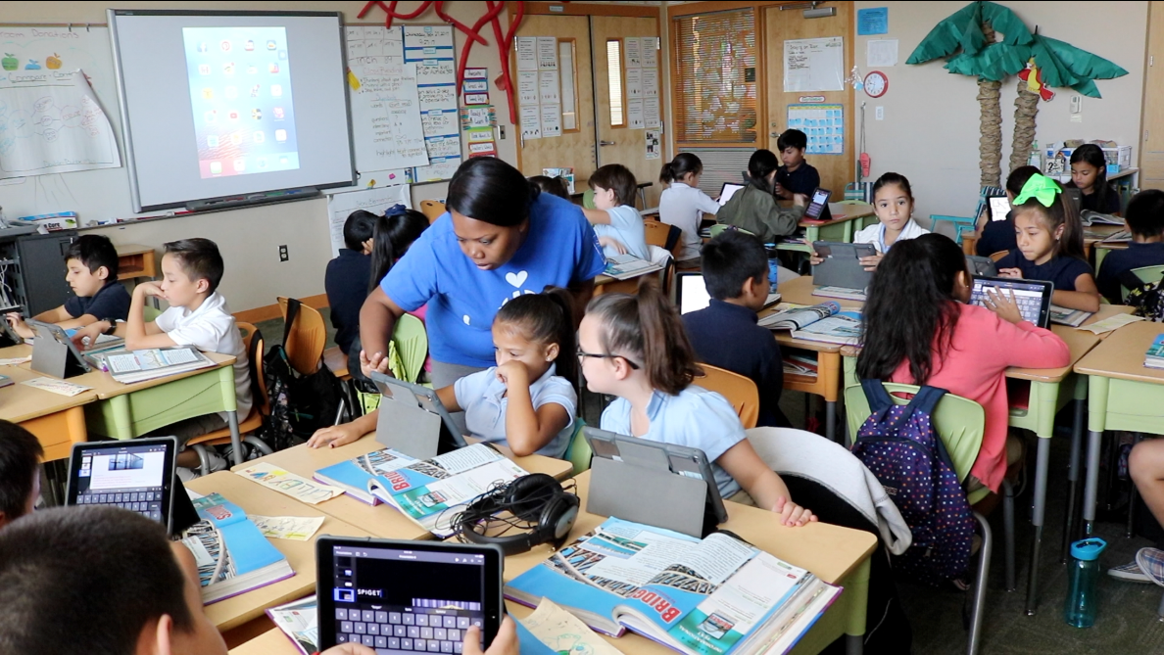
Q3.2
click to return
Having a variety of text activities can help students to be flexible with their modes of learning and expression. Students should have varied opportunities to research questions, make decisions about relevant information for notation, and use the information in constructing or composing a product that presents the learning to others.
Using different forms of media to support text activity with the ability to engage our senses in a variety of ways can enhance the opportunity for learning, and the use of assistive technology can make the text activity more accessible for a diversity of learners.
Ex: p. 17

Slide 37
Q3.3
click to return
The practice and refinement of metacognition is critical to learning and development. Students can exhibit evidence of metacognition by writing reflections, targeted self-assessments, and through the consideration of feedback from formative assessments.
Students can also show how they are setting goals to help strive towards their next steps in the learning process.
Ex: p. 18

Slide 38
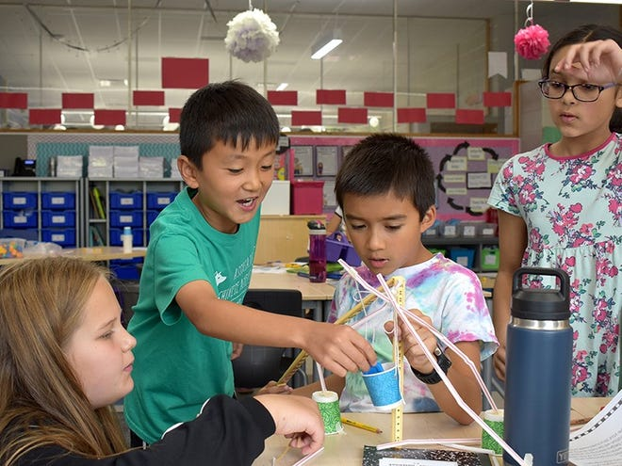
Q3.4
click to return
Having projects that students can complete with peers provides the opportunity for referencing outside experiences, expanding perspectives, and making use of varying learning styles and strengths.
To appreciate and utilize these differences, peers should be able to confer with each other to complete subdivided tasks, collaborate with each other on coordinated tasks, and show evidence of managing their partnership through coping skills and strategies such as being solution-focused and employing strategies to recognize and move on from conflict.
Ex: p. 19

Slide 39
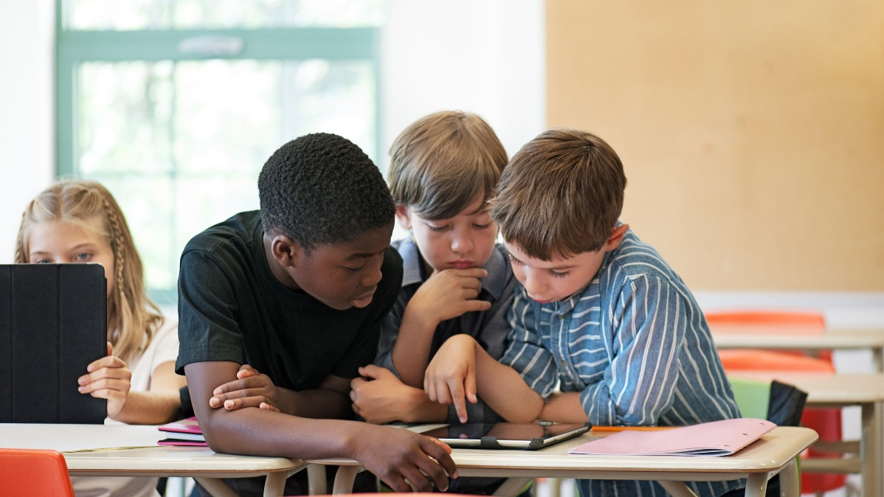
Q3.5
click to return
Before documenting a plan for progress, students can show evidence of stopping to think and visualize their intended steps. This awareness of their progress will help them to not only make choices in the planning stage but also to revise choices during their learning progress.
Students show practice of generalized learning when they are able to apply and adapt skills and concepts that they have learned prior, to the planning and implementation of their current task.
Ex: p. 20

Slide 40
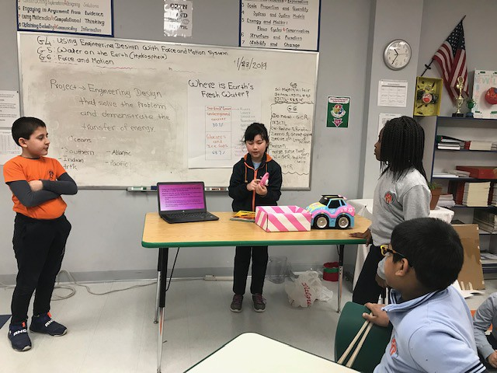
Q3.6
click to return
Students can show evidence that the presentation of their learning was planned. You can see that the presentation has a purpose and is being conducted with the audience in mind. The presentation also contains a mode of literacy expression, such as speaking; reading; and writing.
Ex: p. 21

Slide 41
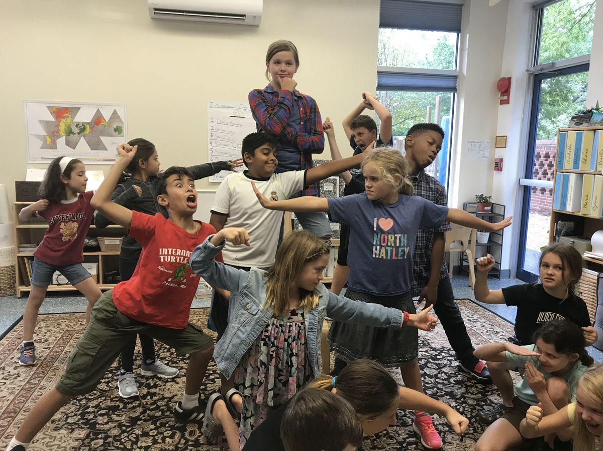
Q3.7
click to return
As a product of higher-order thinking, students will make connections and apply their learning in a variety of modalities. These modalities include the production of art, physical movement, musical expression, and dramatic performance.
Ex: p. 22

Slide 42
Asynchronous Learning: Quadrant 4
Read Individually and Discuss Together for Common Understanding
Practices
Support Links
Topics
Environment
Practices
Interactions
The Process
Notes:
Note: The following slides are for the purpose of gaining a deeper or more common understanding of certain practices. Therefore, after each group member has had an opportunity to read through the quadrant, members can choose which practices and slides might need to be discussed, and the subsequent seven slides can be used for clarification. For additional clarification, group members can also refer to the EBP Examples and Non-Examples document.

Slide 43
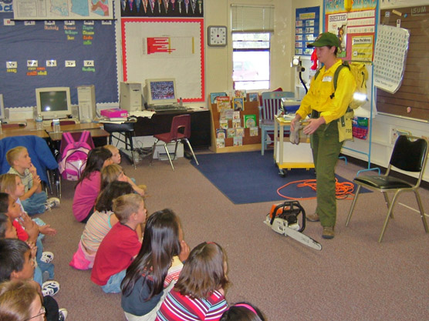
Q4.1
click to return
Because a big part of learning that is highly motivating for students is also directly relevant to them, you will be able to see real-world connections in their learning process.
This includes topics connected to cultural diversity, social justice, and civic issues.
Ex: p. 23

Slide 44
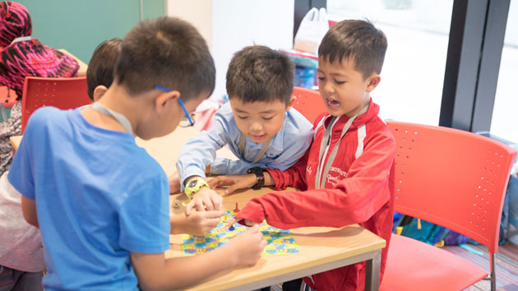
Q4.2
click to return
Relevant learning activities will be meaningful when students are able to make connections to past experiences and prior knowledge.
You can see students challenged to extend their learning and determined to monitor their own learning progress.
Ex: p. 24

Slide 45
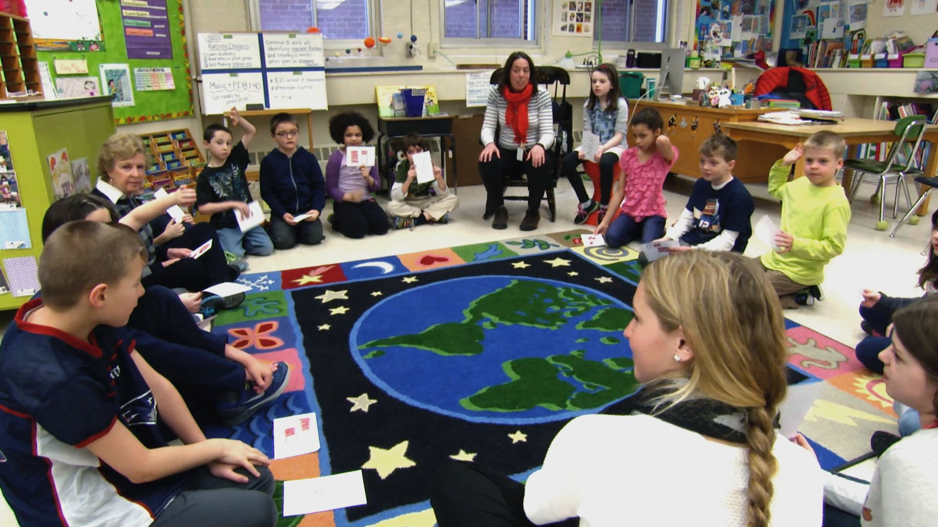
Q4.3
click to return
When students are motivated to apply learning, they use cultural and background experiences to make connections in the support of their learning process.
They will show their strengths through these connections, and they will be aware of and be able to communicate needs.
Ex: p. 25

Slide 46
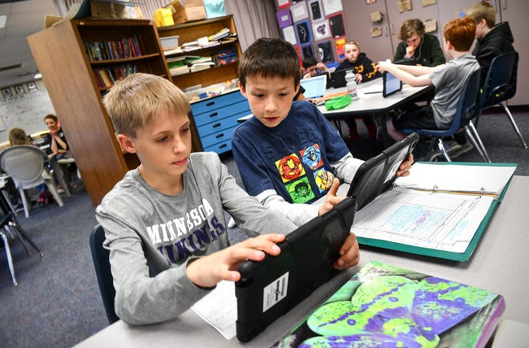
Q4.4
click to return
Students will have the opportunity to process and exhibit learning through a variety of modalities. Students will collaborate with peers to listen, think, speak, and plan learning. They will also use reading, writing, and multi-media throughout the learning experience.
Ex: p. 26

Slide 47
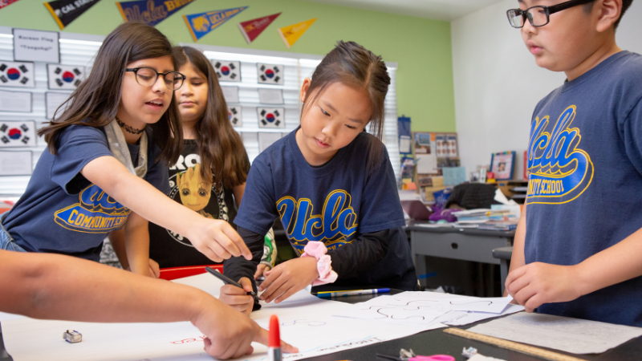
Q4.5
click to return
As students navigate through their use of learning resources, there is a clear connection to the language, content, and social learning outcomes intended by the instructor.
This resource alignment can be seen whether students navigate through given choices or when they regulate making independent choices.
Ex: p. 27

Slide 48
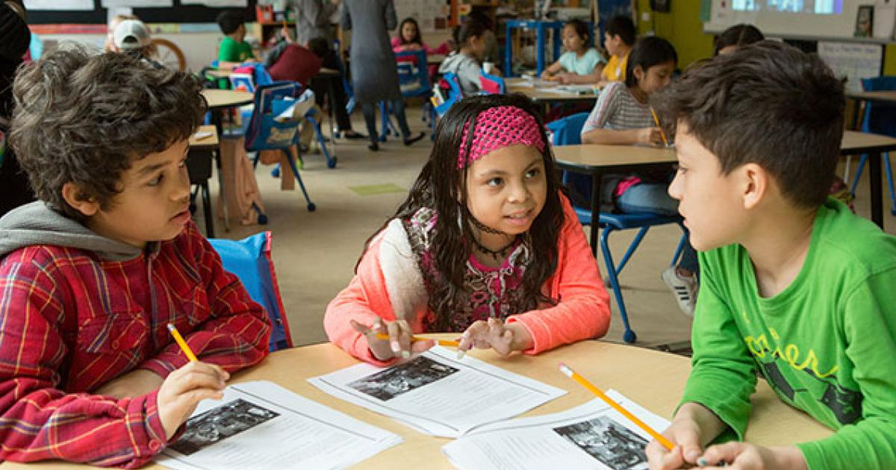
Q4.6
click to return
Students have as many opportunities to process learning through conversation as the instructor. You can see a connection between these guided conversations and the processing of information toward a desired learning outcome.
A higher form of processing this information in conversation can be seen when students generalize learning. They leverage what they already know about a related concept and make a connection to the current topic of discussion toward deeper understanding.
Ex: p. 28

Slide 49
Q4.7
click to return
Because there is a variety of different developmental levels in the learning community, individuals will need accommodations and modifications for grade-level content to effectively progress toward the best learning outcomes.
For example, some students will experience a level of frustration due to the developmental level of a lesson, either because it is too difficult or too easy for learning to take place effectively. In these cases, modifications such as expectations for amount of writing content, providing choices, or process time adjustments can be structurally embedded in the lesson for students where appropriate.
In addition, the teacher should be using accommodations such as assistive technology to aid in the navigation and reading of products, resources, and materials wherever applicable.
Ex: p. 29

Slide 50
The EBP Walkthrough Process
SSIP Submission and Beyond

Slide 51
The Walkthrough Team
The Team is typically comprised of two or more of the following members:
Principal
Assistant Principal
Special Education Leadership
Instructional Coach/Lead
Reading Specialist
Grade Level Team Lead

Slide 52
The Walkthrough Classroom
For the SSIP Process and the focus on foundational literacy outcomes:
Classrooms containing students in Grades K–3
Classrooms having students with disabilities in attendance
Classrooms providing ELA or ELA-integrated instruction during observation
Whenever possible, the same two classrooms/instructors for each submission

Slide 53
The Classroom Teachers
An additional consideration might concern the teachers being observed:
Example:
Exemplary/Lead
Teacher
Growing/Developing
Teacher

Slide 54
Possibilities
Before, During, and After Walkthroughs
Observation & Data Collection
Analysis & Communication*
Celebrate Strengths*
Target Additional Practices*
Development & Implementation*
Subsequent Classroom Observation
Analysis of Student Growth*
*Not a necessary activity component for SSIP

Slide 55
Opportunities during EBP Walkthroughs
The EBP Tool allows for Observation Teams to look for specific practices in subsequent practices.
The EBP Tool produces data that can be used to inform the development of classroom practices.
The EBP Tool produces data that allows for connecting growth in practices to growth in student outcomes

Slide 56
SSIP Submission
Submission #1
Submission #2
Submission #3
EBP Tool – Teacher A
EBP Tool – Teacher B

Slide 57
Thank You
Shaun Stevenson
Lead Education Specialist - SSIP Coordinator
Exceptional Student Services
Program Support & Monitoring
Arizona Department of Education
shaun.stevenson@azed.gov
Office: (602) 542-7072
https://www.azed.gov/specialeducation/ssip

